Slide 1
KEYNOTE-522: Neoadjuvant KEYTRUDA® (pembrolizumab) + chemotherapy followed by adjuvant KEYTRUDA monotherapy in patients with triple-negative breast cancer (TNBC)
These slides are promotional and are provided to UK healthcare professionals as a data resource for personal education. To ensure compliance with all relevant codes and regulations, these slides must not be amended and should only be downloaded with the latest Prescribing Information. Prescribing Information and further safety information can be found in the footer of this slide.
Please refer to the full Summary of Product Characteristics for KEYTRUDA and patient-targeted Risk Minimisation Materials before prescribing, to minimise the risk of treatment. Patients should also receive the Risk Minimisation Materials.
Adverse events should be reported. Reporting forms and information can be found at https://yellowcard.mhra.gov.uk/ (please note that the MHRA Yellow Card link will redirect you to an external website, for which MSD does not review or control the content) or search for MHRA Yellow Card in the Google Play or Apple App Store. Adverse events should also be reported to Merck Sharp & Dohme (UK) Limited (Tel: 020 8154 8000).
Please click the following link for the KEYTRUDA SmPC and Prescribing Information: United Kingdom.
If using a downloaded version of this material, please ensure that you are accessing the most recent version of the Prescribing Information.
Job code: GB-OBR-00166 Date of preparation: October 2025
Copyright © 2025 Merck & Co., Inc., Rahway, NJ, USA and its affiliates. All rights reserved.

Slide 2


Slide deck navigation
To access the navigation page, click the ‘Home’ icon
In the Appendix, click the ‘Return’ icon to return to the last viewed slide
The links in this slide deck may redirect you to third-party websites. Please note that:
MSD does not review or control the content of any third-party website
MSD does not endorse and is not responsible for the accuracy, content, practices or standards of any third-party sources
UK Prescribing Information

Slide 3

Contents
Click the links below to navigate to the section of interest
Heritage of KEYTRUDA and MoA with chemotherapy
KEYNOTE-522: Study overview
KEYNOTE-522: Results – Efficacy
KEYNOTE-522: Results – Safety
Implementing KEYTRUDA + chemotherapy for early-stage TNBC
KEYNOTE-522: Summary
Appendix
MoA, mechanism of action; TNBC, triple-negative breast cancer.
UK Prescribing Information

Slide 4

Heritage of KEYTRUDA and MoA with chemotherapy
Click the links below to navigate to the section of interest
KEYTRUDA and chemotherapy: Two different mechanisms of action
KEYTRUDA + chemotherapy licence in early-stage TNBC
KEYTRUDA in the early-stage TNBC pathway
MoA, mechanism of action; TNBC, triple-negative breast cancer.
UK Prescribing Information

Slide 5
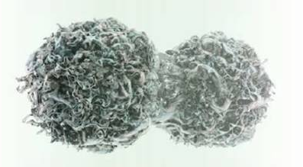
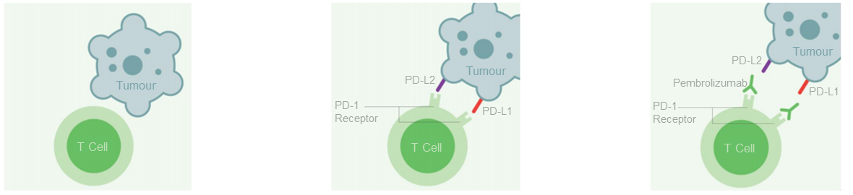
KEYTRUDA and chemotherapy: Two different mechanisms of action
Chemotherapy induces immunogenic cell death
KEYTRUDA activates the anti-tumour immune response
Chemotherapy results in the immunogenic death of tumour cells, leading to the release of tumour antigens that can be recognised by the immune system¹
Chemotherapy has been shown to increase tumour expression of PD-L1²
PD-L1 (and PD-L2) on tumour cells bind to PD-1 on T cells to prevent their activation, leading to immune evasion^{1,3}
KEYTRUDA is a humanised monoclonal antibody that binds to PD-1, blocking its interaction with PD-L1/-L2 and leading to activation of the anti-tumour response^{4,5}
When combined with immunotherapies such as KEYTRUDA, chemotherapy may increase tumour immunogenicity and activate an immune response by increasing antigen shedding and presentation, and by stimulating T-cell infiltration²
PD-1, programmed death receptor-1; PD-L1, programmed death ligand-1; PD-L2, programmed death ligand-2.
1. Emens LA and Middleton G. Cancer Immunol Res 2015;3:436–443; 2. Bailly C et al. NAR Cancer 2020;2(1):zcaa002; 3. Yi M et al. J Hematol Oncol 2021;14:10; 4. KEYTRUDA (pembrolizumab) Summary of Product Characteristics. Available at: https://www.medicines.org.uk/emc/product/2498/smpc. Accessed August 2025; 5. Pardoll DM. Nat Rev Cancer 2012;12:252–264.
UK Prescribing Information

Slide 6
KEYTRUDA + chemotherapy licence in early-stage TNBC
KEYTRUDA, in combination with chemotherapy as neoadjuvant treatment, and then continued as monotherapy as adjuvant treatment after surgery, is indicated in the treatment of adults with locally advanced or early-stage TNBC at high risk of recurrence
TNBC, triple-negative breast cancer. KEYTRUDA (pembrolizumab) Summary of Product Characteristics. Available at: https://www.medicines.org.uk/emc/product/2498/smpc. Accessed August 2025.
UK Prescribing Information

Slide 7
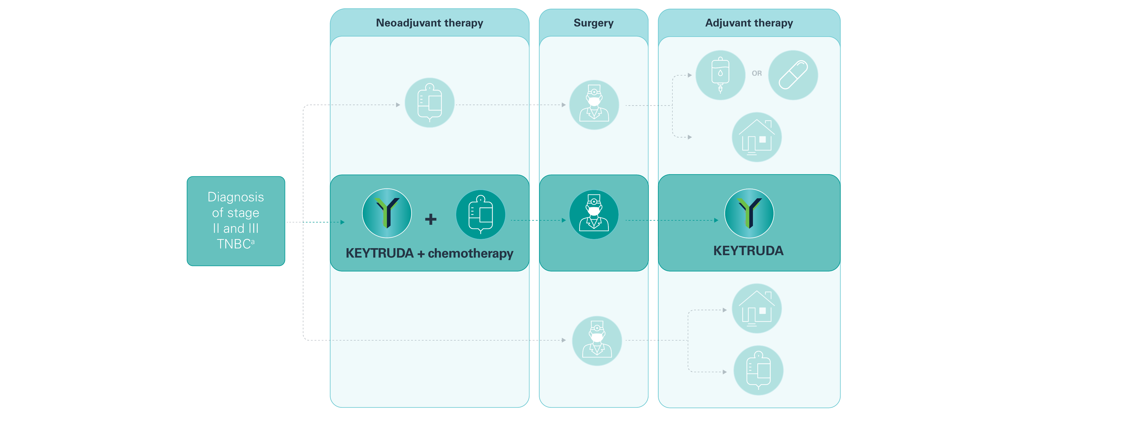

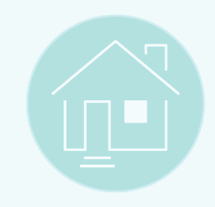

KEYTRUDA in the early-stage TNBC pathway^{1–4}
Neoadjuvant chemotherapy
Patient discharged for regular monitoring
Adjuvant chemotherapy
ªStage IIA, IIB, IIIA and IIIB early TNBC, and IIIC TNBC, as defined by the primary tumour-regional lymph node staging criteria of the AJCC (7th Edition).³ AJCC, American Joint Committee on Cancer; NICE, National Institute for Health and Care Excellence; TNBC, triple-negative breast cancer.
1. NICE. Early and locally advanced breast cancer: diagnosis and management. https://www.nice.org.uk/guidance/ng101/chapter/Recommendations. Accessed August 2025; 2. KEYTRUDA (pembrolizumab) Summary of Product Characteristics. Available at: https://www.medicines.org.uk/emc/product/2498/smpc. Accessed August 2025; 3. AJCC. AJCC Cancer Staging Manual. 7th ed. USA: Springer; 2010; 4. NICE. Technology appraisal guidance [TA851] December 2022. Available at: https://www.nice.org.uk/guidance/ta851. Accessed August 2025.
UK Prescribing Information

Slide 8
KEYNOTE-522: Study overview
Click the links below to navigate to the section of interest
Study design
Primary endpoints
Key patient characteristics
Patient baseline characteristics
UK Prescribing Information

Slide 9
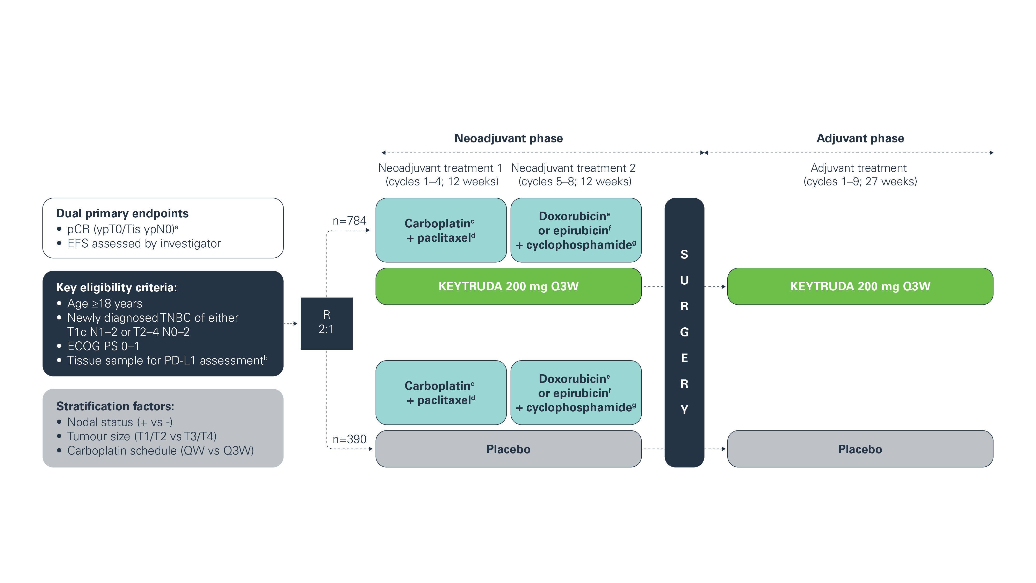
KEYNOTE-522: Study design^{1,2}
Adapted from Schmid P et al. 2020 and Schmid P et al. 2022.
AEs were assessed during each phase of the study, as well as the study as a whole. ªBlinded assessment performed by local pathologist; ^{b}Must consist of at least two separate tumour cores from the primary tumour; ^{c}Carboplatin dose was AUC 5 Q3W or AUC 1.5 QW; ^{d}Paclitaxel dose was 80 mg/m² QW; ^{e}Doxorubicin dose was 60 mg/m² Q3W; ^{f}Epirubicin dose was 90 mg/m² Q3W; ^{g}Cyclophosphamide dose was 600 mg/m² Q3W. AE, adverse event; AUC, area under curve; ECOG PS, Eastern Cooperative Oncology Group performance status; EFS, event-free survival; pCR, pathologic complete response; PD-L1, programmed death ligand-1; QW, every week; Q3W, every 3 weeks; R, randomisation; TNBC, triple-negative breast cancer.
1. Schmid P et al. N Engl J Med 2020;382:810–821 (plus supplementary appendix); 2. Schmid P et al. N Engl J Med 2022;386:556–567 (plus supplementary appendix).
UK Prescribing Information

Slide 10
KEYNOTE-522: Primary endpoints^{1,2}
The primary endpoints of the KEYNOTE-522 trial were pCR and EFS, and were defined as follows:
pCR: The absence of invasive cancer in the breast and lymph nodes (ypT0/Tis ypN0). Blinded assessment performed by local pathologist at the time of definitive surgery
EFS: The time from randomisation to the first occurrence of any of the following events:
Progression of disease that precludes definitive surgery
Local or distant recurrence
Second primary malignancy, OR
Death due to any cause
EFS, event-free survival; pCR, pathologic complete response.
1. Schmid P et al. N Engl J Med 2020;382:810–821 (plus supplementary appendix); 2. Schmid P et al. N Engl J Med 2022;386:556–567.
UK Prescribing Information

Slide 11




KEYNOTE-522: Key patient characteristics
Key characteristics of the KEYTRUDA + chemotherapy arm of the KEYNOTE-522 trial:
Median patient age of 49 years (range: 22–80 years)
Primary tumour classification of 74% for T1/2 and 26% for T3/4
Nodal involvement was positive for 52% and negative for 48%
75% of patients with Stage II disease and 25% with Stage III disease
Total population: 1174 patients (KEYTRUDA + chemotherapy [n=784] and placebo + chemotherapy [n=390])
Schmid P et al. N Engl J Med 2020;382:810–821.
UK Prescribing Information

Slide 12
KEYNOTE-522: Patient baseline characteristics¹
Characteristic, n (%) | KEYTRUDA + chemotherapy (n=784) | Placebo + chemotherapy (n=390)
Median age (range), years | 49 (22–80) | 48 (24–79)
≤65 years | 701 (89.4) | 342 (87.7)
Menopausal status
Premenopausal | 438 (55.9) | 221 (56.7)
Postmenopausal | 345 (44.0) | 169 (43.3)
PD-L1 statusª
Positive | 656 (83.7) | 317 (81.3)
Negative | 127 (16.2) | 69 (17.7)
ECOG PS
0 | 678 (86.5) | 341 (87.4)
1 | 106 (13.5) | 49 (12.6)
Lactase dehydrogenase level
≤ULN | 631 (80.5) | 309 (79.2)
>ULN | 149 (19.0) | 80 (20.5)
Administration of carboplatin
QW | 449 (57.3) | 223 (57.2)
Q3W | 335 (42.7) | 167 (42.8)
Primary tumour classification
T1/T2 | 580 (74.0) | 290 (74.4)
T3/T4 | 204 (26.0) | 100 (25.6)
Nodal involvement
Positive | 405 (51.7) | 200 (51.3)
Negative | 379 (48.3) | 190 (48.7)
Characteristic, n (%) | KEYTRUDA + chemotherapy (n=784) | Placebo + chemotherapy (n=390)
Overall disease stage
Stage II | 590 (75.3) | 291 (74.6)
Stage III | 194 (24.7) | 98 (25.1)
HER2 status score
0–1 | 595 (75.9) | 286 (73.3)
≥2 | 188 (24.0) | 104 (26.7)
Adapted from Schmid P et al. 2020.
ªPD-L1 assessed at a central laboratory using the PD-L1 IHC 22C3 pharmDx assay and measured using the CPS (number of PD-L1-positive tumour cells, lymphocytes and macrophages divided by the total number of viable tumour cells x100). CPS, combined positive score; ECOG PS, Eastern Cooperative Oncology Group performance status; HER2, human epidermal growth factor receptor 2; IHC, immunohistochemistry; PD-L1, programmed death ligand-1; QW, every week; Q3W, every 3 weeks; ULN, upper limit of normal range.
1. Schmid P et al. N Engl J Med 2020;382:810–821 (plus supplementary appendix);
UK Prescribing Information

Slide 13
KEYNOTE-522: Results – Efficacy
Click the links below to navigate to the section of interest
pCR
EFS
OS
DPFS and DRFS
pCR in the ITT population (primary analysis)
EFS in the ITT population (primary analysis)
EFS by nodal status (60-month follow up)
OS in the ITT population (75-month follow up)
DPFS or DRFS (36- and 60-month follow up)
pCR in the ITT population (final analysis)
EFS in the ITT population (75-month follow up)
EFS by disease stage with and without pCR (60-month follow up)
OS in key subgroups (75-month follow up)
EFS in key subgroups (primary analysis)
EFS by nodal status with and without pCR (60-month follow up)
OS by pCR (75-month follow up)
EFS in key subgroups (60-month follow up)
EFS in patients with baseline T2N0 disease (60-month follow up)
OS in patients with baseline T2N0 disease (75-month follow up)
EFS by pCR (36- and 60-month follow up)
Distant recurrence as first EFS event
(60-month follow up)
EFS by disease stage (60-month follow up)
Distant recurrence as first EFS event by pCR
(60-month follow up)
DPFS, distant progression-free survival; DRFS, distant recurrence-free survival; EFS, event-free survival; ITT, intention-to-treat; OS, overall survival; pCR, pathologic complete response.
UK Prescribing Information

Slide 14
KEYNOTE-522: pCR in the ITT population at primary analysis
Statistically significant improvement was observed in pCR rates with KEYTRUDA + chemotherapy (neoadjuvant treatment) vs placebo + chemotherapy (neoadjuvant treatment) in the primary analysis of KEYNOTE-522 (p<0.001)
64.8% of patients (95% CI, 59.9–69.5) achieved pCR in the KEYTRUDA + chemotherapy (neoadjuvant treatment) group vs 51.2% of patients (95% CI, 44.1–58.3) in the placebo + chemotherapy (neoadjuvant treatment) group
64.8%
51.2%
pCR, % (95% CI)
ypT0/Tis ypN0
Adapted from Schmid P et al. 2020.
Data cut-off: 24 September 2018. KEYTRUDA + chemotherapy (n=401); placebo + chemotherapy (n=201). The analysis is based on the Miettinen and Nurminen method stratified according to nodal status (+ vs −), tumour size (T1 [diameter >1–2 cm] to T2 [diameter >2–5 cm] or T3 [diameter >5 cm] to T4 [locally advanced disease]), and frequency of carboplatin administration (QW or Q3W). For the other subgroups, the analysis is based on the unstratified Miettinen and Nurminen method. CI, confidence interval; ITT, intention-to-treat; pCR, pathologic complete response; Q3W, once every three weeks; QW, once weekly. Schmid P et al. N Engl J Med 2020;382:810–821.
UK Prescribing Information

Slide 15
KEYNOTE-522: pCR in the ITT population at final analysis
Statistically significant improvement in pCR was observed with KEYTRUDA + chemotherapy (neoadjuvant treatment) vs placebo + chemotherapy (neoadjuvant treatment) in the final analysis of KEYNOTE-522 (p=0.00221)
64.0% of patients (95% CI, 60.2–67.6) achieved pCR in the KEYTRUDA + chemotherapy (neoadjuvant treatment) group vs 54.7% of patients (95% CI, 49.1–60.1) in the placebo + chemotherapy (neoadjuvant treatment) group
64.0%
54.7%
pCR, % (95% CI)
ypT0/Tis ypN0
Adapted from KEYTRUDA SmPC.
Data cut-off: 23 March 2021. KEYTRUDA + chemotherapy (n=669); placebo + chemotherapy (n=333). The analysis is based on the Miettinen and Nurminen method stratified according to nodal status (+ vs −), tumour size (T1 [diameter >1–2 cm] to T2 [diameter >2–5 cm] or T3 [diameter >5 cm] to T4 [locally advanced disease]), and frequency of carboplatin administration (QW or Q3W). For the other subgroups, the analysis is based on the unstratified Miettinen and Nurminen method. CI, confidence interval; ITT, intention-to-treat; pCR, pathologic complete response; Q3W, once every three weeks; QW, once weekly; SmPC, Summary of Product Characteristics. KEYTRUDA (pembrolizumab) Summary of Product Characteristics. Available at: https://www.medicines.org.uk/emc/product/2498/smpc. Accessed August 2025.
UK Prescribing Information

Slide 16
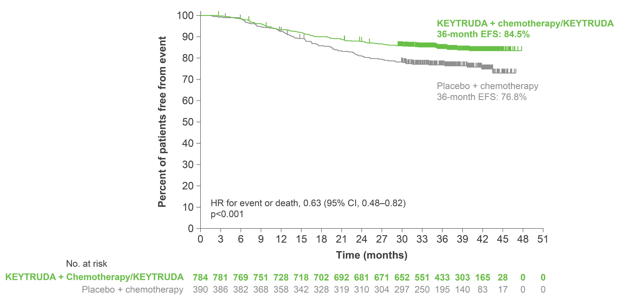
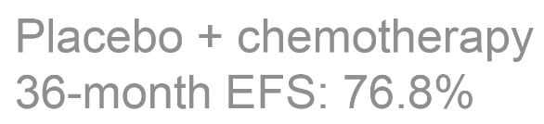
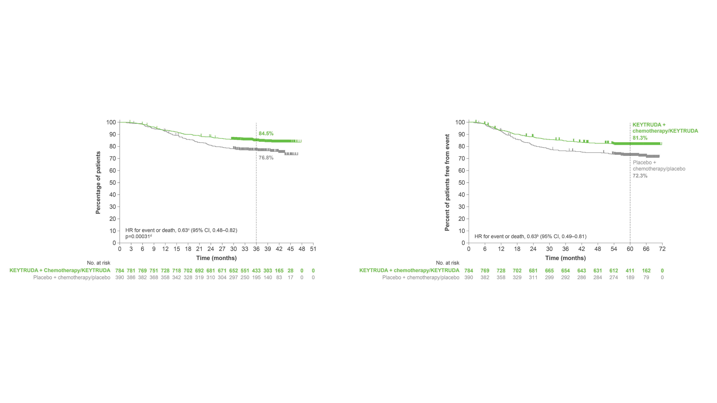
KEYNOTE-522: EFS in the ITT population at primary analysis
KEYTRUDA + chemotherapy in the neoadjuvant setting, followed by KEYTRUDA monotherapy as adjuvant treatment, resulted in a statistically significant improvement in EFS vs neoadjuvant placebo + chemotherapy followed by adjuvant placebo
The 36-month estimated EFS was:
84.5% in the neoadjuvant KEYTRUDA + chemotherapy followed by adjuvant KEYTRUDA group (95% CI, 81.7–86.9)
76.8% in the neoadjuvant placebo + chemotherapy followed by adjuvant placebo group (95% CI, 72.2–80.7)
Median EFS was not reached for either group
Click here to view the forest plot for EFS in key subgroups
Adapted from Schmid P et al. 2022.
Data cut-off: 23 March 2021. Tick marks indicate data censored at the last time the patient was known to be alive and without an event (disease progression that precludes definitive surgery; local or distant recurrence or a second primary tumour; or death from any cause). The HR and CI were analysed with the use of a Cox regression model with treatment as a covariate stratified according to the randomisation stratification factors of nodal status (+ or −), tumour size (T1/T2 or T3/T4) and frequency of carboplatin administration (QW or Q3W). CI, confidence interval; EFS, event-free survival; HR, hazard ratio; ITT, intention-to-treat; QW, every week; Q3W, every 3 weeks.
Schmid P et al. N Engl J Med 2022;386:556–567.
UK Prescribing Information

Slide 17
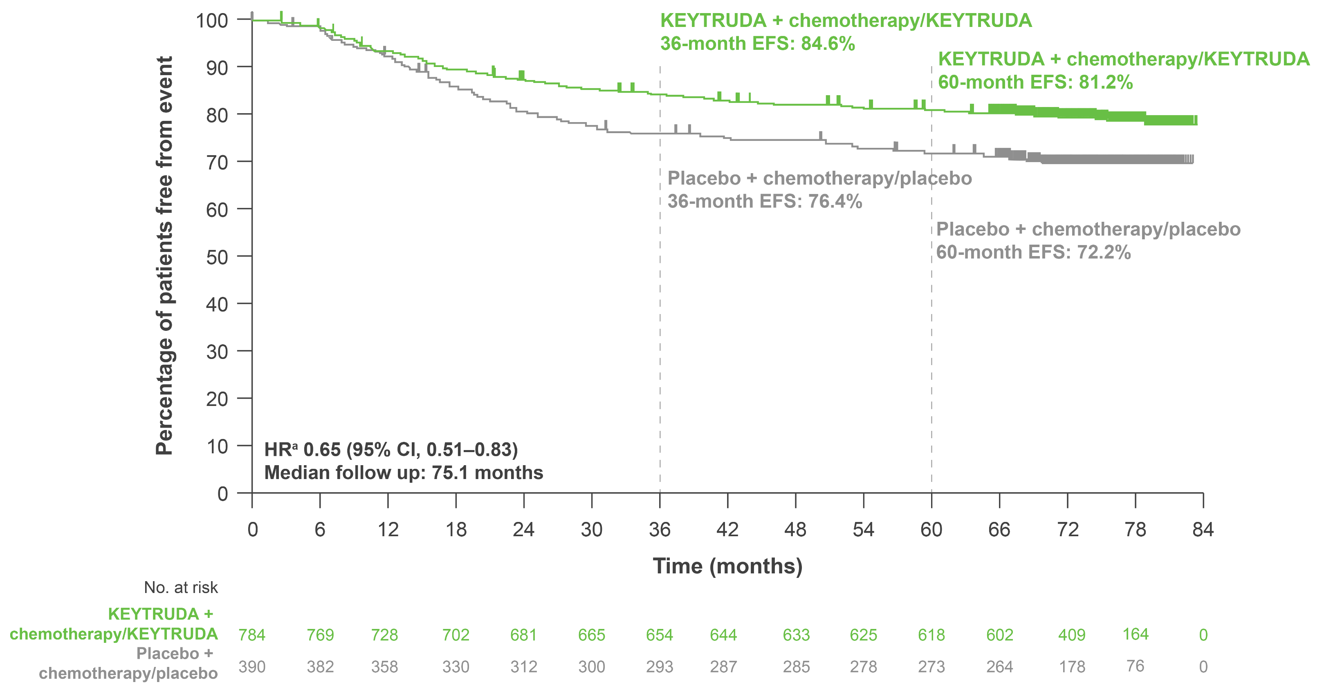
KEYNOTE-522: Exploratory analysis – EFS in the ITT population at 75-month follow up
 | KEYTRUDA + chemotherapy/ KEYTRUDA (n=784) | Placebo + chemotherapy/ placebo (n=390)
Patients with event, % | 20.3 | 29.2
This was an exploratory analysis; significance was not tested and no statistical conclusions can be drawn
Adapted from Schmid P et al. Presented at ESMO 2024.
Data cut-off: 22 March 2024.
ªHR (CI) analysed based on a Cox regression model with treatment as a covariate stratified by the randomisation stratification factors.
CI, confidence interval; HR, hazard ratio; ITT, intention-to-treat.
Schmid P et al. Presented at the European Society of Medical Oncology Congress 2024, 13–17 September, Barcelona, Spain.
UK Prescribing Information

Slide 18
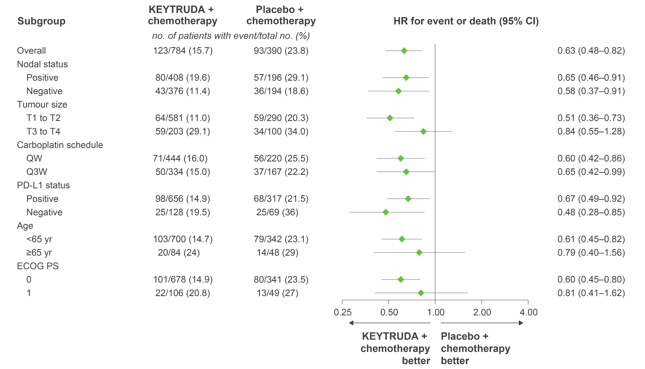
KEYNOTE-522: EFS in key subgroups at primary analysis
KEYNOTE-522 was not powered to detect differences in treatment effect between these subgroups. Results from exploratory analyses should be interpreted with caution due to modest patient numbers and potential imbalances in baseline characteristics
KEYTRUDA + chemotherapy better
Placebo + chemotherapy better
Adapted from Schmid P et al. 2022.
Data cut-off: 23 March 2021. The HR and CI were analysed with the use of a Cox regression model, with treatment as a covariate and stratified according to the randomisation stratification factors of nodal status (+ or −), tumour size (T1/T2 or T3/T4) and frequency of carboplatin administration (QW or Q3W). CI, confidence interval; ECOG PS, Eastern Cooperative Oncology Group performance status; EFS, event-free survival; HR, hazard ratio; ITT, intention-to-treat; pCR, pathologic complete response; PD-L1, programmed death ligand-1; QW, every week; Q3W, every 3 weeks; Yr, years.
Schmid P et al. N Engl J Med 2022;386:556–567 (plus supplementary appendix).
UK Prescribing Information

Slide 19
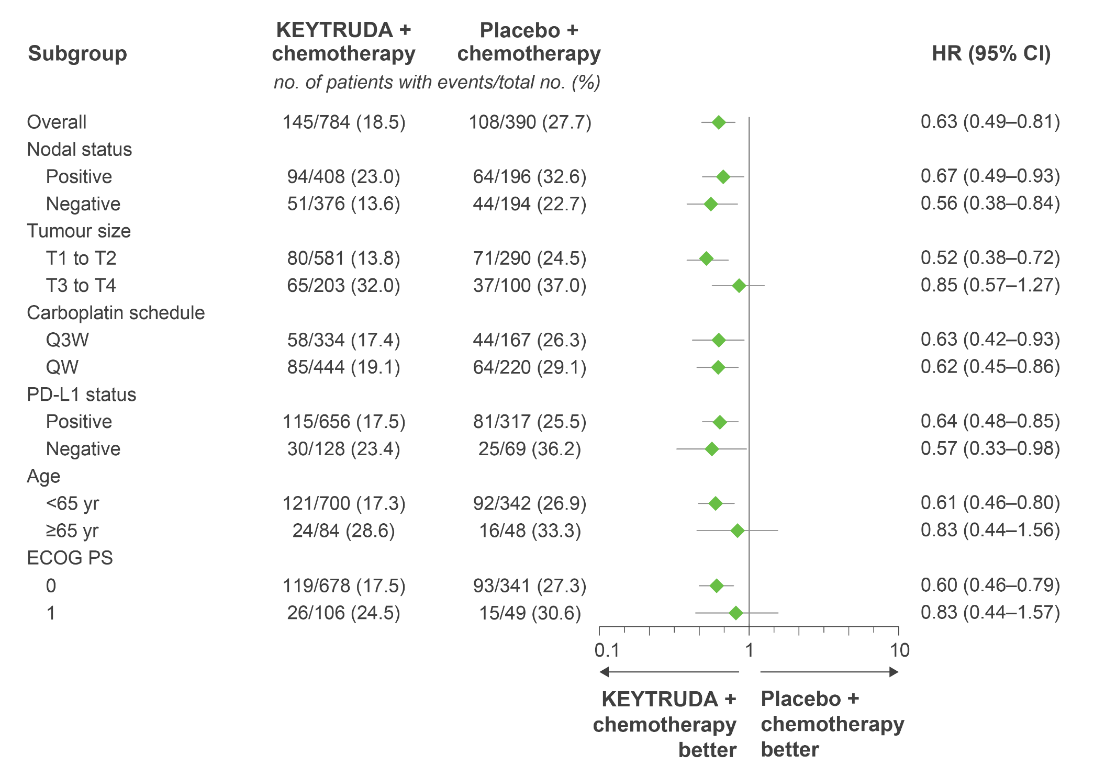
KEYNOTE-522: Exploratory analysis – EFS in key subgroups at
60-month follow up
KEYNOTE-522 was not powered to detect differences in treatment effect between these subgroups. Results from exploratory analyses should be interpreted with caution due to modest patient numbers and potential imbalances in baseline characteristics
Adapted from Schmid P et al. Presented at ESMO 2023.
Data cut-off: 23 March 2023. For the overall population and PD-L1 subgroups, analyses were based on a Cox regression model with Efron’s method of tie handling, with treatment as a covariate and stratification by nodal status (positive vs negative), tumour size (T1/T2 vs T3/T4) and frequency of carboplatin administration (QW vs Q3W); for other subgroups, analysis was based on an unstratified Cox model. CI, confidence interval; ECOG PS, Eastern Cooperative Oncology Group performance status; EFS, event-free survival; HR, hazard ratio; pCR, pathologic complete response; PD-L1, programmed death ligand-1; QW, every week; Q3W, every 3 weeks; yr, years.
Schmid P et al. Presented at the European Society of Medical Oncology Congress 2023, 20–24 September, Madrid, Spain.
UK Prescribing Information

Slide 20
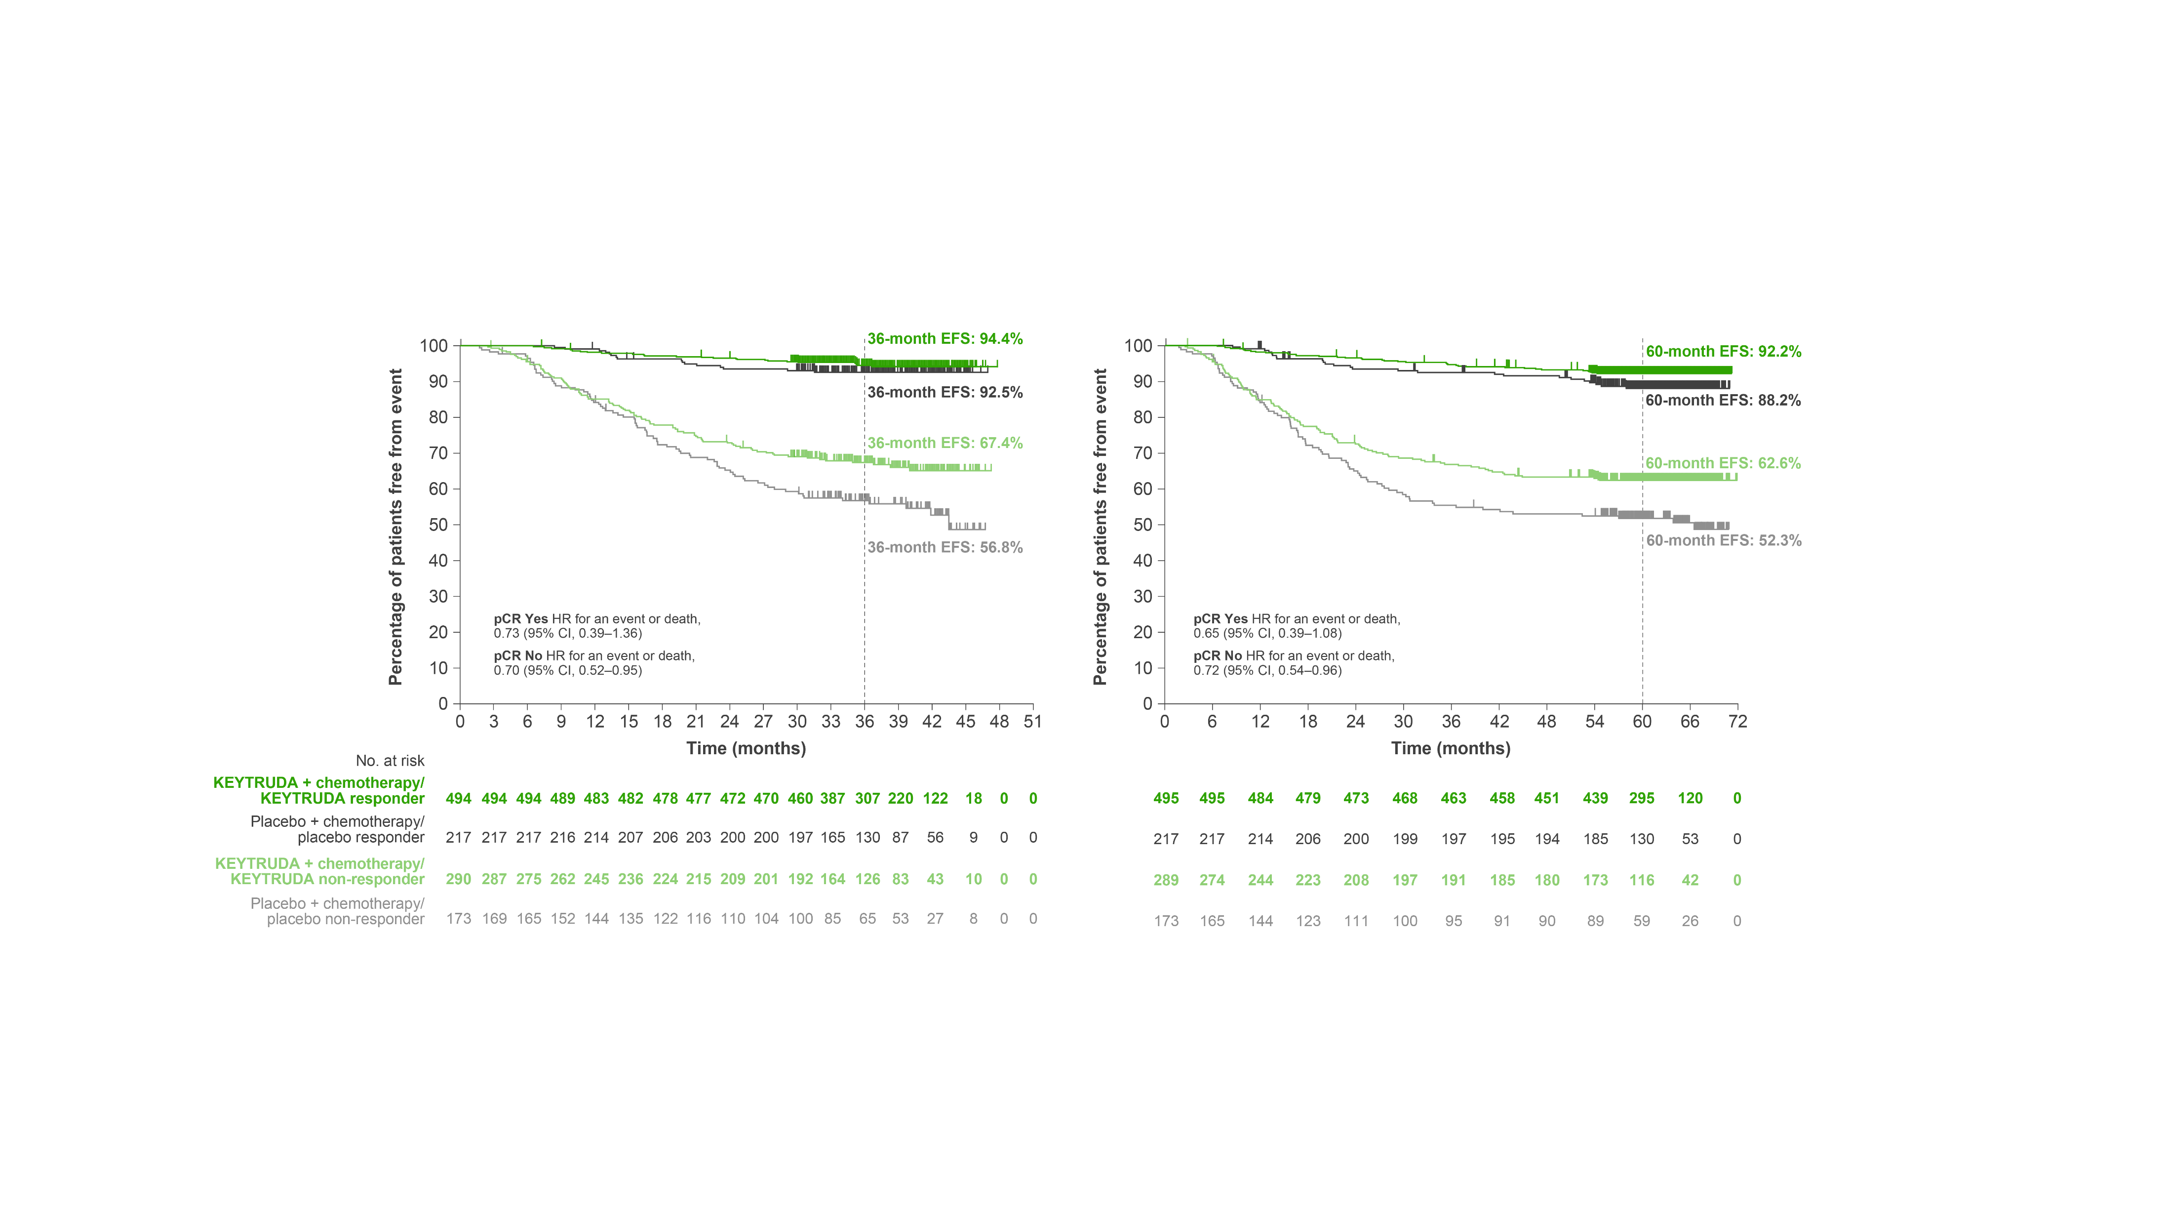
KEYNOTE-522: Exploratory analysis – EFS by pCR
36-month follow up
60-month follow up
Adapted from Schmid P et al. Presented at ESMO 2023.
Data cut-off: 23 March 2021 and 23 March 2023. CI, confidence interval; EFS, event-free survival; HR, hazard ratio; pCR, pathologic complete response.
Schmid P et al. Presented at the European Society of Medical Oncology Congress 2023, 20–24 September, Madrid, Spain.
This was an exploratory analysis; significance was not tested and no statistical conclusions can be drawn
UK Prescribing Information

Slide 21
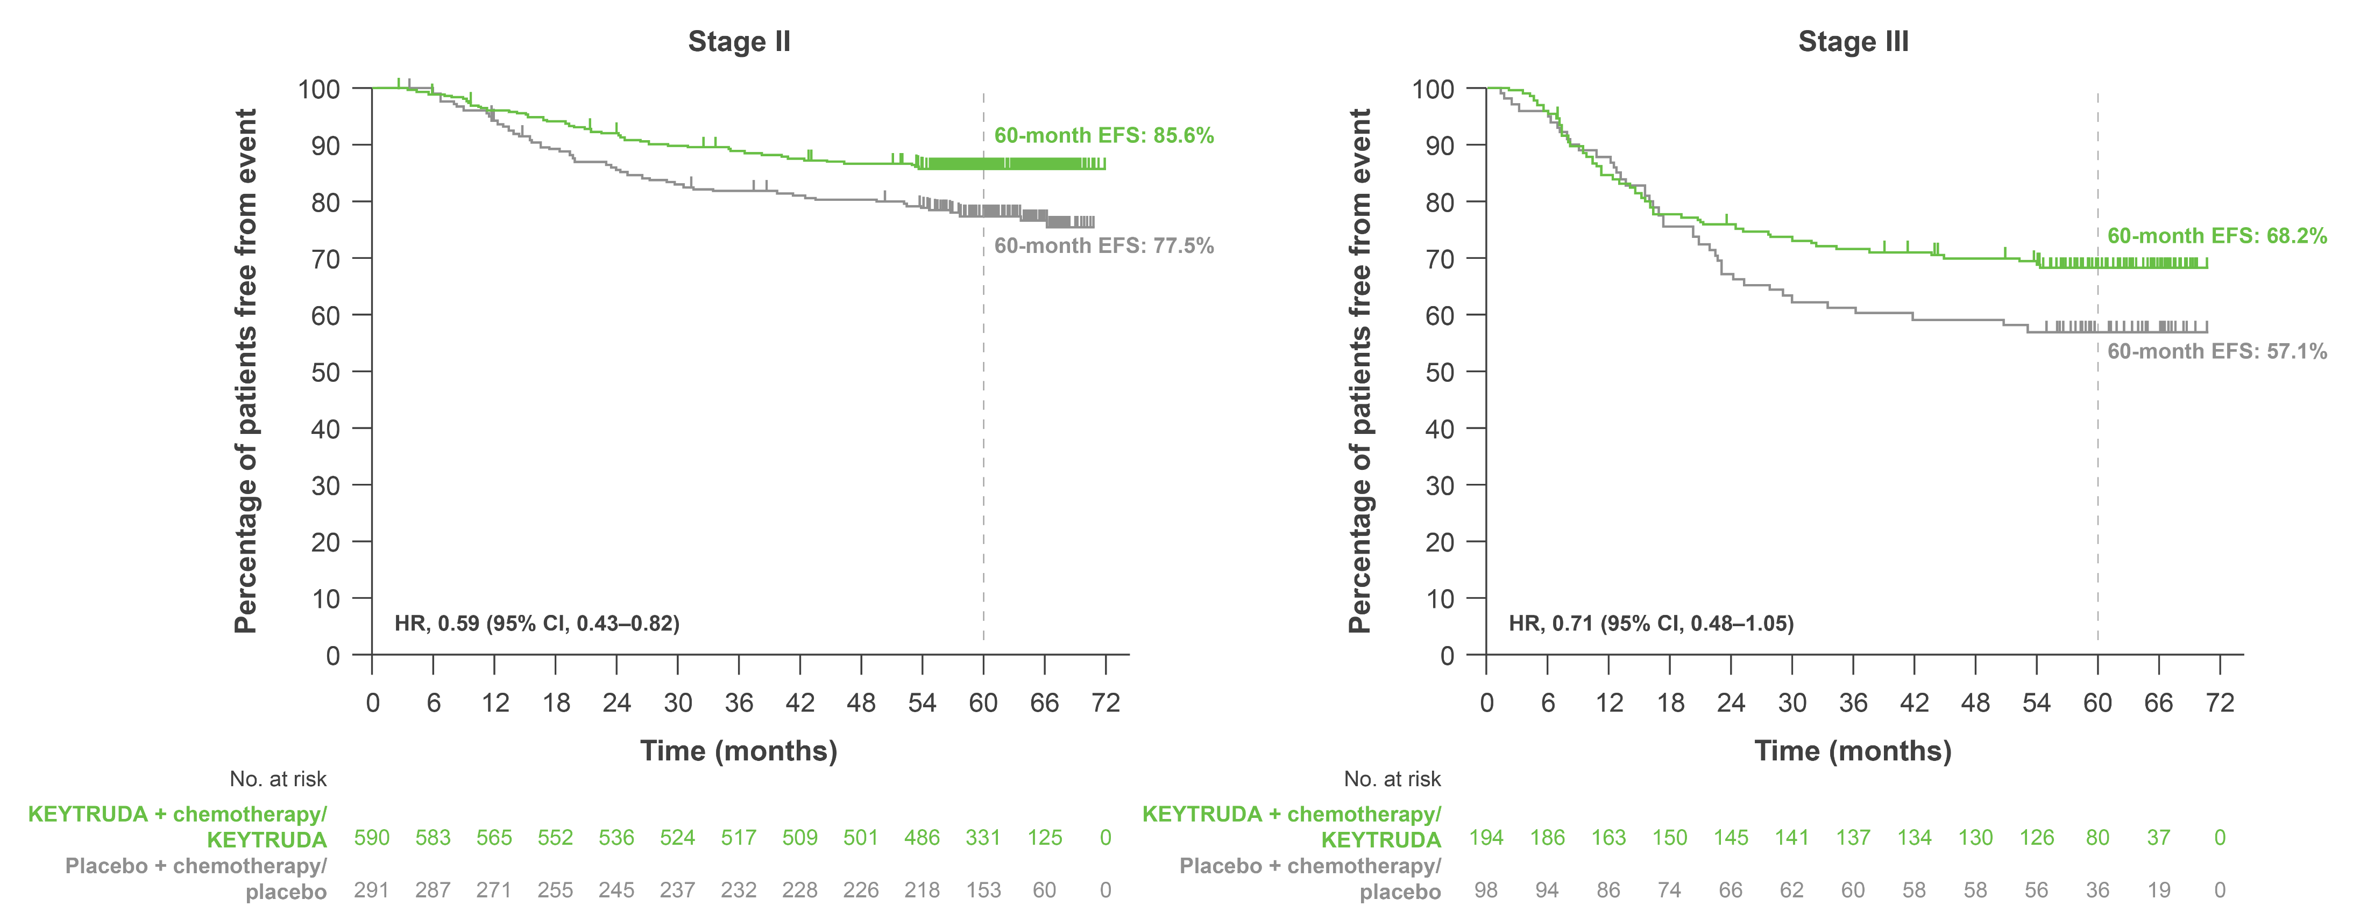
KEYNOTE-522: Exploratory analysis – EFS by disease stage at 60-month follow up
Adapted from Schmid P et al. Presented at SABCS 2023.
Data cut-off: 23 March 2023. CI, confidence interval; EFS, event-free survival; HR, hazard ratio.
Schmid P et al. Presented at the San Antonio Breast Cancer Symposium Congress 2023, 5–9 December, San Antonio, USA.
This was an exploratory analysis; significance was not tested and no statistical conclusions can be drawn
UK Prescribing Information

Slide 22
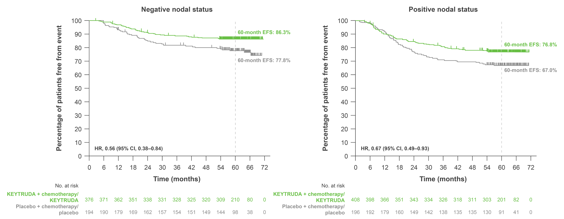
KEYNOTE-522: Exploratory analysis – EFS by nodal status at 60-month follow up
Adapted from Schmid P et al. Presented at SABCS 2023.
Data cut-off: 23 March 2023. CI, confidence interval; EFS, event-free survival; HR, hazard ratio.
Schmid P et al. Presented at the San Antonio Breast Cancer Symposium Congress 2023, 5–9 December, San Antonio, USA.
This was an exploratory analysis; significance was not tested and no statistical conclusions can be drawn
UK Prescribing Information

Slide 23
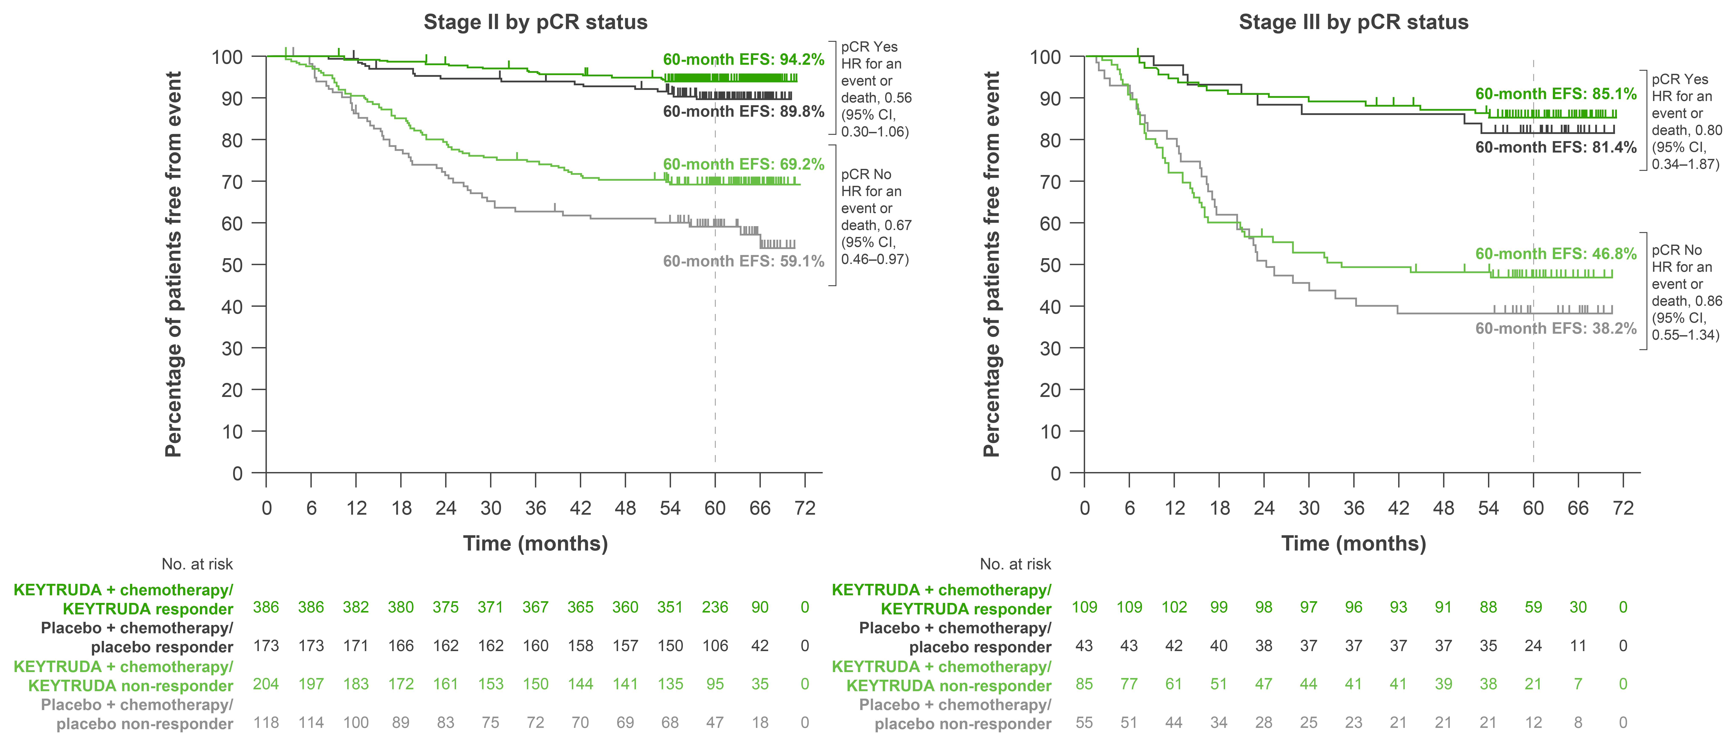
KEYNOTE-522: Exploratory analysis – EFS by disease stage in patients with and without pCR at 60-month follow up
Data cut-off: 23 March 2023. CI, confidence interval; EFS, event-free survival; HR, hazard ratio; pCR, pathologic complete response.
Schmid P et al. Presented at the San Antonio Breast Cancer Symposium Congress 2023, 5–9 December, San Antonio, USA.
Adapted from Schmid P et al. Presented at SABCS 2023.
This was an exploratory analysis; significance was not tested and no statistical conclusions can be drawn
UK Prescribing Information

Slide 24
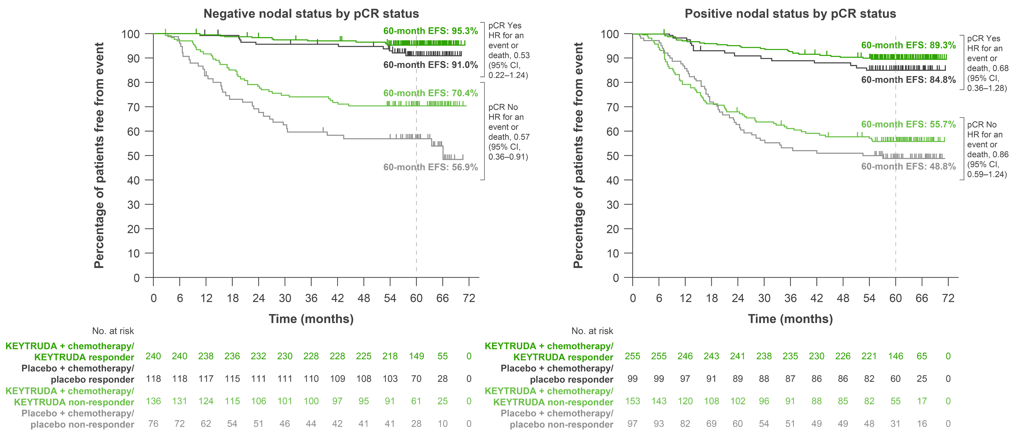
KEYNOTE-522: Exploratory analysis – EFS by nodal status in patients with and without pCR at 60-month follow up
Data cut-off: 23 March 2023. CI, confidence interval; EFS, event-free survival; HR, hazard ratio; pCR, pathologic complete response.
Schmid P et al. Presented at the San Antonio Breast Cancer Symposium Congress 2023, 5–9 December, San Antonio, USA.
Adapted from Schmid P et al. Presented at SABCS 2023.
This was an exploratory analysis; significance was not tested and no statistical conclusions can be drawn
UK Prescribing Information

Slide 25
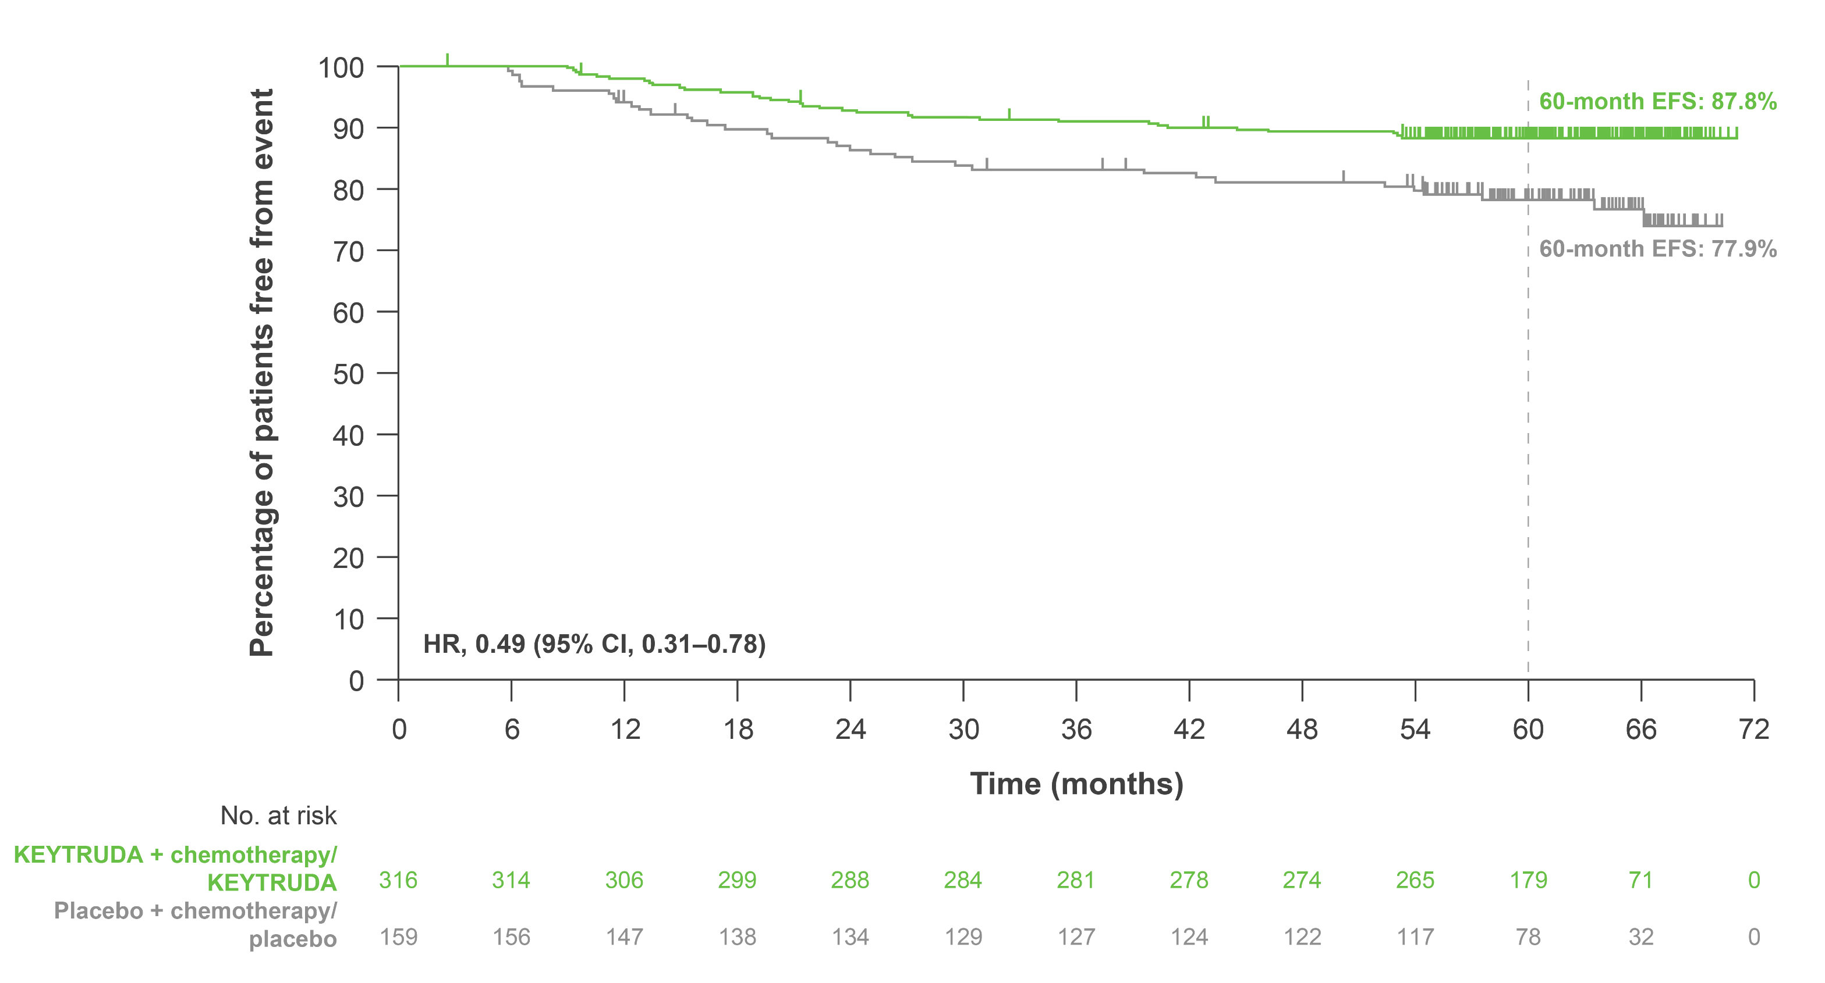
KEYNOTE-522: Exploratory analysis – EFS in patients with baseline T2N0 disease at 60-month follow up
Data cut-off: 23 March 2023. CI, confidence interval; EFS, event-free survival; HR, hazard ratio. Schmid P et al. Presented at the San Antonio Breast Cancer Symposium Congress 2023, 5–9 December, San Antonio, USA.
Adapted from Schmid P et al. Presented at SABCS 2023.
This was an exploratory analysis; significance was not tested and no statistical conclusions can be drawn
UK Prescribing Information

Slide 26
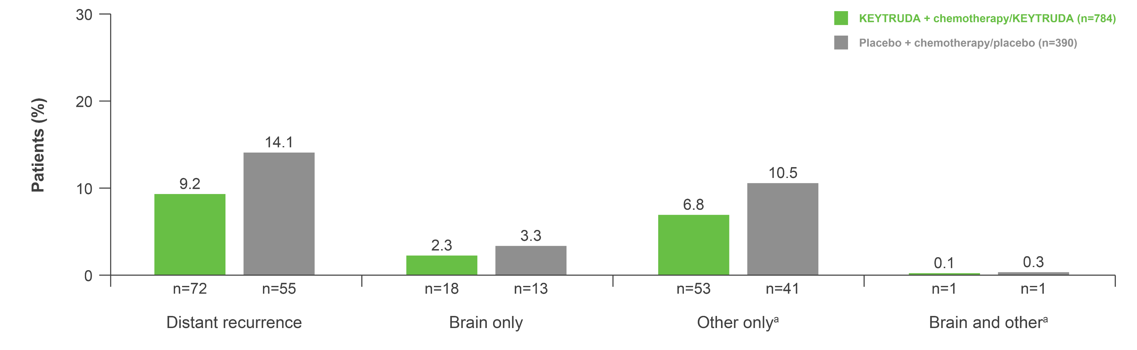
KEYNOTE-522: Exploratory analysis – Distant recurrence as first EFS event at 60-month follow up
Adapted from Schmid P et al. Presented at SABCS 2023.
Data cut-off: 23 March 2023. ªOther refers to non-brain distant recurrence sites, which were classified per clinical identification. CI, confidence interval; EFS, event-free survival; HR, hazard ratio. Schmid P et al. Presented at the San Antonio Breast Cancer Symposium Congress 2023, 5–9 December, San Antonio, USA.
This was an exploratory analysis; significance was not tested and no statistical conclusions can be drawn
UK Prescribing Information

Slide 27
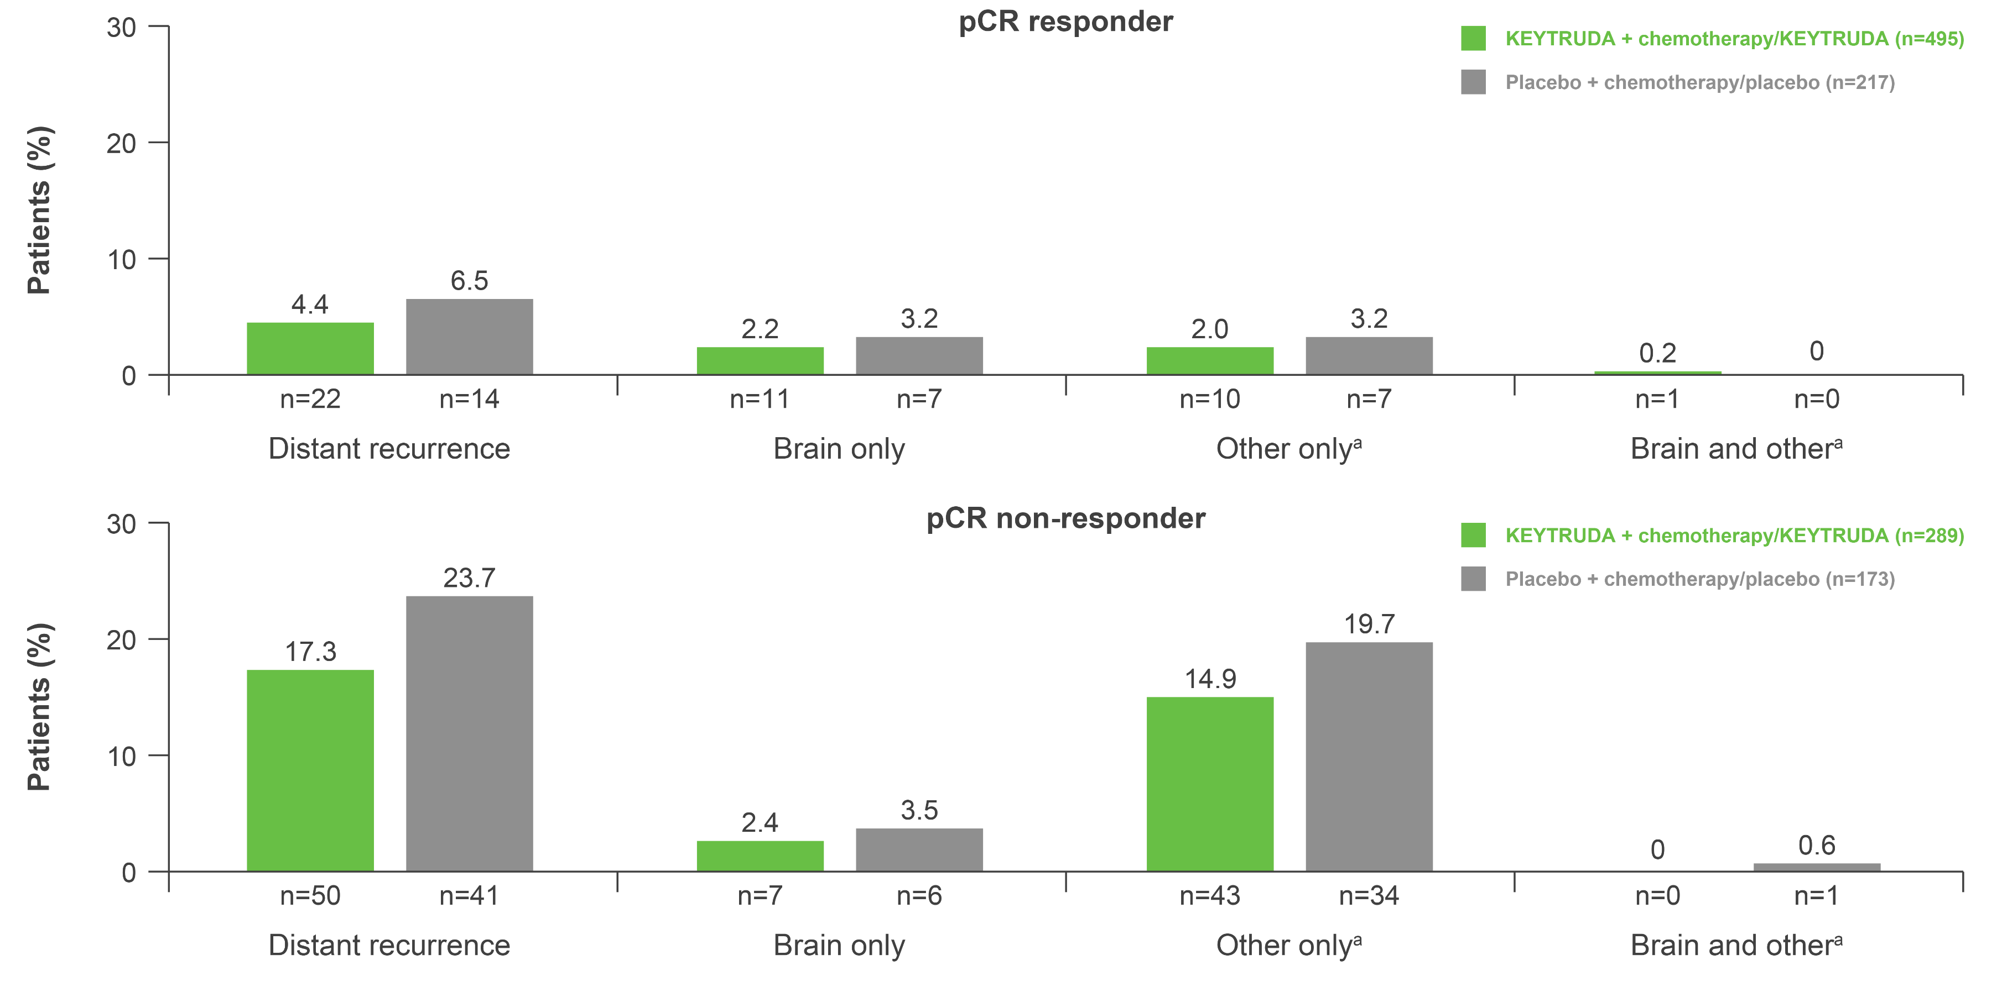
KEYNOTE-522: Exploratory analysis – Distant recurrence as first EFS event by pCR (ypT0/Tis ypN0) at 60-month follow up
Data cut-off: 23 March 2023. ªOther refers to non-brain distant recurrence sites, which were classified per clinical identification. CI, confidence interval; EFS, event-free survival; HR, hazard ratio; pCR, pathologic complete response. Schmid P et al. Presented at the San Antonio Breast Cancer Symposium Congress 2023, 5–9 December, San Antonio, USA.
Adapted from Schmid P et al. Presented at SABCS 2023.
This was an exploratory analysis; significance was not tested and no statistical conclusions can be drawn
UK Prescribing Information

Slide 28
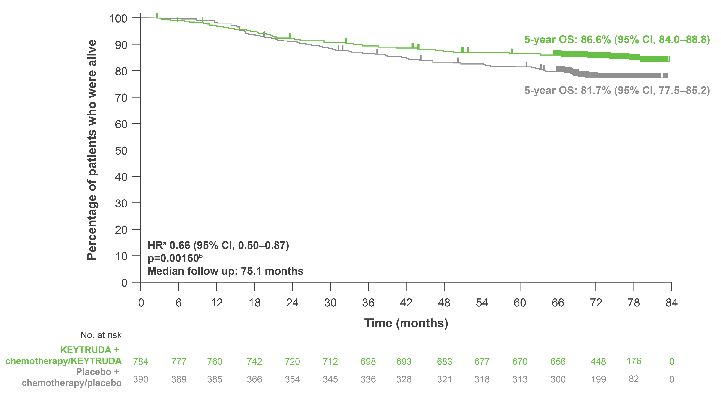
KEYNOTE-522: Key secondary endpoint – OS in the ITT population at 75-month follow up
 | KEYTRUDA + chemotherapy/ KEYTRUDA (n=784) | Placebo + chemotherapy/ placebo (n=390)
Patients with event, % | 14.7 | 21.8
Adapted from Schmid P et al. Presented at ESMO 2024.
Data cut-off: 22 March 2024.
ªThe unstratified piecewise HR was 0.87 (95% CI, 0.57–1.32) before the 2-year follow up and 0.51 (95% CI, 0.35–0.75) afterwards. The weighted average HR with weights of number of events before and after 2-year follow up was 0.66; ^{b}With 200 events (67.3% information fraction), the observed p-value crossed the prespecified nominal boundary of 0.00503 (one-sided) at this interim analysis.
CI, confidence interval; HR, hazard ratio; ITT, intention-to-treat; OS, overall survival.
Schmid P et al. Presented at the European Society of Medical Oncology Congress 2024, 13–17 September, Barcelona, Spain.
UK Prescribing Information

Slide 29
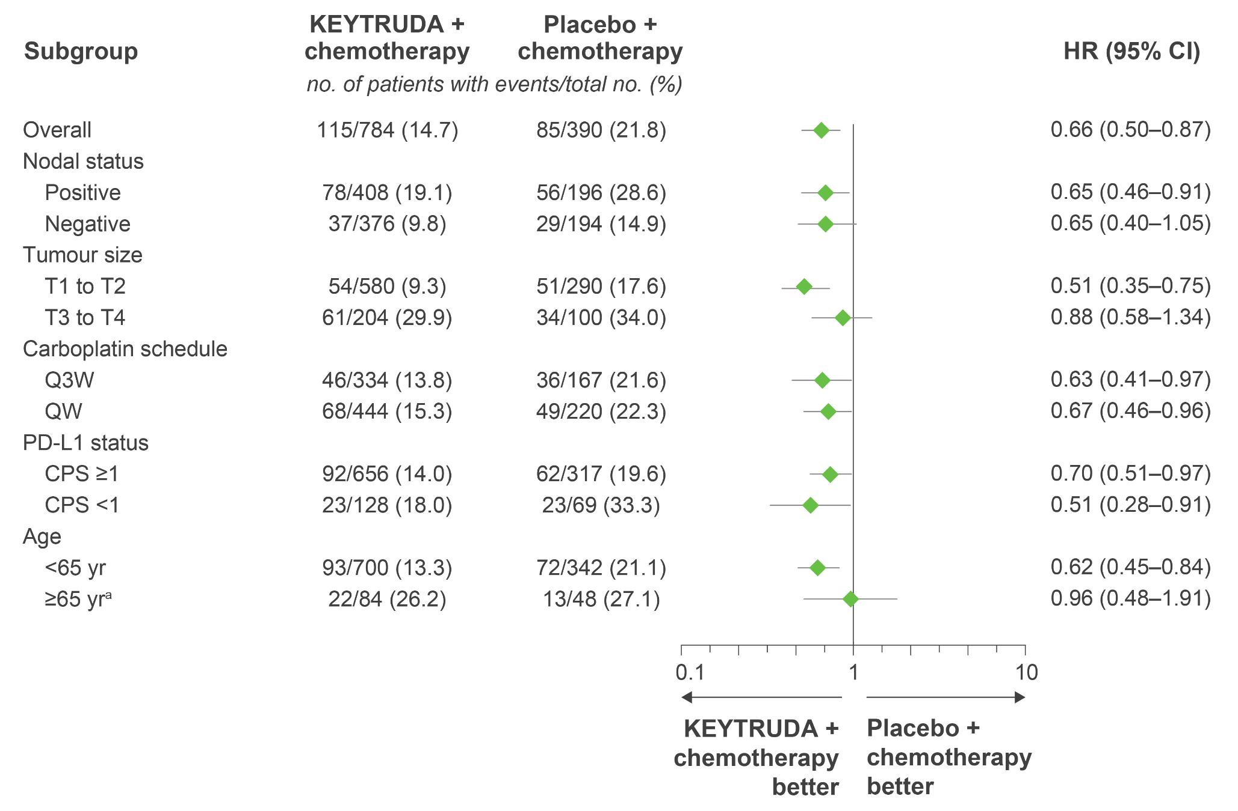
KEYNOTE-522: Exploratory analysis – OS in key patient subgroups at 75-month follow up
Adapted from Schmid P et al. Presented at ESMO 2024.
This was an exploratory analysis; significance was not tested and no statistical conclusions can be drawn
Data cut-off: 22 March 2024.
ªBased on the small sample size and few events, results should be interpreted with caution. For overall population and PD-L1 subgroups, analyses were based on Cox regression model with Efron's method of tie handling, with treatment as a covariate and stratified by nodal status (positive vs negative), tumour size (T1/T2 vs T3/T4), and frequency of carboplatin (Q3W vs QW); for other subgroups, analysis was based on an unstratified Cox model.
CI, confidence interval; CPS, combined positive score; HR, hazard ratio; OS, overall survival; PD-L1, programmed death ligand-1; Q3W, once every three weeks; QW, once weekly; yr, years.
Schmid P et al. Presented at the European Society of Medical Oncology Congress 2024, 13–17 September, Barcelona, Spain.
UK Prescribing Information

Slide 30
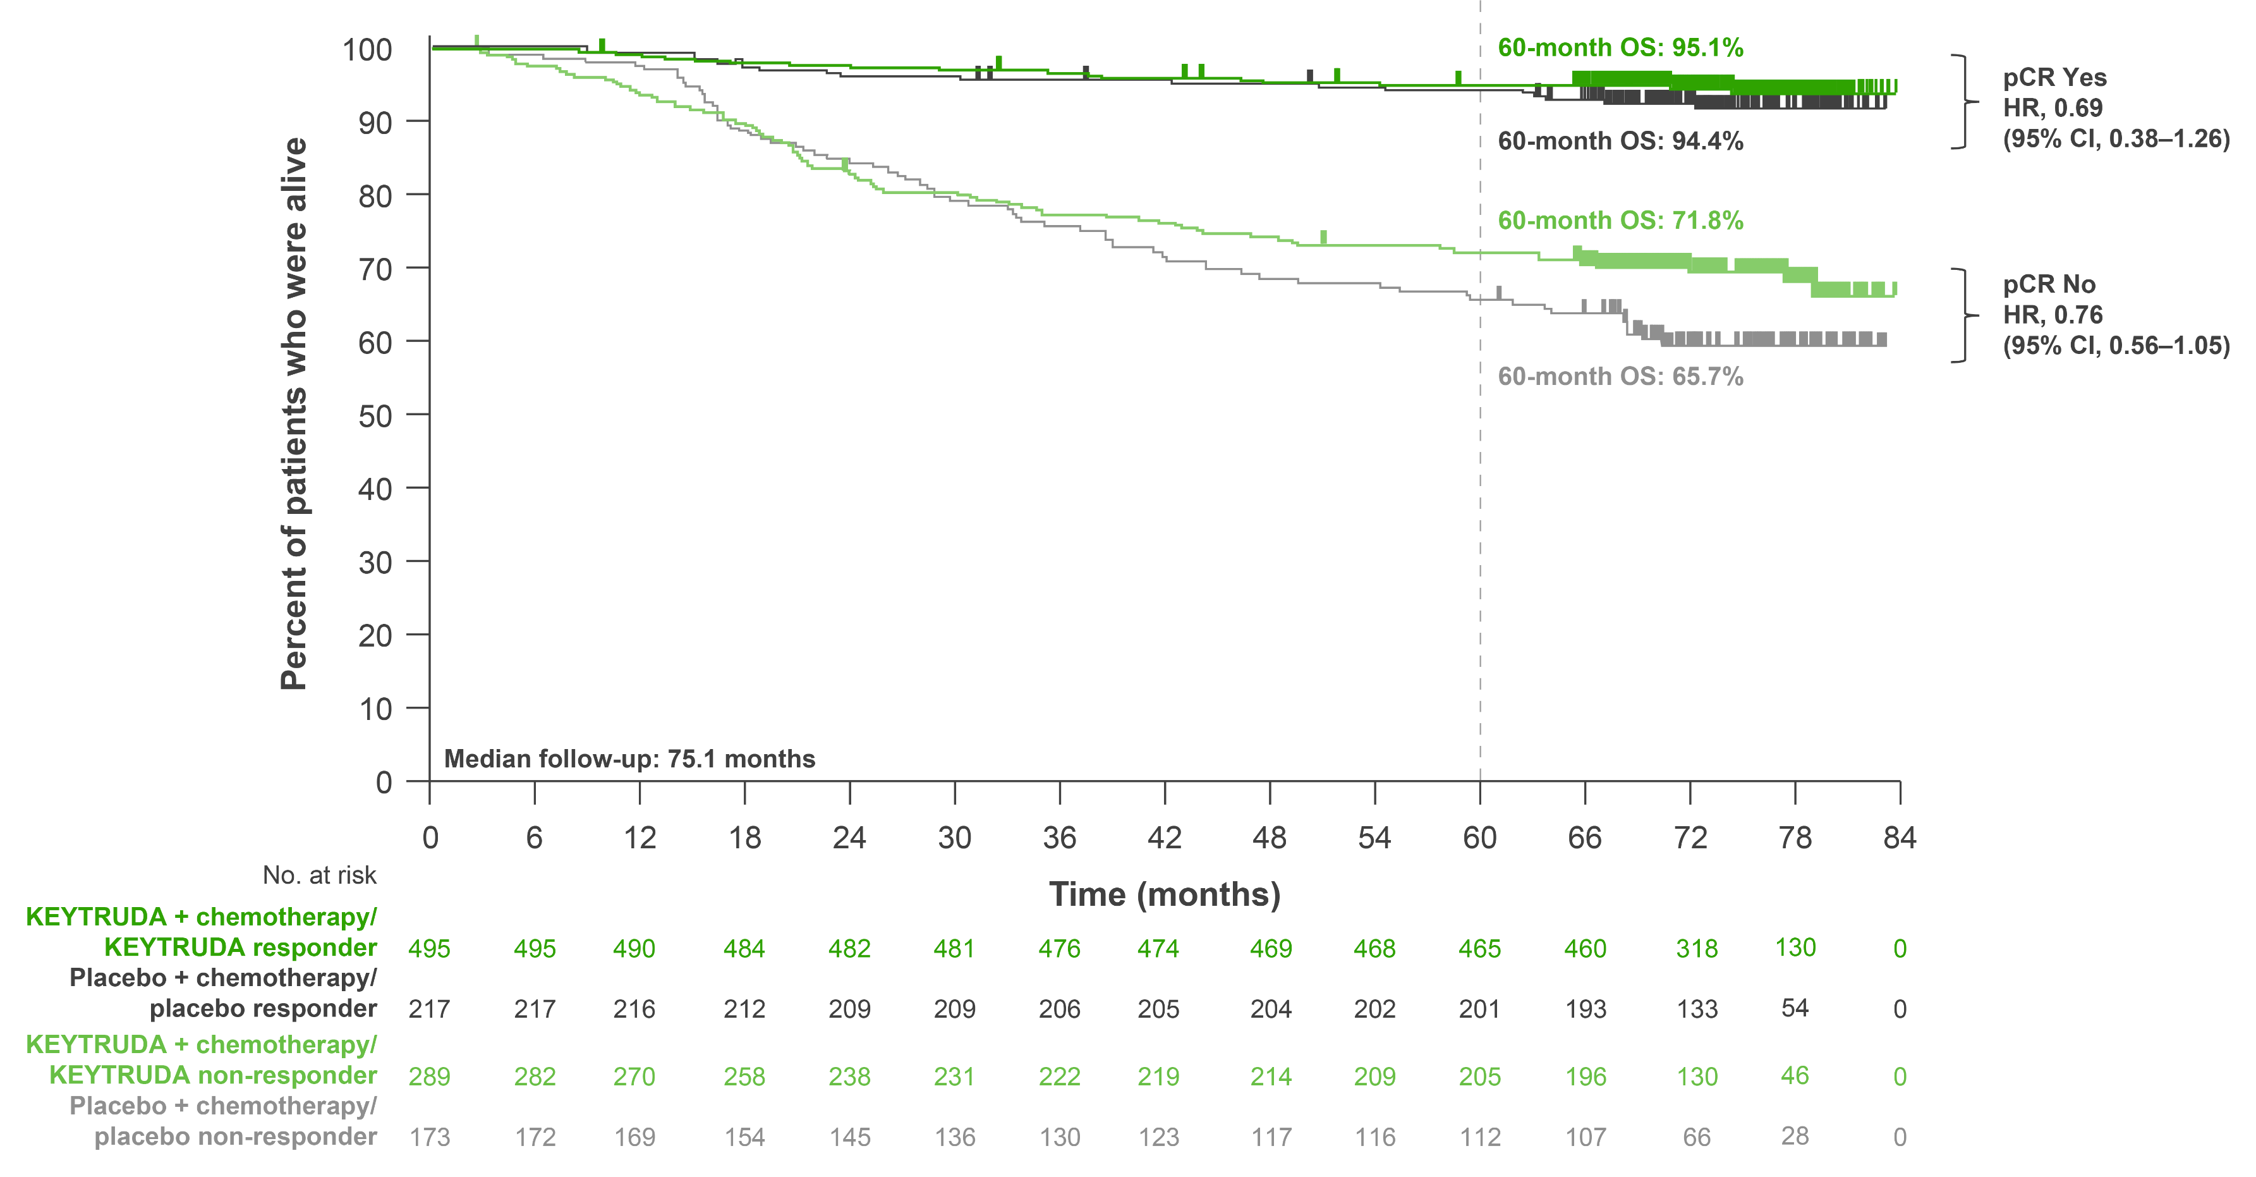
KEYNOTE-522: Exploratory analysis – OS by pCR (pathological stage ypT0/Tis ypN0) at 75-month follow up
Adapted from Schmid P et al. Presented at ESMO 2024.
This was an exploratory analysis; significance was not tested and no statistical conclusions can be drawn
Data cut-off: 22 March 2024.
This is a non-randomised subgroup analysis based on the post-treatment outcome of pCR. HRs should therefore be interpreted with caution.
CI, confidence interval; HR, hazard ratio; OS, overall survival; pCR, pathologic complete response.
Schmid P et al. Presented at the European Society of Medical Oncology Congress 2024, 13–17 September, Barcelona, Spain.
UK Prescribing Information

Slide 31
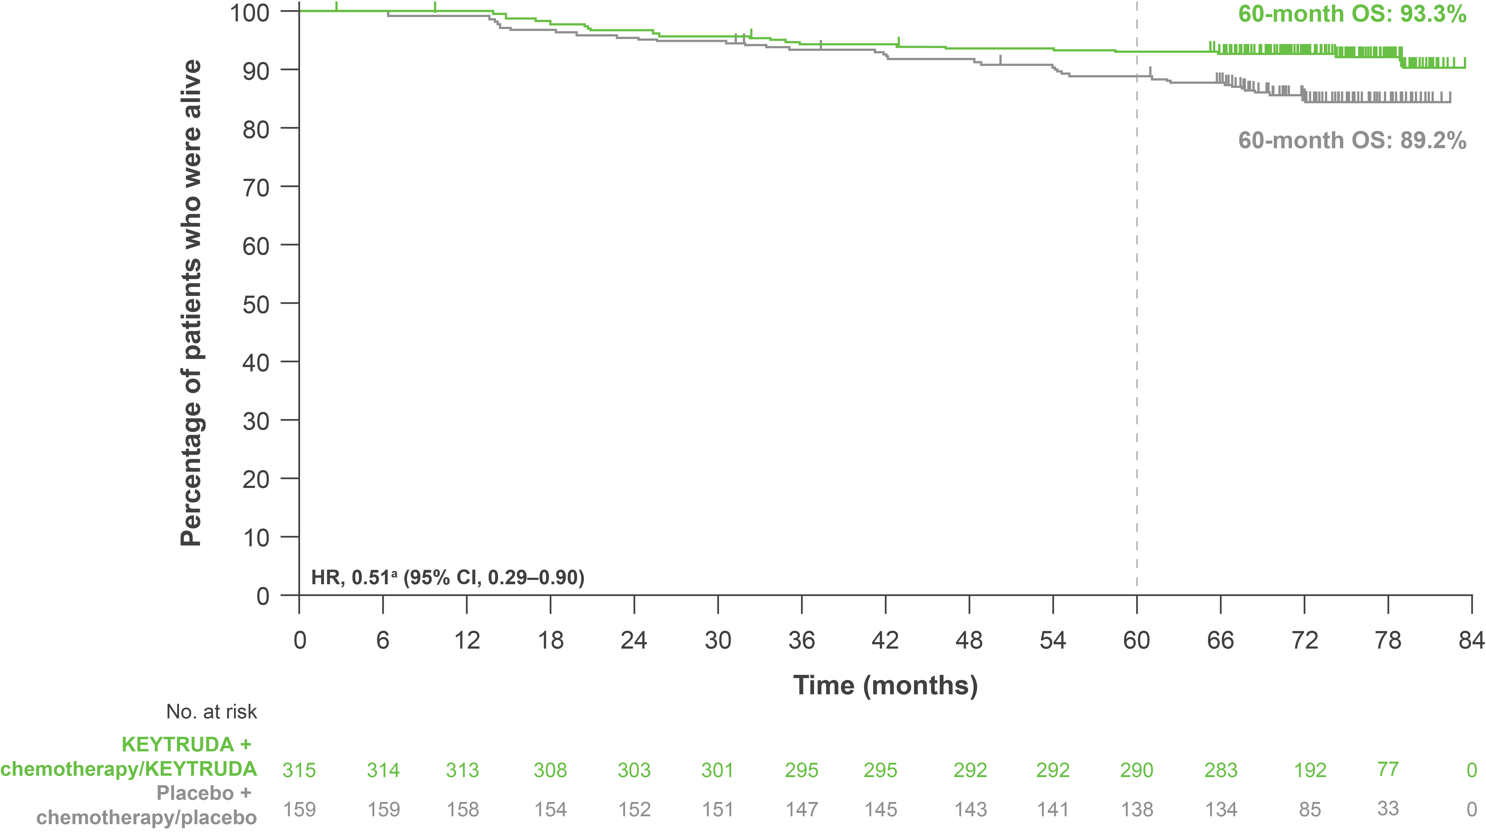
KEYNOTE-522: Exploratory analysis – OS in patients with baseline T2N0 disease at 75-month follow up
 | KEYTRUDA + chemotherapy/ KEYTRUDA (n=315) | Placebo + chemotherapy/ placebo (n=159)
Patients with event, % | 7.6 | 14.5
Adapted from Dent R et al. Presented at SABCS 2024.
Data cut-off: 22 March 2024. ªHR (CI) analysed based on an unstratified Cox regression model with treatment as a covariate. CI, confidence interval; HR, hazard ratio; OS, overall survival. Dent R et al. Presented at the San Antonio Breast Cancer Symposium 2024, 10–13 December, San Antonio, USA.
This was an exploratory analysis; significance was not tested, and no statistical conclusions can be drawn
UK Prescribing Information

Slide 32
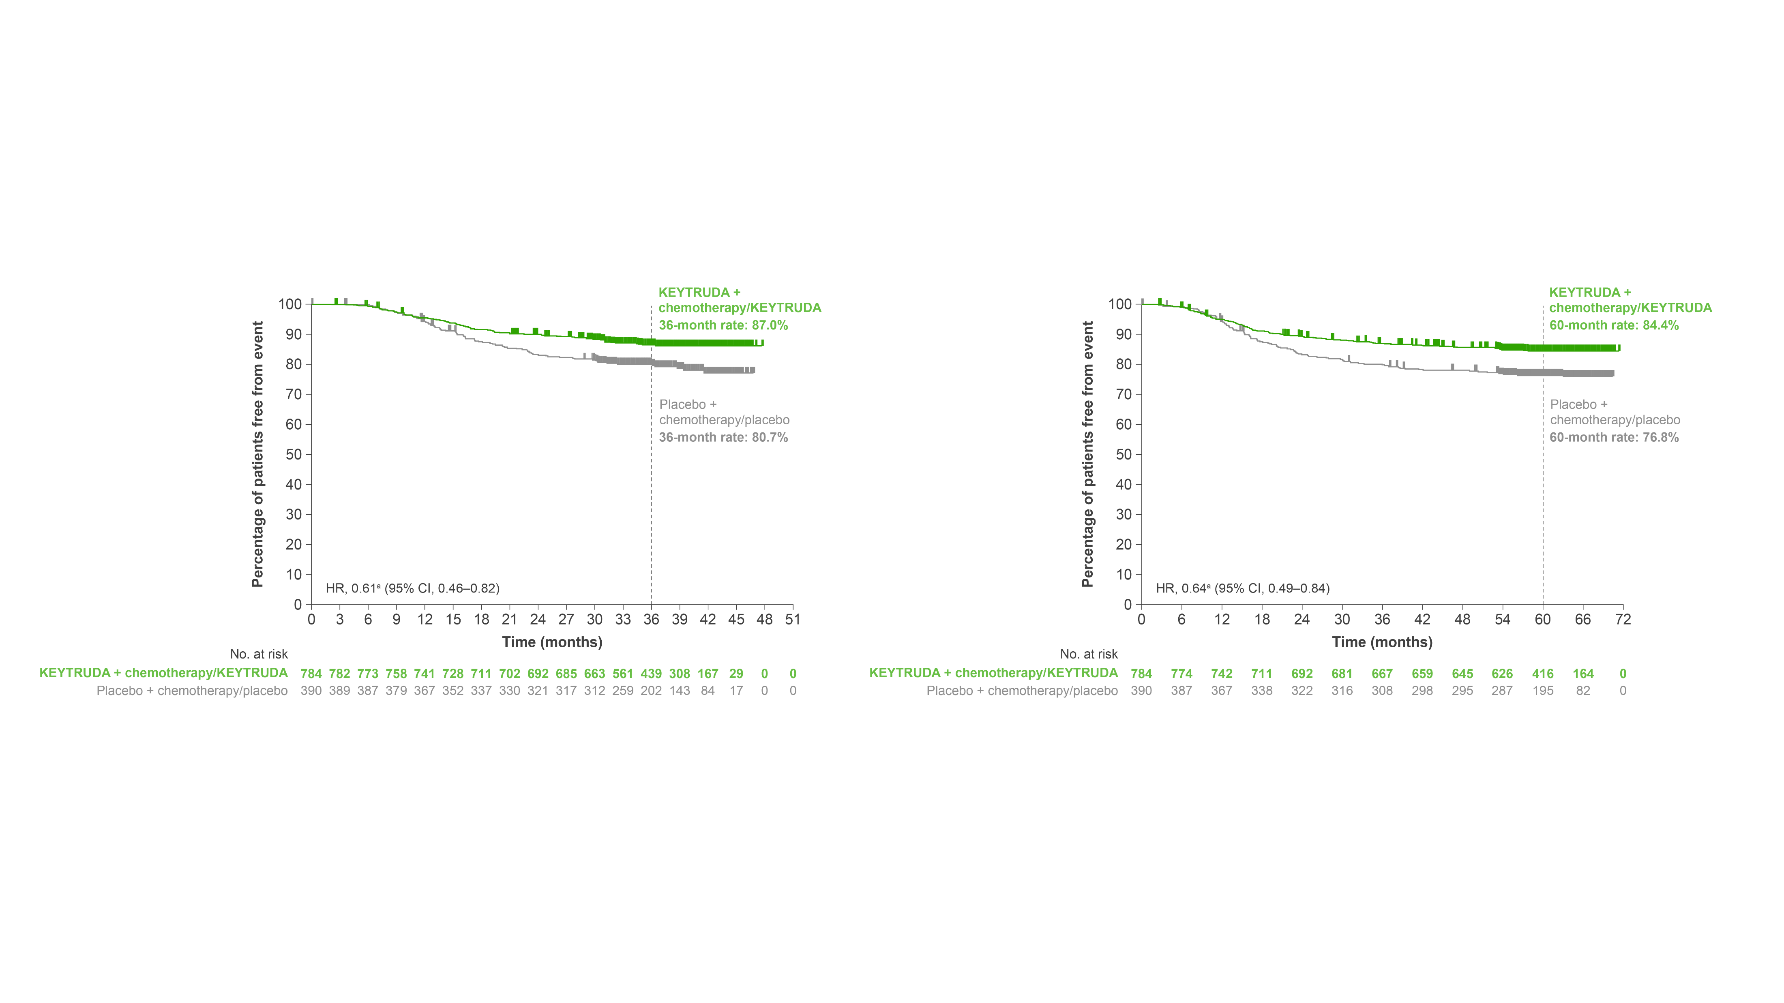
KEYNOTE-522: Exploratory analysis – DPFS or DRFS at 36- and 60-month follow up
36-month follow up
60-month follow up
Adapted from Schmid P et al. Presented at ESMO 2023.
Data cut-off: 23 March 2021 and 23 March 2023. ªHR (CI) analysed based on a Cox regression model with treatment as a covariate stratified by randomisation stratification factors. CI, confidence interval; DPFS, distant progression-free survival; DRFS, distant recurrence-free survival; HR, hazard ratio. Schmid P et al. Presented at the European Society of Medical Oncology Congress 2023, 20–24 September, Madrid, Spain.
This was an exploratory analysis; significance was not tested and no statistical conclusions can be drawn
UK Prescribing Information

Slide 33
KEYNOTE-522: Results – Safety
Click the links below to navigate to the section of interest
Safety assessments
Neoadjuvant phase
Adjuvant phase
Combined phase
Summary of any-grade AEs in the neoadjuvant phase (primary analysis)
TRAEs in the adjuvant phase (36-month follow up)
Summary of safety results in the combined phase
(36-month follow up)
AEs of interest in the neoadjuvant phase
(primary analysis)
Immune-mediated AEs and infusion reactions in the adjuvant phase
(36-month follow up)
Summary of any grade TRAEs in the combined phase (75-month follow up)
Summary of immune-mediated AEs in the combined phase (75-month follow up)
AE, adverse event; TRAE, treatment-related adverse event.
UK Prescribing Information

Slide 34
KEYNOTE-522: Safety assessments^{1,2}
Combined phase
a
c
b
d
e
AEs were assessed during each phase of the study, as well as the study as a whole
a
c
b
d
e
Adapted from Schmid P et al. 2020 and Schmid P et al. 2022.
ªCarboplatin dose was AUC 5 Q3W or AUC 1.5 QW; ^{b}Paclitaxel dose was 80 mg/m² QW; ^{c}Doxorubicin dose was 60 mg/m² Q3W; ^{d}Epirubicin dose was 90 mg/m² Q3W; ^{e}Cyclophosphamide dose was 600 mg/m² Q3W. AE, adverse event; AUC, area under curve; ECOG PS, Eastern Cooperative Oncology Group performance status; EFS, event-free survival; pCR, pathologic complete response; PD-L1, programmed death ligand-1; QW, every week; Q3W, every 3 weeks; R, randomisation; TNBC, triple-negative breast cancer.
1. Schmid P et al. N Engl J Med 2020;382:810–821 (plus supplementary appendix); 2. Schmid P et al. N Engl J Med 2022;386:556–567 (plus supplementary appendix).
UK Prescribing Information

Slide 35
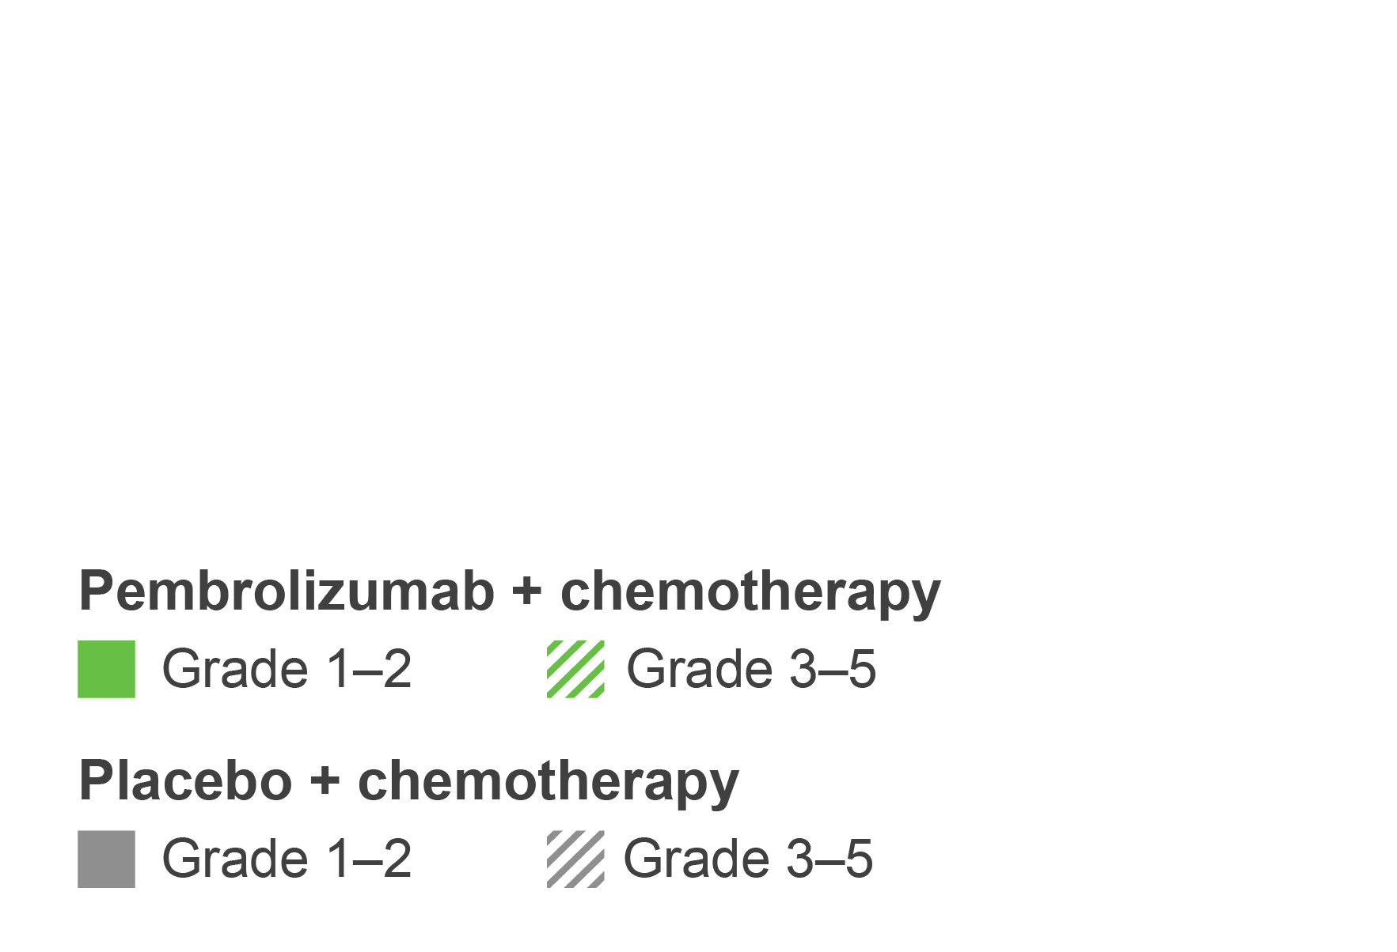
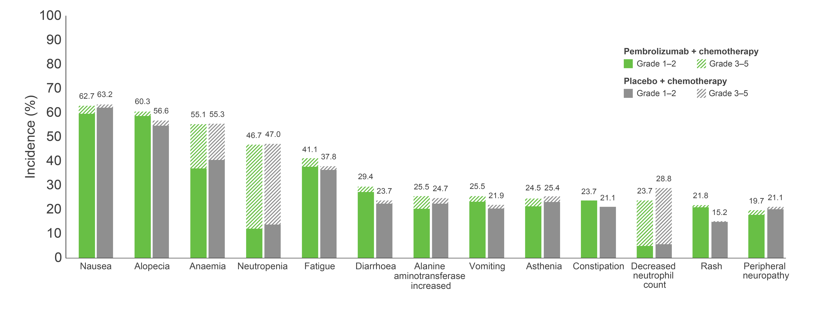
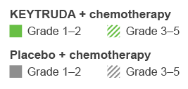
KEYNOTE-522: Summary of any-grade AEs occurring in ≥20% of patients in the neoadjuvant phase at primary analysis
The tabular data for this plot is shown in the appendix. Click here to view.
Adapted from Schmid P et al. 2020.
Listed are AEs that occurred during the treatment period or within 30 days after the treatment period (or, for serious AEs, within 90 days) in patients who were randomised and received at least one trial drug or surgery. The severity of the AEs was graded according to the Common Terminology Criteria for Adverse Events, v4.0, of the National Cancer Institute. Patients may have had more than one event. AE, adverse event. Schmid P et al. N Engl J Med 2020;382:810–821.
UK Prescribing Information

Slide 36
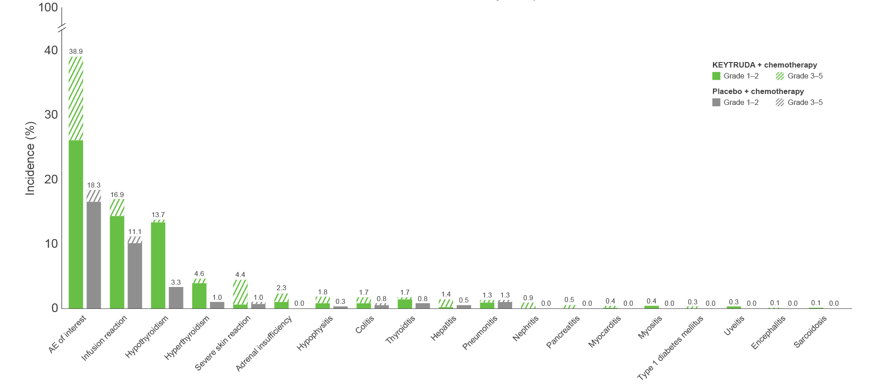
KEYNOTE-522: AEs of interest in the neoadjuvant phase at primary analysisª
The tabular data for this plot is shown in the appendix. Click here to view.
Adapted from Schmid P et al. 2020.
Listed are AEs that occurred during the treatment period or within 30 days after the treatment period (or, for serious AEs, within 90 days) in patients who were randomised and received at least one trial drug or surgery. The severity of the AEs was graded according to the Common Terminology Criteria for Adverse Events, v4.0, of the National Cancer Institute. Patients may have had more than one event. ªAEs of interest were determined according to a list of terms specified by the sponsor, regardless of attribution to any trial treatment by the investigators. AE, adverse event. Schmid P et al. N Engl J Med 2020;382:810–821 (plus supplementary appendix).
UK Prescribing Information

Slide 37
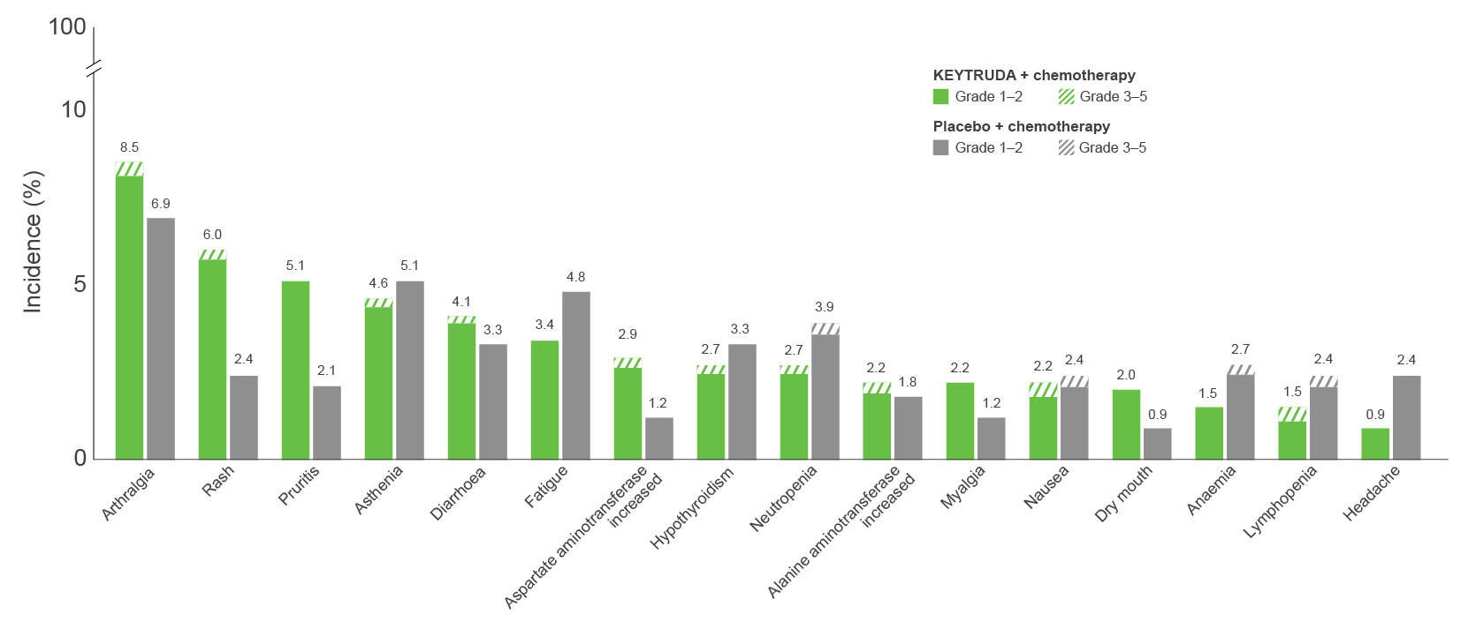
KEYNOTE-522: TRAEs occurring in ≥2% of patients in the adjuvant phase at 36-month follow up
Pruritus
The tabular data for this plot is shown in the appendix. Click here to view.
Adapted from Schmid P et al. Presented at ESMO 2021.
Listed are AEs that occurred during the treatment period or within 30 days after the treatment period (or, for serious AEs, within 90 days) in patients who were randomised and received at least one trial drug or surgery. The severity of the AEs was graded according to the Common Terminology Criteria for Adverse Events, v4.0, of the National Cancer Institute. Patients may have had more than one event. AE, adverse event; TRAE, treatment-related adverse event. Schmid P et al. Presented at the European Society for Medical Oncology (ESMO) Virtual Plenary 2021, 16–21 September.
UK Prescribing Information

Slide 38
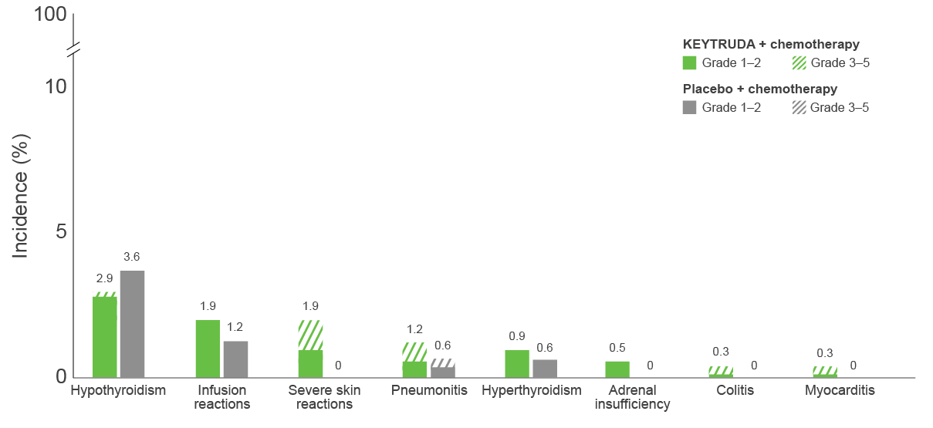
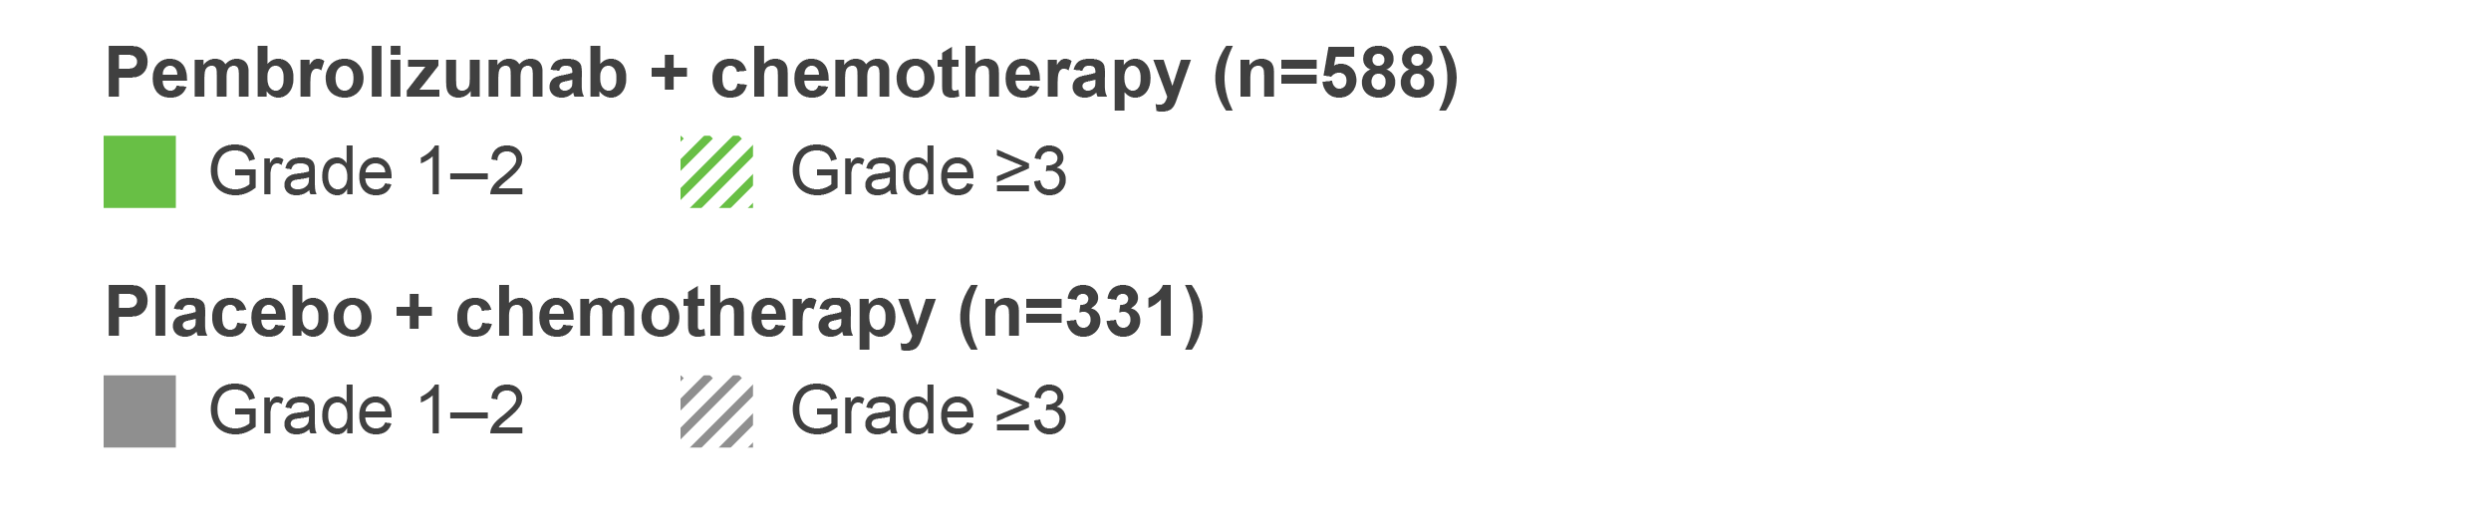
KEYNOTE-522: Immune-mediated AEs and infusion reactions in the adjuvant phase at 36-month follow up
The tabular data for this plot is shown in the appendix. Click here to view.
Adapted from Schmid P et al. Presented at ESMO 2021.
Listed are AEs that occurred during the treatment period or within 30 days after the treatment period (or, for serious AEs, within 90 days) in patients who were randomised and received at least one trial drug or surgery. The severity of the AEs was graded according to the Common Terminology Criteria for Adverse Events, v4.0, of the National Cancer Institute. Patients may have had more than one event. Immune-mediated AEs were determined according to the sponsor, regardless of attribution to any trial treatment. Grade 5 immune-mediated AEs were pulmonary embolism and autoimmune encephalitis (n=1 each) in the KEYTRUDA + chemotherapy group. AE, adverse event. Schmid P et al. Presented at the European Society for Medical Oncology (ESMO) Virtual Plenary 2021, 16–21 September.
UK Prescribing Information

Slide 39
KEYNOTE-522: Summary of safety results in the combined (neoadjuvant and adjuvant) phase at 36-month follow up
Immune-mediated AEs and infusion reactions
Time to onset and management of the most common (≥20 patients) immune-mediated AEs and infusion reactions
 | KEYTRUDA + chemotherapy/ KEYTRUDA (n=783) | Placebo + chemotherapy/ placebo (n=389)
Any | 341 (43.6) | 85 (21.9)
Grade 1–2 | 224 (28.6) | 77 (19.8)
Grade 3–4 | 115 (14.7) | 8 (2.1)ª
Grade 5 | 2 (0.3)^{b} | 0
Led to dose reduction^{c}
Chemotherapy^{d} | 1 (0.1)^{e} | 0
Led to treatment interruption
KEYTRUDA/placebo | 43 (5.5) | 9 (2.3)
Chemotherapy^{d} | 88 (11.2) | 25 (6.4)
Led to discontinuation of any drug
KEYTRUDA/placebo | 61 (7.8) | 4 (1.0)
Chemotherapy^{d} | 45 (5.7) | 7 (1.8)
 | KEYTRUDA + chemotherapy/ KEYTRUDA (n=783) | Placebo + chemotherapy/ placebo (n=389)
Infusion reactions, n (%) | 141 (18.0) | 45 (11.6)
Median time to onset (range), days | 16 (1–458) | 22 (1–325)
Treated with corticosteroids, n | 85 | 28
Hypothyroidism, n (%) | 118 (15.1) | 22 (5.7)
Median time to onset (range), days | 105 (7–510) | 255 (7–527)
Treated with thyroid replacement, n | 106 | 13
Severe skin reactions, n (%) | 45 (5.7) | 4 (1.0)
Median time to onset (range), days | 64 (4–479) | 50.5 (32–186)
Treated with corticosteroids, n | 28 | 0
Hyperthyroidism, n (%) | 41 (5.2) | 7 (1.8)
Median time to onset (range), days | 107 (20–470) | 184 (1–284)
Adrenal insufficiency, n (%) | 20 (2.6) | 0
Median time to onset (range), days | 175.5 (100–383) | -
Treated with hormone replacement, n | 20 | -
Adapted from Cortés J et al. Presented at SABCS 2023.
ªThere were no Grade 4 immune-mediated AEs or infusion reactions; ^{b}n=1 with pneumonitis (neoadjuvant phase), n=1 with autoimmune encephalitis (adjuvant phase); ^{c}Dose reduction was not allowed for KEYTRUDA or placebo; ^{d}Chemotherapy was administered during the neoadjuvant phase only; ^{e}Due to a severe skin reaction. AE, adverse event. Cortés J et al. Presented at the San Antonio Breast Cancer Symposium Congress 2023, 5–9 December, San Antonio, USA.
UK Prescribing Information

Slide 40
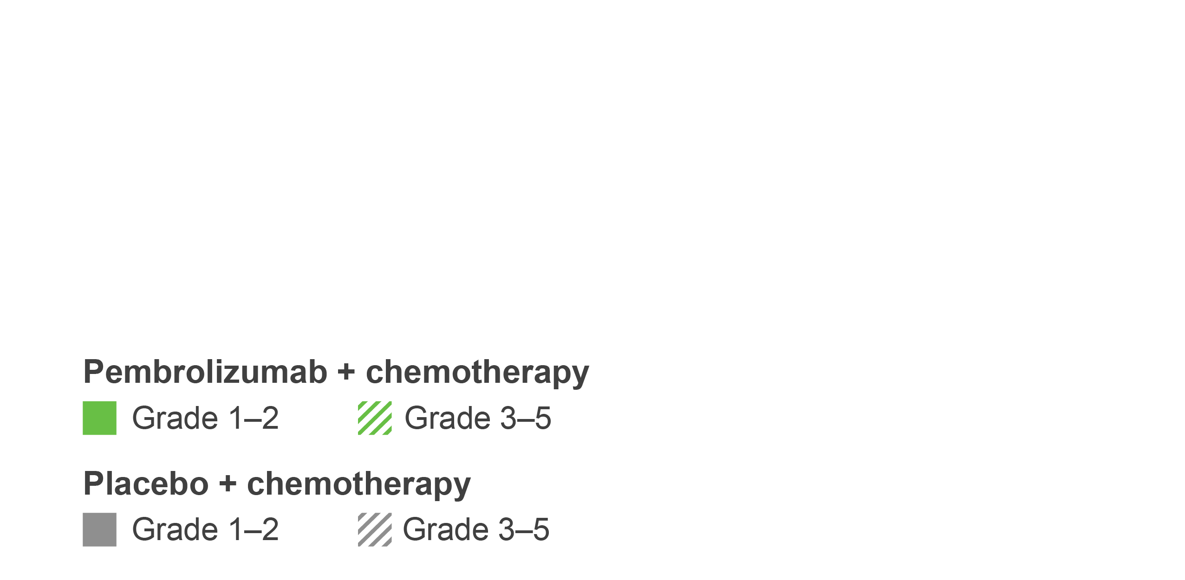
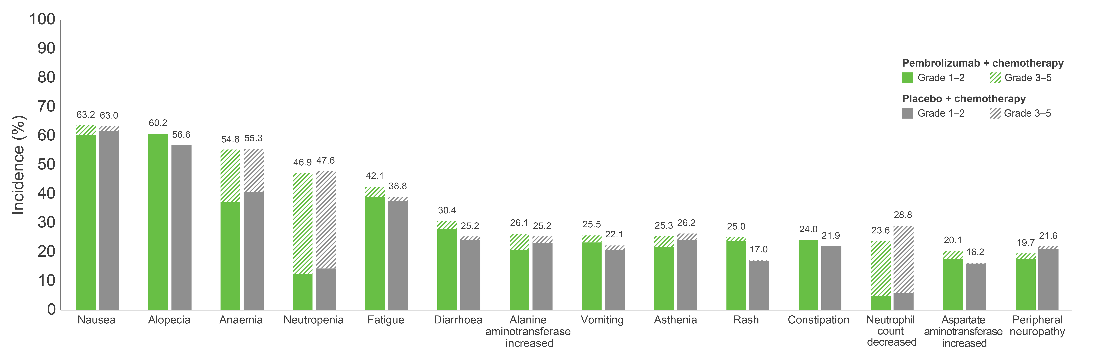
KEYNOTE-522: Summary of any-grade TRAEs occurring in ≥20% of patients in the combined neoadjuvant and adjuvant phases at 75-month follow up^{1,2}
All TRAEs | KEYTRUDA + chemotherapy/ KEYTRUDA (n=783) | Placebo + chemotherapy/ placebo (n=389)
Any grade, n (%) | 774 (98.9) | 388 (99.7)
Grade 3–5, n (%) | 604 (77.1) | 285 (73.3)
Death, n (%) | 4 (0.5)ª | 1 (0.3)^{b}
Serious TRAE, % | 34.1 | 20.1
Discontinuation of any drug, % | 27.6 | 14.1
The tabular data for this plot is shown in the appendix. Click here to view.
Adapted from Schmid P et al. Presented at ESMO 2024.¹
Data cut-off: 22 March 2024. AEs were assessed during each phase of the study, as well as the study as a whole. Listed are AEs that occurred during the treatment period or within 30 days after the treatment period (or, for serious AEs, within 90 days) in patients who were randomised and received at least one trial drug or surgery. The severity of the AEs was graded according to the Common Terminology Criteria for Adverse Events v4.0 of the National Cancer Institute. Patients may have had more than one event.
ªGrade 5 AEs in the KEYTRUDA + chemotherapy arm were sepsis and multiple organ dysfunction syndrome (n=1) and pneumonitis, pulmonary embolism and autoimmune encephalitis (n=1 in each group); ^{b}Grade 5 AEs in the placebo + chemotherapy arm were septic shock (n=1). AE, adverse event; TRAE, treatment-related adverse event. 1. Schmid P et al. Presented at the European Society of Medical Oncology Congress 2024, 13–17 September, Barcelona, Spain;
2. Schmid P et al. N Engl J Med 2024; doi:10.1056/NEJMoa2409932 [Epub ahead of print].
UK Prescribing Information

Slide 41
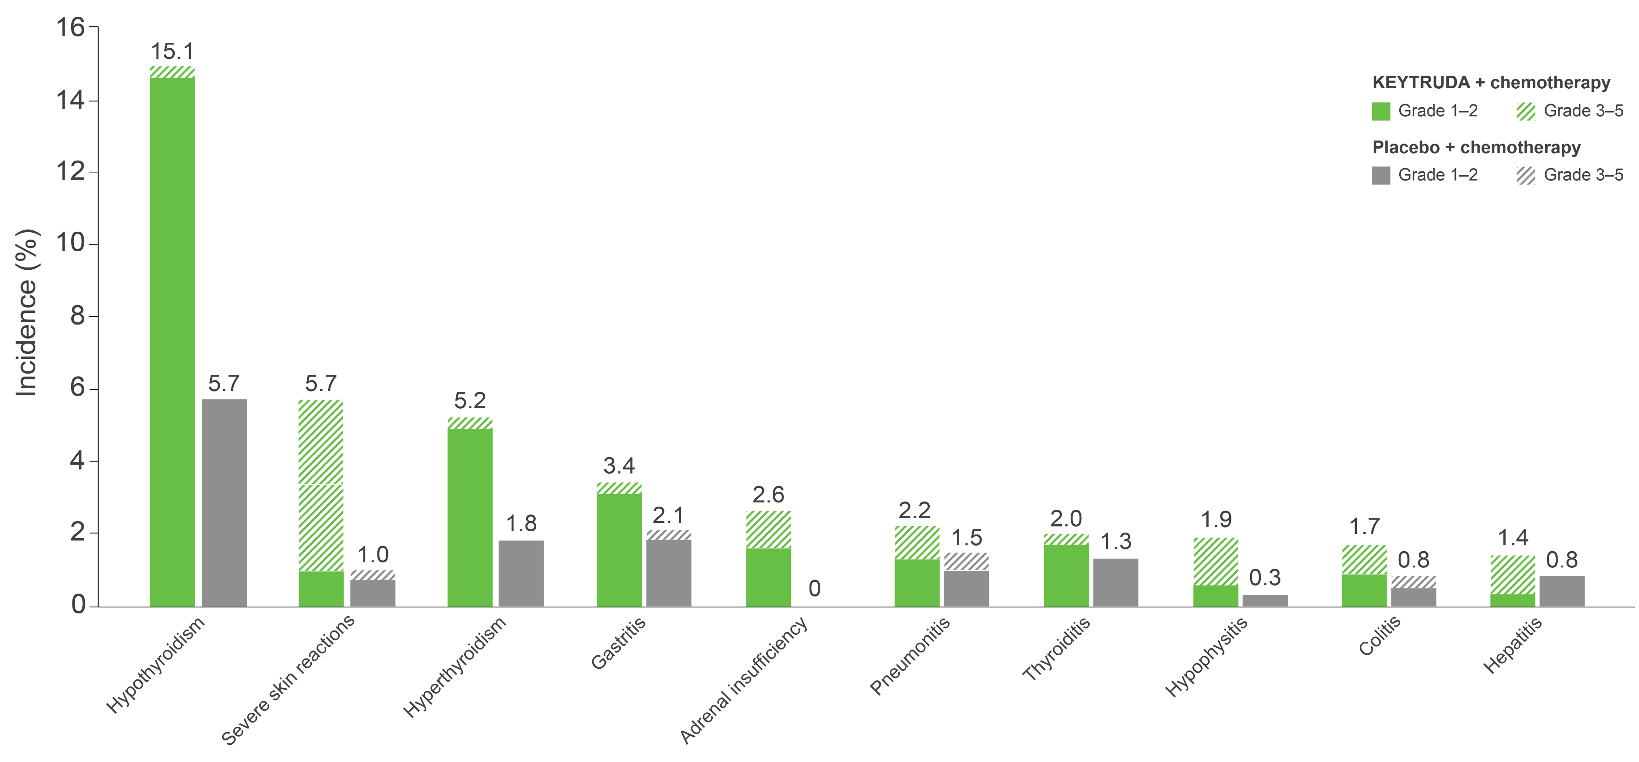
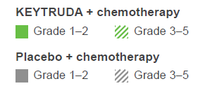
KEYNOTE-522: Summary of immune-mediated AEs occurring in ≥10 patients in the combined neoadjuvant and adjuvant phases at 75-month follow up^{1,2}
All immune-mediated AEs | KEYTRUDA + chemotherapy/ KEYTRUDA (n=783) | Placebo + chemotherapy/ placebo (n=389)
Any grade, n (%) | 274 (35.0) | 51 (13.1)
Grade 3–5, n (%) | 102 (13.0) | 6 (1.5)
Death, n (%) | 2 (0.3)ª | 0 (0)
Discontinuation of any drug, % | 7.7 | 1.0
Adapted from Schmid P et al. Presented at ESMO 2024.¹
The tabular data for this plot is shown in the appendix. Click here to view.
Data cut-off: 22 March 2024. Data presented for AEs experienced by ≥10 patients.
ªOne patient from pneumonitis and one patient from autoimmune encephalitis. Considered regardless of attribution to treatment or immune-relatedness by the investigator. Related terms included in addition to preferred terms listed. AE, adverse event. 1. Schmid P et al. Presented at the European Society of Medical Oncology Congress 2024, 13–17 September, Barcelona, Spain;
2. Schmid P et al. N Engl J Med 2024; doi:10.1056/NEJMoa2409932 [Epub ahead of print].
UK Prescribing Information

Slide 42
Implementing KEYTRUDA + chemotherapy for early-stage TNBC
Click the links below to navigate to the section of interest
KEYTRUDA dosing in KEYNOTE-522
KEYTRUDA offers flexibility of dosing
TNBC, triple-negative breast cancer.
UK Prescribing Information

Slide 43





KEYTRUDA dosing in KEYNOTE-522
First neoadjuvant phase¹
Patients should be treated with KEYTRUDA until disease progression or unacceptable toxicity³
Atypical responses (i.e. an initial transient increase in tumour size or new small lesions within the first few months, followed by tumour shrinkage) have been observed³
It is recommended to continue treatment in clinically stable patients with initial evidence of disease progression until disease progression is confirmed³
No dose reductions of KEYTRUDA are recommended. KEYTRUDA should be withheld or discontinued to manage AEs as described within the SmPC³
When administering KEYTRUDA in combination with IV chemotherapy, KEYTRUDA should be administered first³
Consult the full KEYTRUDA SmPC for guidance on dosing
200 mg KEYTRUDA + paclitaxelª and carboplatin^{b}
Q3W up to 12 weeks
Second neoadjuvant phase¹
200 mg KEYTRUDA + doxorubicin^{c} or epirubicin^{d} and cyclophosphamide^{e}
Q3W up to 12 weeks
Adjuvant cycle²
200 mg KEYTRUDA monotherapy (radiation therapy concurrently or 2 weeks prior to adjuvant KEYTRUDA)
Q3W up to 27 weeks
ª80 mg/m² QW; ^{b}AUC of 5 mg/mm/min Q3W or 1.5 mg/mm/min QW; ^{c}60 mg/m² Q3W; ^{d}90 mg/m² Q3W; ^{e}600 mg/m² Q3W. AE, adverse event; AUC, area under the curve; IV, intravenous; Q3W, every 3 weeks; QW, once weekly; SmPC, Summary of Product Characteristics. 1. Schmid P et al. N Engl J Med 2020;382:810–821; 2. Schmid P et al. N Engl J Med 2022;386:556–567; 3. KEYTRUDA (pembrolizumab) Summary of Product Characteristics. Available at: https://www.medicines.org.uk/emc/product/2498/smpc. Accessed August 2025.
UK Prescribing Information

Slide 44

KEYTRUDA offers flexibility of dosing
Patients should be treated with KEYTRUDA until disease progression or unacceptable toxicity.
Atypical responses (i.e. an initial transient increase in tumour size or new small lesions within the first few months, followed by tumour shrinkage) have been observed.
It is recommended to continue treatment in clinically stable patients with suspected disease progression until disease progression is confirmed.
No dose reductions of KEYTRUDA are recommended. KEYTRUDA should be withheld or discontinued to manage AEs as described within the SmPC.
When administering KEYTRUDA in combination with IV chemotherapy, KEYTRUDA should be administered first.
Consult the full KEYTRUDA SmPC for guidance on dosing.
KEYTRUDA dosing:
Administered as an IV infusion
Over 30 minutes
200 mg Q3W or 400 mg Q6W
The KEYTRUDA 200 mg Q3W regimen has been assessed in Phase 2 and Phase 3 registration studies across a multitude of indications. An exposure–response evaluation (using modelling and simulation) led to the approval of the 400 mg Q6W dosing for monotherapy and combination therapy.
AE, adverse event; IV, intravenous; Q3W, every 3 weeks; Q6W, every 6 weeks; SmPC, Summary of Product Characteristics. KEYTRUDA (pembrolizumab) Summary of Product Characteristics. Available at: https://www.medicines.org.uk/emc/product/2498/smpc. Accessed August 2025.
UK Prescribing Information

Slide 45
KEYNOTE-522: Summary
Click the links below to navigate to the section of interest
Summary: Efficacy
Summary: Safety
UK Prescribing Information

Slide 46

Summary: Efficacy (1)
KEYTRUDA, in combination with chemotherapy as neoadjuvant treatment, and then continued as monotherapy as adjuvant treatment after surgery, is indicated in the treatment of adults with locally advanced or early-stage TNBC at high risk of recurrence¹
There was a statistically significant improvement in pCR rates with KEYTRUDA + chemotherapy (neoadjuvant treatment) vs placebo + chemotherapy (neoadjuvant treatment) in the primary analysis (64.8% vs 51.2%, respectively; p<0.001) and in the prespecified final analysis of KEYNOTE-522 (64.0% vs 54.7%, respectively; p=0.00221)¹
KEYTRUDA + chemotherapy in the neoadjuvant setting, followed by KEYTRUDA monotherapy as adjuvant treatment, resulted in a statistically significant improvement in EFS compared with placebo + chemotherapy followed by placebo at the 36-month analysis (HR: 0.63; 95% CI: 0.48–0.82 [p<0.001])^{a,b,2} and numerically higher EFS at 75-month follow up (HR: 0.65; 95% CI: 0.51–0.83)^{a,3}
At 36- and 75-month follow up, the percentage of patients who experienced an event were 15.7% and 20.3% in the KEYTRUDA + chemotherapy group and 23.8% and 29.2% in the placebo + chemotherapy group, respectively^{2,3}
An exploratory analysis of EFS in key subgroups, including disease stage, nodal status and T2N0 status, suggested a benefit for patients treated with KEYTRUDA + chemotherapy vs placebo + chemotherapy^{2,4,5}
ªHR (CI) analysed based on a Cox regression model with treatment as a covariate stratified by the randomisation stratification factors; ^{b}Prespecified p-value boundary of 0.00517 was crossed. CI, confidence interval; EFS, event-free survival; HR, hazard ratio; pCR, pathologic complete response; TNBC, triple-negative breast cancer. 1. KEYTRUDA (pembrolizumab) Summary of Product Characteristics. Available at: https://www.medicines.org.uk/emc/product/2498/smpc. Accessed August 2025; 2. Schmid P et al. N Engl J Med 2022;386:556–567; 3. Schmid P et al. Presented at the European Society of Medical Oncology Congress 2024, 13–17 September, Barcelona, Spain; 4. Schmid P et al. Presented at the San Antonio Breast Cancer Symposium (SABCS) Congress 2023, 5–9 December, San Antonio, USA; 5. Schmid P et al. Presented at the European Society of Medical Oncology Congress 2023, 20–24 September, Madrid, Spain.
UK Prescribing Information

Slide 47
Summary: Efficacy (2)
KEYTRUDA, in combination with chemotherapy as neoadjuvant treatment, and then continued as monotherapy as adjuvant treatment after surgery, is indicated in the treatment of adults with locally advanced or early-stage TNBC at high risk of recurrence¹
An exploratory analysis of EFS by pCR (ypT0/Tis ypN0) suggested a benefit for KEYTRUDA + chemotherapy vs placebo + chemotherapy regardless of pCR outcome at 36 months of follow up, with the difference maintained at 60 months of follow up²
KEYTRUDA + chemotherapy in the neoadjuvant setting, followed by KEYTRUDA monotherapy as adjuvant treatment, resulted in a statistically significant and clinically meaningful improvement in OS (key secondary endpoint) at 75-month follow up (HR: 0.66; 95% CI: 0.50–0.87 [p=0.00150])ª compared with neoadjuvant placebo + chemotherapy followed by placebo in patients with previously untreated, high-risk, early-stage TNBC³
OS was numerically higher for patients treated with KEYTRUDA + chemotherapy vs placebo + chemotherapy in an exploratory analysis of key subgroups, including nodal status, tumour size T1/T2 vs T3/T4 and patients with baseline T2N0 disease^{3,4}
ªWith 200 events (67.3% information fraction), the observed p-value crossed the prespecified nominal boundary of 0.00503 (one-sided) at this interim analysis. CI, confidence interval; EFS, event-free survival; HR, hazard ratio; OS, overall survival; pCR, pathologic complete response; TNBC, triple-negative breast cancer. 1. KEYTRUDA (pembrolizumab) Summary of Product Characteristics. Available at: https://www.medicines.org.uk/emc/product/2498/smpc. Accessed August 2025; 2. Schmid P et al. Presented at the European Society of Medical Oncology Congress 2023, 20–24 September, Madrid, Spain; 3. Schmid P et al. Presented at the European Society of Medical Oncology Congress 2024, 13–17 September, Barcelona, Spain; 4. Dent R et al. Presented at the San Antonio Breast Cancer Symposium 2024, 10–13 December, San Antonio, USA.
UK Prescribing Information

Slide 48
Summary: Safety
KEYTRUDA, in combination with chemotherapy as neoadjuvant treatment, and then continued as monotherapy as adjuvant treatment after surgery, is indicated in the treatment of adults with locally advanced or early-stage TNBC at high risk of recurrence¹
The safety data for KEYTRUDA + chemotherapy as neoadjuvant treatment, followed by KEYTRUDA monotherapy as adjuvant treatment, are consistent with the known AE profiles of each regimen, being generally manageable in both phases^{2–4}
No indication-specific immune-mediated AEs were identified at the 36-month analysis⁴
Most immune-mediated AEs and infusion reactions were Grade 1–2 in severity, manageable with corticosteroids, treatment interruption and/or hormone replacement, and did not result in treatment discontinuation⁴
The safety profile remained consistent with the previous analyses and the established safety profiles of KEYTRUDA + chemotherapy.⁵ No new safety concerns were identified with longer follow up (75 months)
AE, adverse event; TNBC, triple-negative breast cancer. 1. KEYTRUDA (pembrolizumab) Summary of Product Characteristics. Available at: https://www.medicines.org.uk/emc/product/2498/smpc. Accessed August 2025; 2. Schmid P et al. N Engl J Med 2022;386:556–567; 3. Schmid P et al. N Engl J Med 2020;382:810–821; 4. Cortés J et al. Presented at the San Antonio Breast Cancer Symposium Congress 2023, 5–9 December, San Antonio, USA; 5. Schmid P et al. Presented at the European Society of Medical Oncology Congress 2024, 13–17 September, Barcelona, Spain.
UK Prescribing Information

Slide 49
Appendix
Click the links below to navigate to the section of interest
Efficacy
Safety
EFS by RCB category
Summary of any-grade AEs in the neoadjuvant phase (primary analysis)
Immune-mediated AEs and infusion reactions in the adjuvant phase (36-month follow up)
First EFS events by RCB category
AEs of interest in the neoadjuvant phase (1/2) (primary analysis)
Any-grade AEs in the combined phase (75-month follow up)
pCR by PD-L1 expression level
AEs of interest in the neoadjuvant phase (2/2) (primary analysis)
Immune-mediated AEs in the combined phase (75-month follow up)
TRAEs in the adjuvant phase
(36-month follow up)
AE, adverse event; EFS, event-free survival; pCR, pathologic complete response; PD-L1, programmed death ligand-1; RCB, residual cancer burden; TRAE, treatment-related adverse event.
UK Prescribing Information

Slide 50
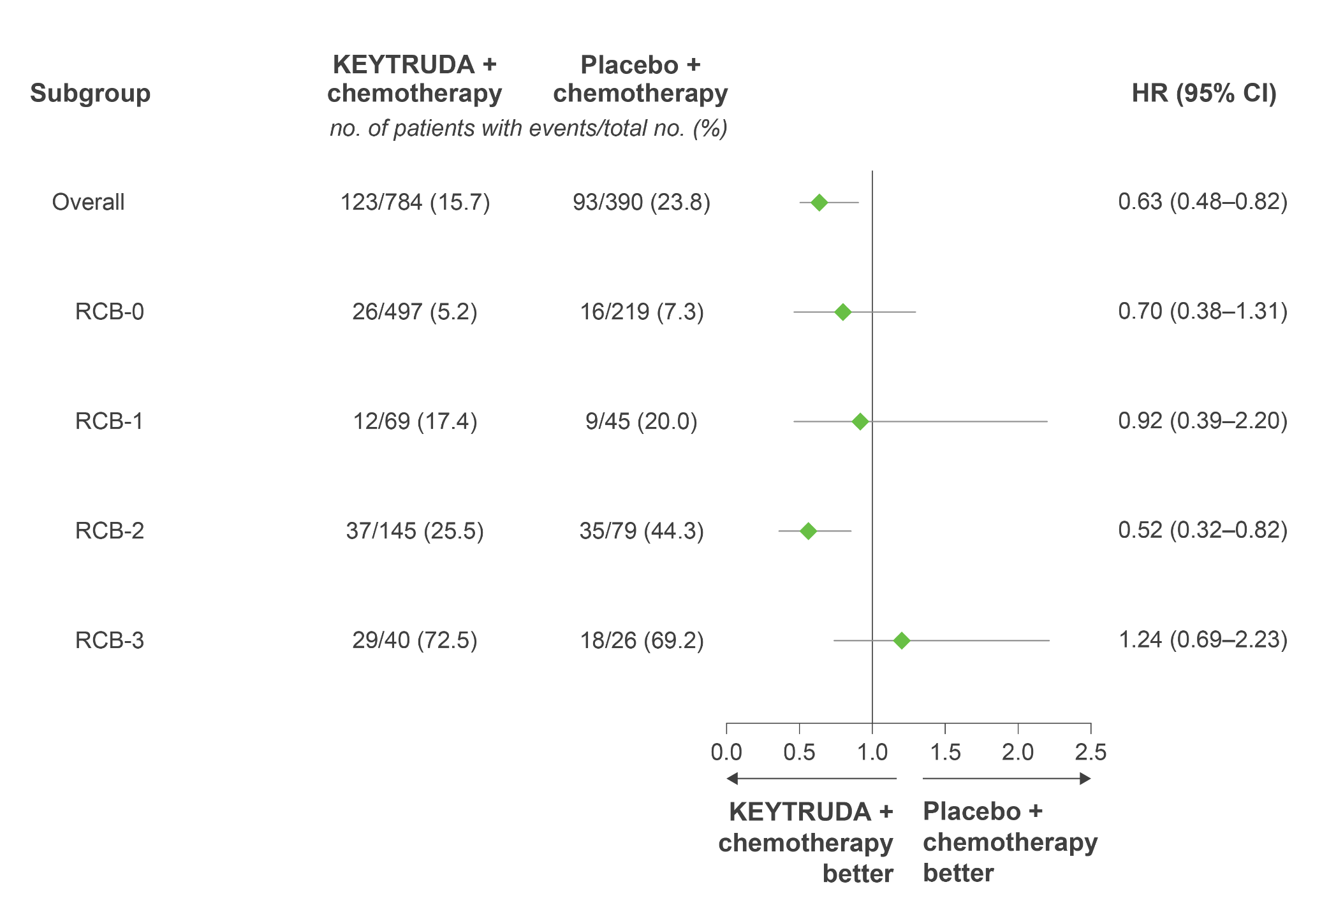
KEYNOTE-522: Exploratory analysis – EFS by RCB category
Adapted from Pusztai L et al. Presented at ASCO 2022.
This was an exploratory analysis; significance was not tested and no statistical conclusions can be drawn
Data cut-off: 23 March 2021.
EFS in the overall population is based on a stratified Cox model; EFS by RCB is based on an unstratified Cox model. CI, confidence interval; EFS, event-free survival; HR, hazard ratio; RCB, residual cancer burden. Pusztai L et al. Presented at the American Society of Clinical Oncology (ASCO) Annual Meeting 2022, 3–7 June, Chicago, USA.
UK Prescribing Information

Slide 51
KEYNOTE-522: Exploratory analysis – First EFS events by RCB category
Event, % | RCB-0 |  | RCB-1 |  | RCB-2 |  | RCB-3
 | KEYTRUDA + chemo (n=497) | Placebo + chemo (n=219) | KEYTRUDA + chemo (n=69) | Placebo + chemo (n=45) | KEYTRUDA + chemo (n=145) | Placebo + chemo (n=79) | KEYTRUDA + chemo (n=40) | Placebo + chemo (n=26)
Any EFS event | 5.2 | 7.3 | 17.4 | 20.0 | 25.5 | 44.3 | 72.5 | 69.2
Secondary primary malignancy | 0.2 | 0 | 1.4 | 2.2 | 1.4 | 3.8 | 2.5 | 0
PD precluded definitive surgery | 0 | 0 | 1.4 | 2.2 | 1.4 | 5.1 | 10.0 | 7.7
Local recurrence | 0.6 | 1.4 | 4.3 | 6.7 | 6.9 | 8.9 | 25.0 | 7.7
Distant recurrence | 3.2 | 5.5 | 8.7 | 8.9 | 15.2 | 22.8 | 35.0 | 53.8
Death | 1.2 | 0.5 | 1.4 | 0 | 0.7 | 3.8 | 0 | 0
Adapted from Pusztai L et al. Presented at ASCO 2022.
Data cut-off: 23 March 2021.
The treatment regimen in each arm included chemotherapy. Among all patients (N=1174), 54 (4.6%) patients had missing RCB categorical data: 33 (4.2%) in the KEYTRUDA + chemotherapy group and 21 (5.4%) in the placebo + chemotherapy group. EFS, event-free survival; PD, progressive disease; RCB, residual cancer burden. Pusztai L et al. Presented at the American Society of Clinical Oncology (ASCO) Annual Meeting 2022, 3–7 June, Chicago, USA.
UK Prescribing Information

Slide 52
KEYNOTE-522: Exploratory analysis – pCR by PD-L1 expression level
Similar pCRª benefits were observed in PD-L1–positive and PD-L1–negative patients treated with KEYTRUDA + chemotherapy
Δ18.5%
(5.0–32.7)
Δ17.5% (6.2–29.1)
Δ14.2%
(5.3–23.1)
Δ18.3%
(−3.3–36.8)
29/64
10/33
230/334
90/164
162/208
55/92
103/126
40/64
Adapted from Schmid P et al. Presented at SABCS 2019.
Data cut-off: 24 September 2018.
ªEstimated treatment difference based on Miettinen and Nurminen method stratified by nodal status (+ vs −), tumour size (T1/T2 vs T3/T4) and frequency of carboplatin administration (Q3W vs QW).
CI, confidence interval; CPS, combined positive score; pCR, pathologic complete response; PD-L1, programmed death ligand-1; Q3W, once every three weeks; QW, once weekly.
Schmid P et al. Presented at the San Antonio Breast Cancer Symposium 2019, 11–14 December, San Antonio, USA.
This was an exploratory analysis; significance was not tested and no statistical conclusions can be drawn
UK Prescribing Information

Slide 53
KEYNOTE-522: Summary of any-grade AEs occurring in ≥20% of patients in the neoadjuvant phase at primary analysis
AE, n (%) | KEYTRUDA + chemotherapy (n=781) |  | Placebo + chemotherapy (n=389)
 | Any grade | Grade ≥3 | Any grade | Grade ≥3
Any AE | 777 (99.2) | 633 (81.0) | 389 (100.0) | 295 (75.8)
Treatment-related AEª | 773 (99.0) | 600 (76.8) | 388 (99.7) | 281 (72.2)
Nausea | 490 (62.7) | 26 (3.3) | 246 (63.2) | 5 (1.3)
Alopecia | 471 (60.3) | 14 (1.8) | 220 (56.6) | 8 (2.1)
Anaemia | 430 (55.1) | 142 (18.2) | 215 (55.3) | 58 (14.9)
Neutropenia | 365 (46.7) | 270 (34.6) | 183 (47.0) | 129 (33.2)
Fatigue | 321 (41.1) | 27 (3.5) | 147 (37.8) | 6 (1.5)
Diarrhoea | 230 (29.4) | 17 (2.2) | 92 (23.7) | 5 (1.3)
Alanine aminotransferase increased | 199 (25.5) | 41 (5.2) | 96 (24.7) | 9 (2.3)
Vomiting | 199 (25.5) | 18 (2.3) | 85 (21.9) | 6 (1.5)
Asthenia | 191 (24.5) | 25 (3.2) | 99 (25.4) | 9 (2.3)
Constipation | 185 (23.7) | 0 | 82 (21.1) | 0
Decreased neutrophil count | 185 (23.7) | 146 (18.7) | 112 (28.8) | 90 (23.1)
Rash | 170 (21.8) | 7 (0.9) | 59 (15.2) | 1 (0.3)
Peripheral neuropathy | 154 (19.7) | 15 (1.9) | 82 (21.1) | 4 (1.0)
Adapted from Schmid P et al. 2020.
Listed are AEs that occurred during the treatment period or within 30 days after the treatment period (or, for serious AEs, within 90 days) in patients who were randomised and received at least one trial drug or surgery. The severity of the AEs was graded according to the Common Terminology Criteria for Adverse Events, v4.0, of the National Cancer Institute. Patients may have had more than one event. AE, adverse event. Schmid P et al. N Engl J Med 2020;382:810–821.
UK Prescribing Information

Slide 54
KEYNOTE-522: AEs of interest in the neoadjuvant phase at primary analysis (1/2)
AE, n (%) | KEYTRUDA + chemotherapy (n=781) |  | Placebo + chemotherapy (n=389)
 | Any grade | Grade ≥3 | Any grade | Grade ≥3
Any AE | 777 (99.5) | 633 (81.0) | 389 (100.0) | 295 (75.8)
Treatment-related AEª | 773 (99.0) | 600 (76.8) | 388 (99.7) | 281 (72.2)
AE of interest^{b} | 304 (38.9) | 101 (12.9) | 71 (18.3) | 7 (1.8)
Infusion reaction | 132 (16.9) | 20 (2.6) | 43 (11.1) | 4 (1.0)
Hypothyroidism | 107 (13.7) | 3 (0.4) | 13 (3.3) | 0
Hyperthyroidism | 36 (4.6) | 2 (0.3) | 4 (1.0) | 0
Severe skin reaction | 34 (4.4) | 30 (3.8) | 4 (1.0) | 1 (0.3)
Adrenal insufficiency | 18 (2.3) | 10 (1.3) | 0 | 0
Hypophysitis | 14 (1.8) | 8 (1.0) | 1 (0.3) | 0
Colitis | 13 (1.7) | 7 (0.9) | 3 (0.8) | 1 (0.3)
Thyroiditis | 13 (1.7) | 2 (0.3) | 3 (0.8) | 0
Hepatitis | 11 (1.4) | 9 (1.2) | 2 (0.5) | 0
Adapted from Schmid P et al. 2020.
Listed are AEs that occurred during the treatment period or within 30 days after the treatment period (or, for serious AEs, within 90 days) in patients who underwent randomisation and received at least one trial drug or surgery. The severity of the AEs was graded according to the Common Terminology Criteria for Adverse Events, v4.0, of the National Cancer Institute. Patients may have had more than one event. ªTreatment-related AEs were events occurring in ≥20% of patients or considered medically relevant by the investigator; ^{b}AEs of interest were determined according to a list of terms specified by the sponsor, regardless of attribution to any trial treatment by the investigators. AE, adverse event. Schmid P et al. N Engl J Med 2020;382:810–821.
UK Prescribing Information

Slide 55
KEYNOTE-522: AEs of interest in the neoadjuvant phase at primary analysis (2/2)
AE, n (%) | KEYTRUDA + chemotherapy (n=781) |  | Placebo + chemotherapy (n=389)
 | Any grade | Grade ≥3 | Any grade | Grade ≥3
Any AE | 777 (99.5) | 633 (81.0) | 389 (100.0) | 295 (75.8)
Treatment-related AEª | 773 (99.0) | 600 (76.8) | 388 (99.7) | 281 (72.2)
AE of interest^{b} | 304 (38.9) | 101 (12.9) | 71 (18.3) | 7 (1.8)
Pneumonitis | 10 (1.3) | 3 (0.4) | 5 (1.3) | 1 (0.3)
Nephritis | 7 (0.9) | 7 (0.9) | 0 | 0
Pancreatitis | 4 (0.5) | 4 (0.5) | 0 | 0
Myocarditis | 3 (0.4) | 2 (0.3) | 0 | 0
Myositis | 3 (0.4) | 0 | 0 | 0
Type 1 diabetes mellitus | 2 (0.3) | 2 (0.3) | 0 | 0
Uveitis | 2 (0.3) | 0 | 0 | 0
Encephalitis | 1 (0.1) | 1 (0.1) | 0 | 0
Sarcoidosis | 1 (0.1) | 0 | 0 | 0
Adapted from Schmid P et al. 2020.
Listed are AEs that occurred during the treatment period or within 30 days after the treatment period (or, for serious AEs, within 90 days) in patients who were randomised and received at least one trial drug or surgery. The severity of the AEs was graded according to the Common Terminology Criteria for Adverse Events, v4.0, of the National Cancer Institute. Patients may have had more than one event. ªTreatment-related AEs were events occurring in ≥20% of patients or considered medically relevant by the investigator; ^{b}AEs of interest were determined according to a list of terms specified by the sponsor, regardless of attribution to any trial treatment by the investigators. AE, adverse event. Schmid P et al. N Engl J Med 2020;382:810–821.
UK Prescribing Information

Slide 56
KEYNOTE-522: TRAEs occurring in ≥2% of patients in the adjuvant phase at 36-month follow up
AE, n (%)ª | KEYTRUDA + chemotherapy (n=588) | Placebo + chemotherapy (n=331)
Any grade | 316 | 286
Arthralgia | 50 (8.5) | 41 (6.9)
Rash | 35 (6.0) | 14 (2.4)
Pruritus | 30 (5.1) | 12 (2.1)
Asthenia | 27 (4.6) | 30 (5.1)
Diarrhoea | 24 (4.1) | 19 (3.3)
Fatigue | 20 (3.4) | 28 (4.8)
Aspartate aminotransferase increased | 17 (2.9) | 7 (1.2)
Hypothyroidism | 16 (2.7) | 19 (3.3)
Neutropenia | 16 (2.7) | 23 (3.9)
Alanine aminotransferase increased | 13 (2.2) | 11 (1.8)
Myalgia | 13 (2.2) | 7 (1.2)
Nausea | 13 (2.2) | 14 (2.4)
Dry mouth | 12 (2.0) | 5 (0.9)
Anaemia | 9 (1.5) | 16 (2.7)
Lymphopenia | 9 (1.5) | 14 (2.4)
Headache | 5 (0.9) | 14 (2.4)
Adapted from Schmid P et al. Presented at ESMO 2021.
Listed are AEs that occurred during the treatment period or within 30 days after the treatment period (or, for serious AEs, within 90 days) in patients who were randomised and received at least one trial drug or surgery. The severity of the AEs was graded according to the Common Terminology Criteria for Adverse Events, v4.0, of the National Cancer Institute. Patients may have had more than one event. ªn numbers for each AE have been calculated from provided percentages. AE, adverse event; TRAE, treatment-related adverse event. Schmid P et al. Presented at the European Society for Medical Oncology (ESMO) Virtual Plenary 2021, 16–21 September.
UK Prescribing Information

Slide 57
KEYNOTE-522: Immune-mediated AEs and infusion reactions in the adjuvant phase at 36-month follow upª
AE, n (%)^{b} | KEYTRUDA + chemotherapy (n=588) | Placebo + chemotherapy (n=331)
Any grade | 60 (10.2) | 35 (6.0)
Hypothyroidism | 17 (2.9) | 21 (3.6)
Infusion reactions | 11 (1.9) | 7 (1.2)
Severe skin reactions | 11 (1.9) | 0
Pneumonitis | 7 (1.2) | 4 (0.6)
Hyperthyroidism | 5 (0.9) | 4 (0.6)
Adrenal insufficiency | 3 (0.5) | 0
Colitis | 2 (0.3) | 0
Myocarditis | 2 (0.3) | 0
Adapted from Schmid P et al. Presented at ESMO 2021.
Listed are AEs that occurred during the treatment period or within 30 days after the treatment period (or, for serious AEs, within 90 days) in patients who were randomised and received at least one trial drug or surgery. The severity of the AEs was graded according to the Common Terminology Criteria for Adverse Events, v4.0, of the National Cancer Institute. Patients may have had more than one event. ªImmune-mediated AEs were considered regardless of attribution to treatment or immune-relatedness by the investigator; ^{b}n numbers for each AE have been calculated from provided percentages. AE, adverse event. Schmid P et al. Presented at the European Society for Medical Oncology (ESMO) Virtual Plenary 2021, 16–21 September.
UK Prescribing Information

Slide 58
KEYNOTE-522: Any-grade AEs in the combined neoadjuvant and adjuvant phases occurring in ≥20% of patients at 75-month follow up
AE, n (%) | KEYTRUDA + chemotherapy (n=783) |  | Placebo + chemotherapy (n=389)
 | Any grade | Grade ≥3 | Any grade | Grade ≥3
Any AE | 777 (99.2) | 645 (82.4) | 389 (100.0) | 306 (78.7)
TRAEª | 774 (98.9) | 604 (77.1) | 388 (99.7) | 285 (73.3)
Nausea | 495 (63.2) | 27 (3.4) | 245 (63.0) | 6 (1.5)
Alopecia | 471 (60.2) | 0 | 220 (56.6) | 0
Anaemia | 429 (54.8) | 141 (18.0) | 215 (55.3) | 58 (14.9)
Neutropenia | 367 (46.9) | 270 (34.5) | 185 (47.6) | 130 (33.4)
Fatigue | 330 (42.1) | 28 (3.6) | 151 (38.8) | 7 (1.8)
Diarrhoea | 238 (30.4) | 20 (2.6) | 98 (25.2) | 5 (1.3)
Alanine aminotransferase increased | 204 (26.1) | 43 (5.5) | 98 (25.2) | 9 (2.3)
Vomiting | 200 (25.5) | 19 (2.4) | 86 (22.1) | 6 (1.5)
Asthenia | 198 (25.3) | 28 (3.6) | 102 (26.2) | 9 (2.3)
Rash | 196 (25.0) | 12 (1.5) | 66 (17.0) | 1 (0.3)
Constipation | 188 (24.0) | 0 | 85 (21.9) | 0
Neutrophil count decreased | 185 (23.6) | 146 (18.6) | 112 (28.8) | 90 (23.1)
Aspartate aminotransferase increased | 157 (20.1) | 20 (2.6) | 63 (16.2) | 1 (0.3)
Peripheral neuropathy | 154 (19.7) | 15 (1.9) | 84 (21.6) | 4 (1.0)
Adapted from Schmid P et al. Presented at ESMO 2024.
Listed are AEs that occurred during the treatment period or within 30 days after the treatment period (or, for serious AEs, within 90 days) in patients who were randomised and received at least one trial drug, underwent surgery, or both. The severity of the AEs was graded according to the Common Terminology Criteria for Adverse Events, v4.0, of the National Cancer Institute. Patients may have had more than one event. ªGrade 5 TRAEs were sepsis and multiple organ dysfunction syndrome (n=1) and pneumonitis, pulmonary embolism and autoimmune encephalitis (n=1 in each group) in the KEYTRUDA + chemotherapy arm and septic shock (n=1) in the placebo + chemotherapy arm. AE, adverse event. Schmid P et al. N Engl J Med 2024; doi:10.1056/NEJMoa2409932 [Epub ahead of print].
UK Prescribing Information

Slide 59
KEYNOTE-522: Immune-mediated AEs occurring in patients in the combined neoadjuvant and adjuvant phases at 75-month follow up
AE, n (%) | KEYTRUDA + chemotherapy (n=783) |  | Placebo + chemotherapy (n=389)
 | Any grade | Grade ≥3 | Any grade | Grade ≥3
Any AE | 777 (99.2) | 645 (82.4) | 389 (100.0) | 306 (78.7)
TRAEª | 774 (98.9) | 604 (77.1) | 388 (99.7) | 285 (73.3)
Immune-mediated AE^{b} | 274 (35.0) | 102 (13.0) | 51 (13.1) | 6 (1.5)
Hypothyroidism | 118 (15.1) | 4 (0.5) | 22 (5.7) | 0
Severe skin reaction | 45 (5.7) | 37 (4.7) | 4 (1.0) | 1 (0.3)
Hyperthyroidism | 41 (5.2) | 2 (0.3) | 7 (1.8) | 0
Gastritis | 27 (3.4) | 2 (0.3) | 8 (2.1) | 1 (0.3)
Adrenal insufficiency | 20 (2.6) | 8 (1.0) | 0 | 0
Pneumonitis | 17 (2.2) | 7 (0.9) | 6 (1.5) | 2 (0.5)
Thyroiditis | 16 (2.0) | 2 (0.3) | 5 (1.3) | 0
Hypophysitis | 15 (1.9) | 10 (1.3) | 1 (0.3) | 0
Adapted from Schmid P et al. 2024.
Listed are AEs that occurred during, or 30 days after the treatment period (or, for serious AEs, within 90 days) in patients who were randomised and received ≥1 trial drug, underwent surgery, or both. The severity of the AEs was graded according to the Common Terminology Criteria for Adverse Events, v4.0, of the National Cancer Institute. Immune-mediated adverse events that occurred in ≥15
patients in either treatment group are reported. Patients may have had more than one event. ªGrade 5 TRAEs were sepsis and multiple organ dysfunction syndrome (n=1) and pneumonitis, pulmonary embolism and autoimmune encephalitis (n=1 in each group) in the KEYTRUDA + chemotherapy arm and septic shock (n=1) in the placebo + chemotherapy arm; ^{b}Immune-mediated AEs were determined according to a list of terms determined by the sponsor, regardless of attribution to any trial treatment by the investigators. Grade 5 immune-mediated AEs were pulmonary embolism and autoimmune encephalitis (n=1 each) in the KEYTRUDA + chemotherapy group. AE, adverse event. Schmid P et al. N Engl J Med 2024; doi:10.1056/NEJMoa2409932 [Epub ahead of print].
UK Prescribing Information

