Slide 1
KEYNOTE-522: Neoadjuvant KEYTRUDA® (pembrolizumab) + chemotherapy followed by adjuvant KEYTRUDA monotherapy in patients with triple-negative breast cancer (TNBC)
These slides are promotional and are provided to UK healthcare professionals as a data resource for personal education. To ensure compliance with all relevant codes and regulations, these slides must not be amended and should only be downloaded with the latest Prescribing Information. Prescribing Information and further safety information can be found in the footer of this slide.
Please refer to the full Summary of Product Characteristics for KEYTRUDA and patient-targeted
Risk Minimisation Materials before prescribing, to minimise the risk of treatment. Patients should also receive the Risk Minimisation Materials.
Adverse events should be reported. Reporting forms and information can be found at https://yellowcard.mhra.gov.uk/ (please note that the MHRA Yellow Card link will redirect you to an external website, for which MSD does not review or control the content) or search for MHRA Yellow Card in the
Google Play or Apple App Store. Adverse events should also be reported to Merck Sharp & Dohme (UK) Limited
(Tel: 020 8154 8000).
Please click the following link for the KEYTRUDA SmPC and Prescribing Information:
United Kingdom.
If using a downloaded version of this material, please ensure that you are accessing the most recent version
of the Prescribing Information.
Job code: GB-OBR-00218 Date of preparation: July 2026
Copyright © 2026 Merck & Co., Inc., Rahway, NJ, USA and its affiliates. All rights reserved.

Slide 2
Slide deck navigation
To access the navigation page, click the ‘Home’ icon
In the Appendix, click the ‘Return’ icon to return to the last viewed slide
The links in this slide deck may redirect you to third-party websites.
Please note that:
  MSD does not review or control the content of any third-party website
  MSD does not endorse and is not responsible for the accuracy, content, practices or standards of any third-party sources
UK Prescribing Information

Slide 3
Contents
Click the links below to navigate to the section of interest
  Heritage of KEYTRUDA and MoA with chemotherapy
  KEYNOTE-522: Study overview
  KEYNOTE-522:
  Results – Efficacy
  KEYNOTE-522:
  Results – Safety
  Implementing KEYTRUDA + chemotherapy for early-stage TNBC
  KEYNOTE-522:
  Summary
  Appendix
MoA, mechanism of action; TNBC, triple-negative breast cancer.
UK Prescribing Information

Slide 4
Heritage of KEYTRUDA and MoA with chemotherapy
Click the links below to navigate to the section of interest
  KEYTRUDA and chemotherapy:
  Two different mechanisms of action
  KEYTRUDA + chemotherapy licence in early-stage TNBC
  KEYTRUDA in the early-stage
  TNBC pathway
MoA, mechanism of action; TNBC, triple-negative breast cancer.
UK Prescribing Information

Slide 5
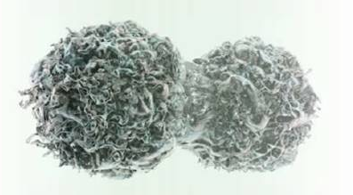
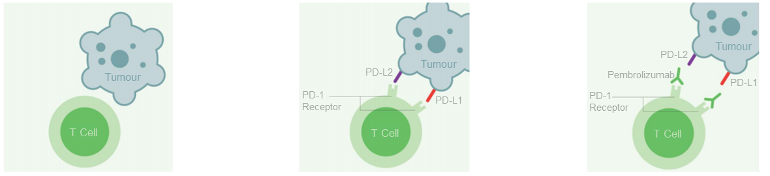
KEYTRUDA and chemotherapy: Two different mechanisms of action
Chemotherapy induces immunogenic cell death
KEYTRUDA activates the anti-tumour
immune response
Chemotherapy results in the immunogenic death of tumour cells, leading to the release of tumour antigens that can be recognised by the immune system¹
Chemotherapy has been shown to increase tumour expression of PD-L1²
PD-L1 (and PD-L2) on tumour cells bind to PD-1 on T cells
to prevent their activation, leading to immune evasion^{1,3}
KEYTRUDA is a humanised monoclonal antibody that binds to PD-1, blocking its interaction with PD-L1/-L2 and leading to activation of the anti-tumour response^{4,5}
When combined with immunotherapies such as KEYTRUDA, chemotherapy may increase tumour immunogenicity and
activate an immune response by increasing antigen shedding and presentation, and by stimulating T-cell infiltration²
PD-1, programmed death receptor-1; PD-L1, programmed death ligand-1; PD-L2, programmed death ligand-2.
1. Emens LA and Middleton G. Cancer Immunol Res 2015;3:436–443; 2. Bailly C et al. NAR Cancer 2020;2(1):zcaa002; 3. Yi M et al. J Hematol Oncol 2021;14:10;
4. KEYTRUDA (pembrolizumab) Summary of Product Characteristics. Available at: https://www.medicines.org.uk/emc/product/2498/smpc. Accessed August 2025;
5. Pardoll DM. Nat Rev Cancer 2012;12:252–264.
UK Prescribing Information

Slide 6
KEYTRUDA + chemotherapy licence in early-stage TNBC
KEYTRUDA, in combination with chemotherapy as neoadjuvant treatment, and then continued as monotherapy as adjuvant treatment after surgery, is indicated in the treatment of adults with locally advanced or early-stage TNBC at high risk of recurrence
TNBC, triple-negative breast cancer.
KEYTRUDA (pembrolizumab) Summary of Product Characteristics. Available at: https://www.medicines.org.uk/emc/product/2498/smpc. Accessed August 2025.
UK Prescribing Information

Slide 7
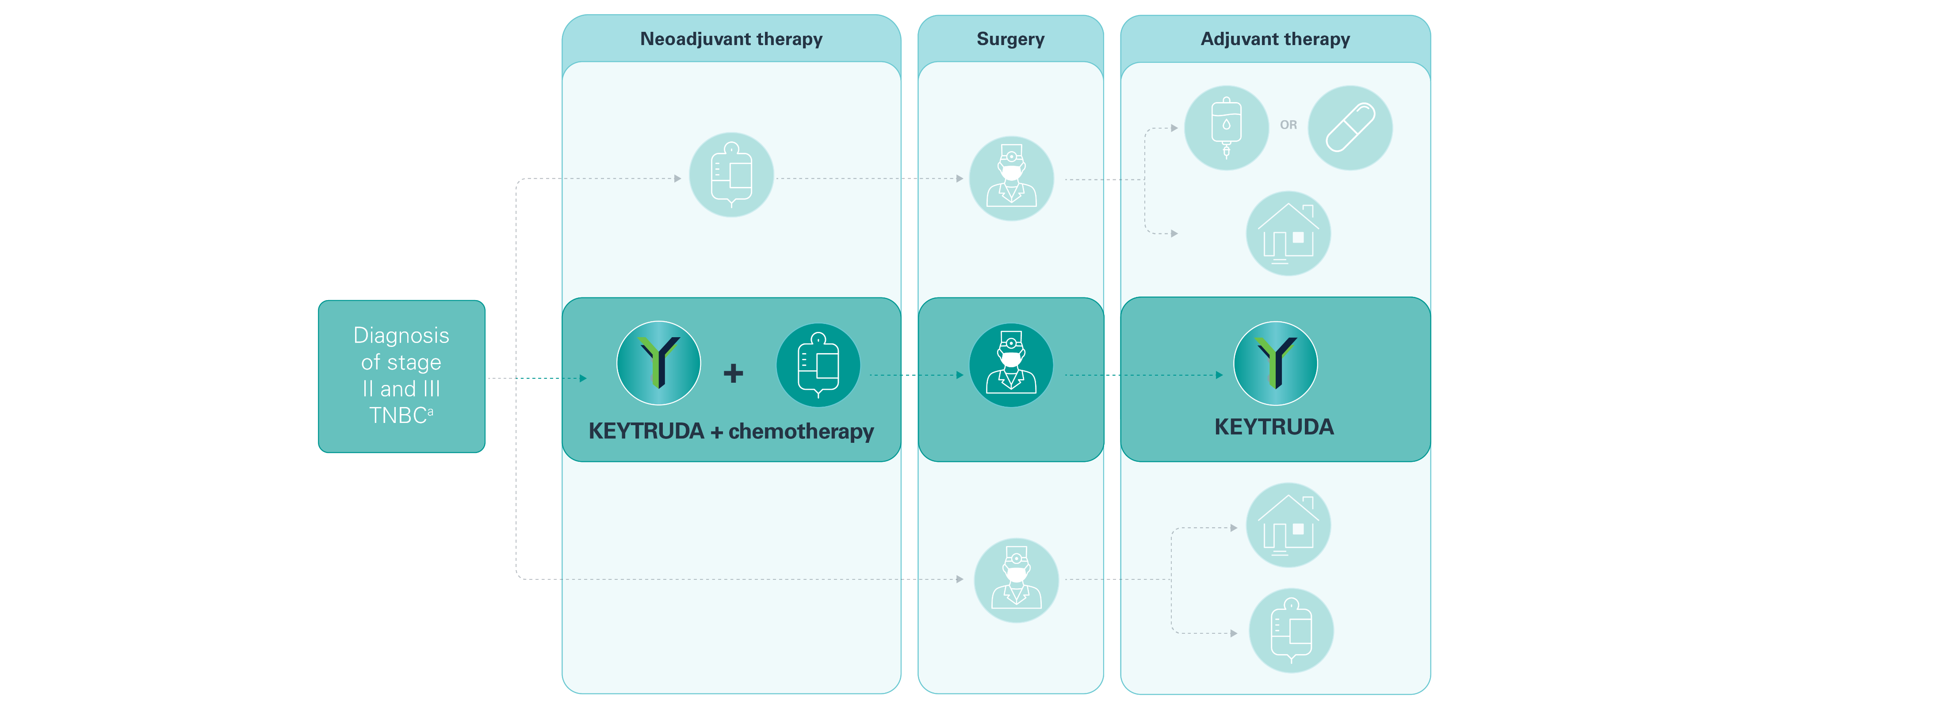

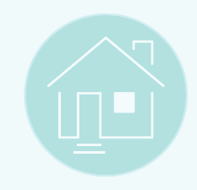

KEYTRUDA in the early-stage TNBC pathway^{1–4}
Neoadjuvant chemotherapy
Patient discharged for regular monitoring
Adjuvant chemotherapy
ªStage IIA, IIB, IIIA and IIIB early TNBC, and IIIC TNBC, as defined by the primary tumour-regional lymph node staging criteria of the AJCC (7th Edition).³
AJCC, American Joint Committee on Cancer; NICE, National Institute for Health and Care Excellence; TNBC, triple-negative breast cancer.
1. NICE. Early and locally advanced breast cancer: diagnosis and management. https://www.nice.org.uk/guidance/ng101/chapter/Recommendations. Accessed August 2025;
2. KEYTRUDA (pembrolizumab) Summary of Product Characteristics. Available at: https://www.medicines.org.uk/emc/product/2498/smpc. Accessed August 2025;
3. AJCC. AJCC Cancer Staging Manual. 7th ed. USA: Springer; 2010; 4. NICE. Technology appraisal guidance [TA851] December 2022. Available at:
https://www.nice.org.uk/guidance/ta851. Accessed August 2025.
UK Prescribing Information

Slide 8
KEYNOTE-522: Study overview
Click the links below to navigate to the section of interest
  Study design
  Primary endpoints
  Key patient characteristics
  Patient baseline characteristics
UK Prescribing Information

Slide 9
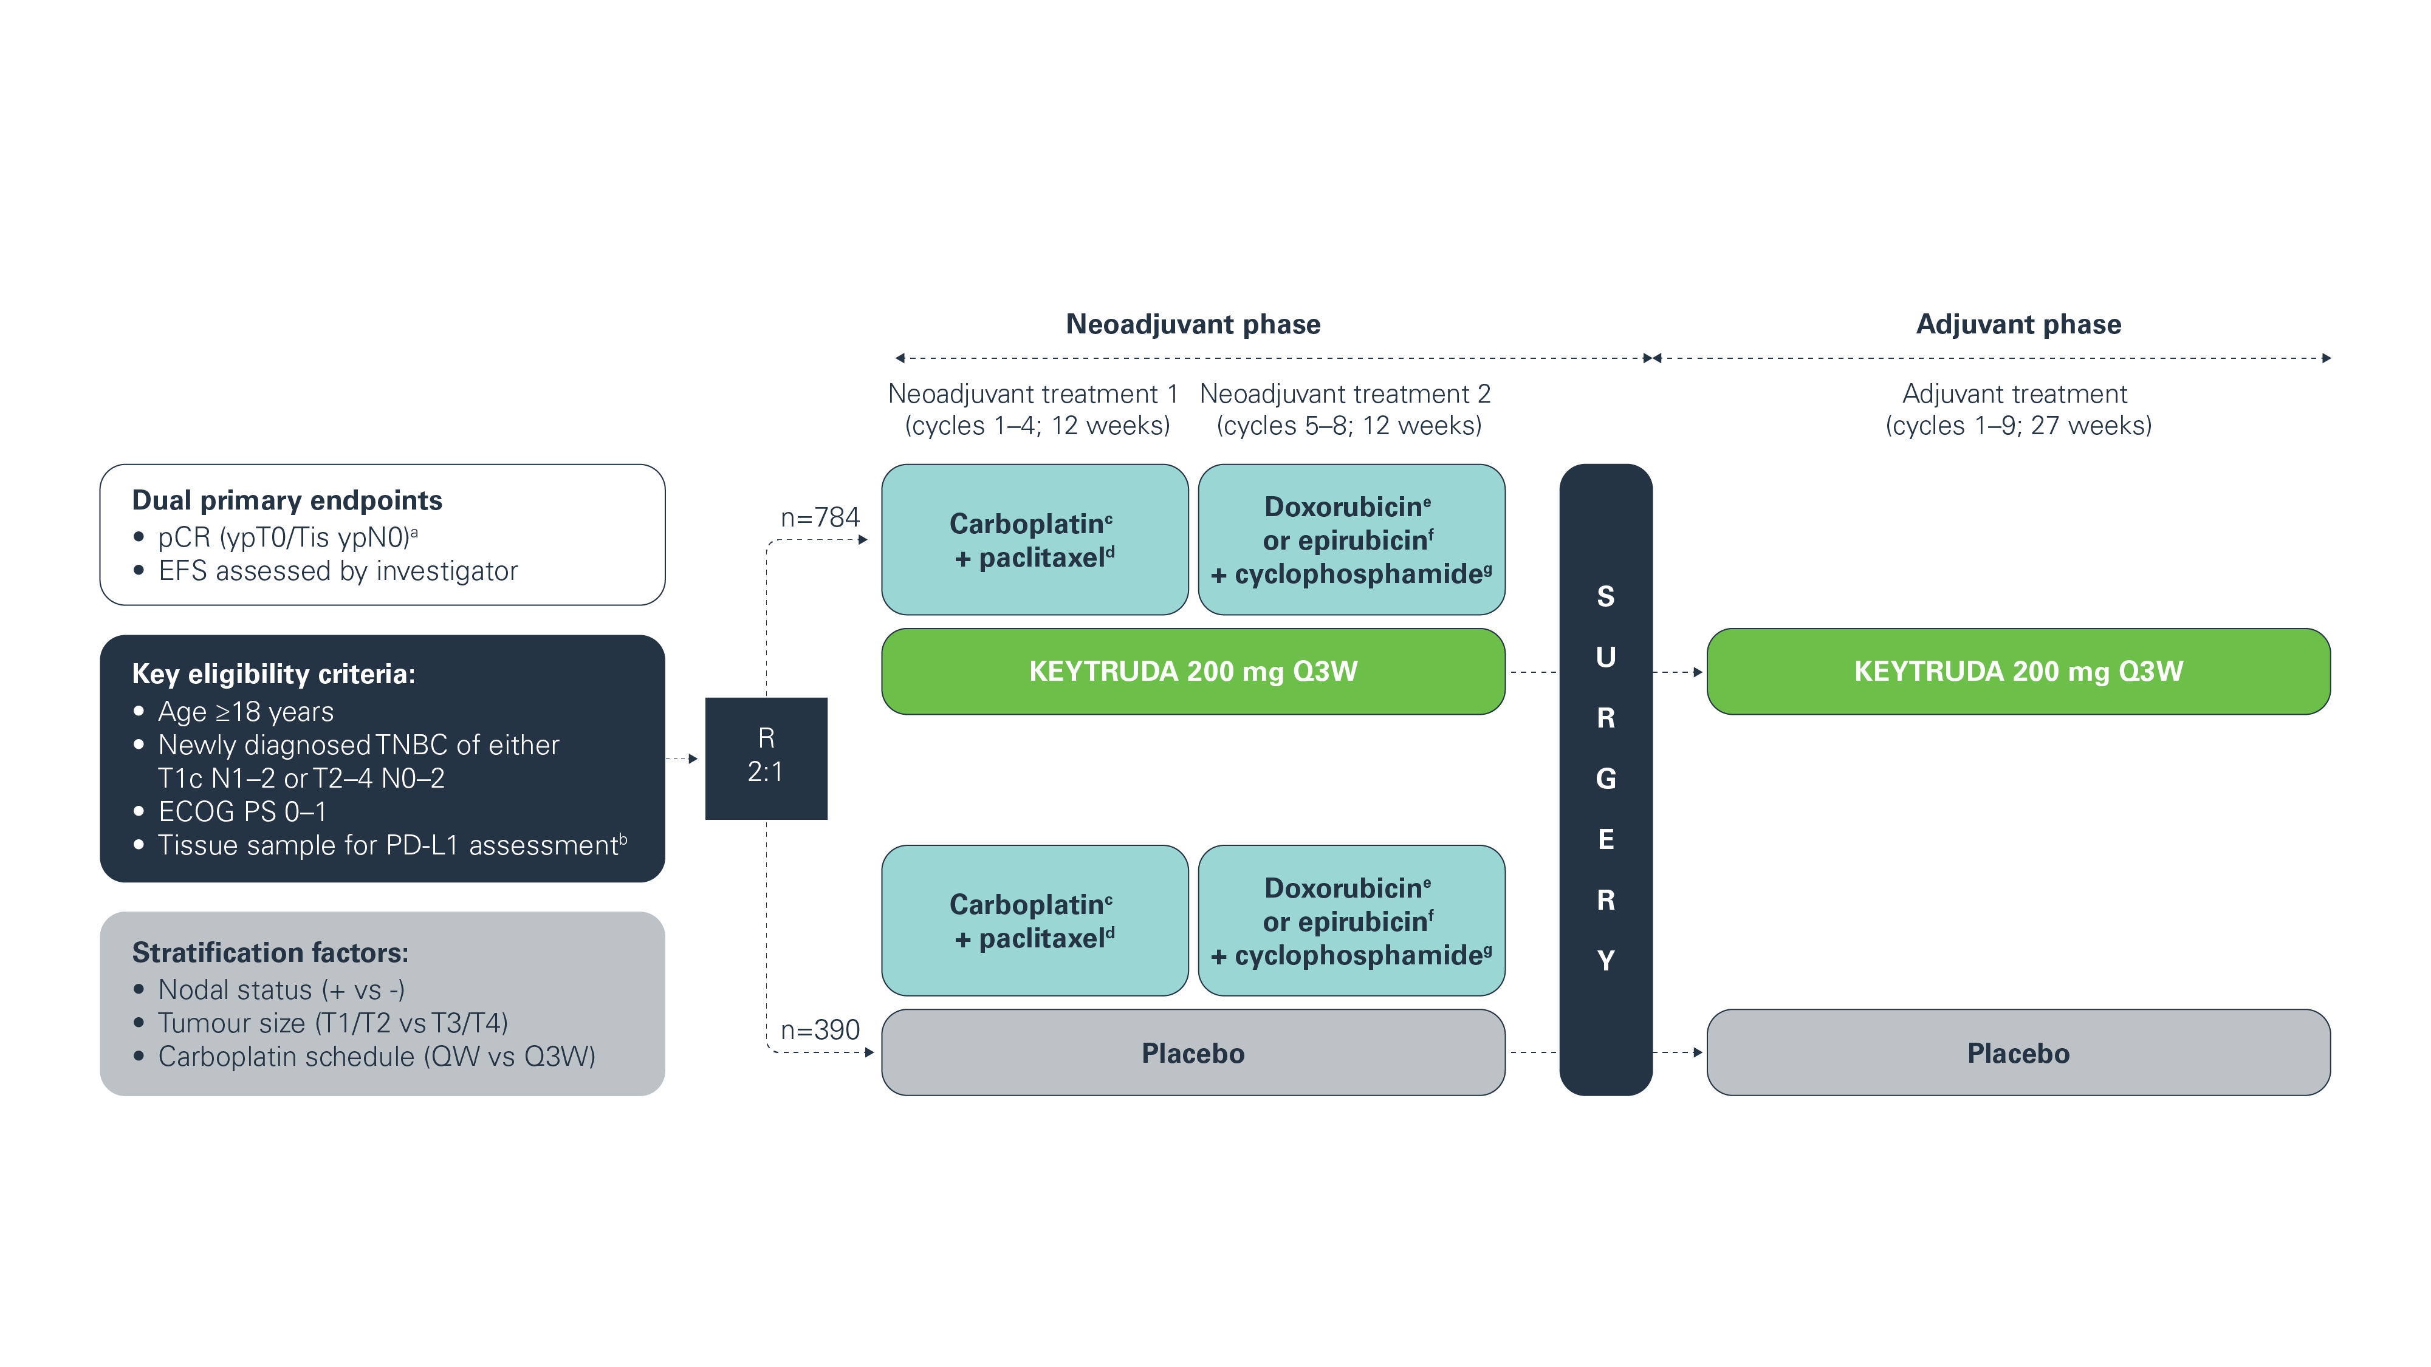
KEYNOTE-522: Study design^{1,2}
Adapted from Schmid P et al. 2020 and Schmid P et al. 2022.
AEs were assessed during each phase of the study, as well as the study as a whole.
ªBlinded assessment performed by local pathologist; ^{b}Must consist of at least two separate tumour cores from the primary tumour; ^{c}Carboplatin dose was AUC 5 Q3W or AUC 1.5 QW;
^{d}Paclitaxel dose was 80 mg/m² QW; ^{e}Doxorubicin dose was 60 mg/m² Q3W; ^{f}Epirubicin dose was 90 mg/m² Q3W; ^{g}Cyclophosphamide dose was 600 mg/m² Q3W.
AE, adverse event; AUC, area under the curve; ECOG PS, Eastern Cooperative Oncology Group performance status; EFS, event-free survival; pCR, pathologic complete response;
PD-L1, programmed death ligand-1; Q3W, every 3 weeks; QW, once a week; R, randomisation; TNBC, triple-negative breast cancer.
1. Schmid P et al. N Engl J Med 2020;382:810–821 (plus supplementary appendix); 2. Schmid P et al. N Engl J Med 2022;386:556–567 (plus supplementary appendix).
UK Prescribing Information

Slide 10
KEYNOTE-522: Primary endpoints^{1,2}
The primary endpoints of the KEYNOTE-522 trial were pCR and EFS, and were
defined as follows:
  pCR: The absence of invasive cancer in the breast and lymph nodes (ypT0/Tis ypN0). Blinded assessment performed by local pathologist at the time of definitive surgery
  EFS: The time from randomisation to the first occurrence of any of the following events:
      Progression of disease that precludes definitive surgery
      Local or distant recurrence
      Second primary malignancy, OR
      Death due to any cause
EFS, event-free survival; pCR, pathologic complete response.
1. Schmid P et al. N Engl J Med 2020;382:810–821 (plus supplementary appendix); 2. Schmid P et al. N Engl J Med 2022;386:556–567.
UK Prescribing Information

Slide 11

KEYNOTE-522: Key patient characteristics
Key characteristics of the KEYTRUDA + chemotherapy arm of the KEYNOTE-522 trial:
  Median patient age of 49 years (range: 22–80 years)
  Primary tumour classification of 74% for T1/2 and 26% for T3/4
  Nodal involvement was positive for 52% and negative for 48%
  75% of patients with Stage II disease and 25% with Stage III disease
Total population: 1174 patients (KEYTRUDA + chemotherapy [n=784] and placebo + chemotherapy [n=390])
Schmid P et al. N Engl J Med 2020;382:810–821.
UK Prescribing Information

Slide 12
KEYNOTE-522: Patient baseline characteristics^{1,2}
Characteristic, n (%) | KEYTRUDA + chemotherapy (n=784) | Placebo + chemotherapy (n=390)
Median age (range), years | 49 (22–80) | 48 (24–79)
≤65 years | 701 (89.4) | 342 (87.7)
Menopausal status
Premenopausal | 438 (55.9) | 221 (56.7)
Postmenopausal | 345 (44.0) | 169 (43.3)
PD-L1 statusª
Positive | 656 (83.7) | 317 (81.3)^{b}
Negative | 127 (16.2) | 69 (17.7)
ECOG PS
0 | 678 (86.5) | 341 (87.4)
1 | 106 (13.5) | 49 (12.6)
Lactase dehydrogenase level
≤ULN | 631 (80.5) | 309 (79.2)
>ULN | 149 (19.0) | 80 (20.5)
Administration of carboplatin
QW | 449 (57.3) | 223 (57.2)
Q3W | 335 (42.7) | 167 (42.8)
Primary tumour classification
T1/T2 | 580 (74.0) | 290 (74.4)
T3/T4 | 204 (26.0) | 100 (25.6)
Nodal involvement
Positive | 405 (51.7) | 200 (51.3)
Negative | 379 (48.3) | 190 (48.7)
Characteristic, n (%) | KEYTRUDA + chemotherapy (n=784) | Placebo + chemotherapy (n=390)
Overall disease stage
Stage II | 590 (75.3) | 291 (74.6)
Stage III | 194 (24.7) | 98 (25.1)
HER2 status score
0–1 | 595 (75.9) | 286 (73.3)
≥2 | 188 (24.0) | 104 (26.7)
Adapted from Schmid P et al. 2020.
ªPD-L1 assessed at a central laboratory using the PD-L1 IHC 22C3 pharmDx assay and measured using the CPS (number of PD-L1-positive tumour cells, lymphocytes and macrophages divided by the total number of viable tumour cells ×100);¹ ^{b}Final analysis reports 316 patients (81.0%) as PD-L1 positive (CPS ≥1) in the placebo + chemotherapy arm.²
CPS, combined positive score; ECOG PS, Eastern Cooperative Oncology Group performance status; HER2, human epidermal growth factor receptor 2; IHC, immunohistochemistry;
PD-L1, programmed death ligand-1; Q3W, every 3 weeks; QW, once a week; ULN, upper limit of normal range.
1. Schmid P et al. N Engl J Med 2020;382:810–821 (plus supplementary appendix); 2. Schmid P et al. Presented at the American Society of Clinical Oncology (ASCO) Annual Meeting 2026,
29 May–2 June, Chicago, IL USA.
UK Prescribing Information

Slide 13
KEYNOTE-522: Results – Efficacy
Click the links below to navigate to the section of interest
pCR
EFS (continued)
OS
  pCR in the
  ITT population (primary analysis)
  EFS by pCR
  (60 months)
  Distant recurrence as first EFS event
  (60 months)
  OS in the ITT population
  (75-month follow-up)
  OS in the ITT population
  (final analysis)
  pCR in the
  ITT population
  (final analysis)
  EFS by disease stage (60 months)
  Distant recurrence as first EFS event by pCR
  (60 months)
  OS in key subgroups
  (75-month follow-up)
  OS in key subgroups
  (final analysis)
EFS
  EFS by nodal status (60 months)
  EFS in the
  ITT population
  (75-month follow-up)
  OS by pCR
  (75-month follow-up)
  OS by pCR
  (final analysis)
  EFS in the
  ITT population
  (primary analysis)
  EFS by disease stage with and without pCR (60 months)
  EFS in the
  ITT population
  (final analysis)
  OS in patients with baseline T2N0 disease (75-month follow-up)
  EFS in key subgroups (primary analysis)
  EFS by nodal status with and without pCR (60 months)
  EFS in key subgroups
  (final analysis)
  EFS by pCR
  (36 months)
DPFS and DRFS
  EFS in patients with baseline T2N0 disease (60 months)
  EFS by pCR
  (final analysis)
  DPFS or DRFS
  (36 and 60 months)
  DPFS or DRFS
  (final analysis)
  EFS in key subgroups
  (60 months)
DPFS, distant progression-free survival; DRFS, distant recurrence-free survival; EFS, event-free survival; ITT, intention-to-treat; OS, overall survival; pCR, pathologic complete response.
UK Prescribing Information

Slide 14
KEYNOTE-522: pCR in the ITT population at primary analysis
Statistically significant improvement was observed in pCR rates with KEYTRUDA + chemotherapy (neoadjuvant treatment) vs placebo + chemotherapy (neoadjuvant treatment) in the primary analysis of
KEYNOTE-522 (p<0.001)
64.8% of patients (95% CI, 59.9–69.5) achieved pCR in the KEYTRUDA + chemotherapy (neoadjuvant treatment) group vs 51.2% of patients (95% CI, 44.1–58.3) in the placebo + chemotherapy (neoadjuvant treatment) group
64.8%
51.2%
pCR, % (95% CI)
ypT0/Tis ypN0
Adapted from Schmid P et al. 2020.
Data cutoff: 24 September 2018. KEYTRUDA + chemotherapy (n=401); placebo + chemotherapy (n=201).
The analysis is based on the Miettinen and Nurminen method stratified according to nodal status (+ vs −), tumour size (T1 [diameter >1–2 cm] to T2 [diameter >2–5 cm] or T3 [diameter >5 cm]
to T4 [locally advanced disease]), and frequency of carboplatin administration (QW or Q3W). For the other subgroups, the analysis is based on the unstratified Miettinen and Nurminen method.
CI, confidence interval; ITT, intention-to-treat; pCR, pathologic complete response; Q3W, every 3 weeks; QW, once a week.
Schmid P et al. N Engl J Med 2020;382:810–821.
UK Prescribing Information

Slide 15
KEYNOTE-522: pCR in the ITT population at final analysis
Statistically significant improvement in pCR was observed with KEYTRUDA + chemotherapy (neoadjuvant treatment) vs placebo + chemotherapy (neoadjuvant treatment) in the final analysis of KEYNOTE-522 (p=0.00221)
64.0% of patients (95% CI, 60.2–67.6) achieved pCR in the KEYTRUDA + chemotherapy (neoadjuvant treatment) group vs 54.7% of patients (95% CI, 49.1–60.1) in the placebo + chemotherapy (neoadjuvant treatment) group
64.0%
54.7%
pCR, % (95% CI)
ypT0/Tis ypN0
Adapted from KEYTRUDA SmPC.
Data cutoff: 23 March 2021. KEYTRUDA + chemotherapy (n=669); placebo + chemotherapy (n=333).
The analysis is based on the Miettinen and Nurminen method stratified according to nodal status (+ vs −), tumour size (T1 [diameter >1–2 cm] to T2 [diameter >2–5 cm] or T3 [diameter >5 cm]
to T4 [locally advanced disease]), and frequency of carboplatin administration (QW or Q3W). For the other subgroups, the analysis is based on the unstratified Miettinen and Nurminen method.
CI, confidence interval; ITT, intention-to-treat; pCR, pathologic complete response; Q3W, every 3 weeks; QW, once a week; SmPC, Summary of Product Characteristics.
KEYTRUDA (pembrolizumab) Summary of Product Characteristics. Available at: https://www.medicines.org.uk/emc/product/2498/smpc. Accessed August 2025.
UK Prescribing Information

Slide 16
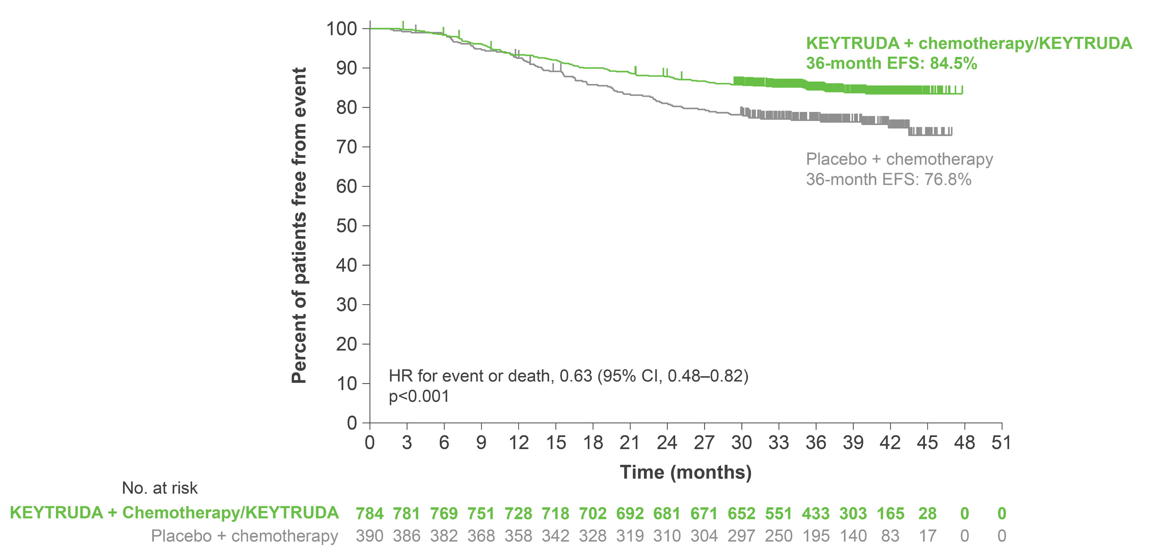
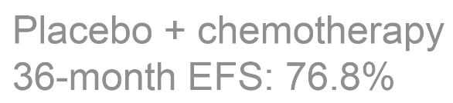
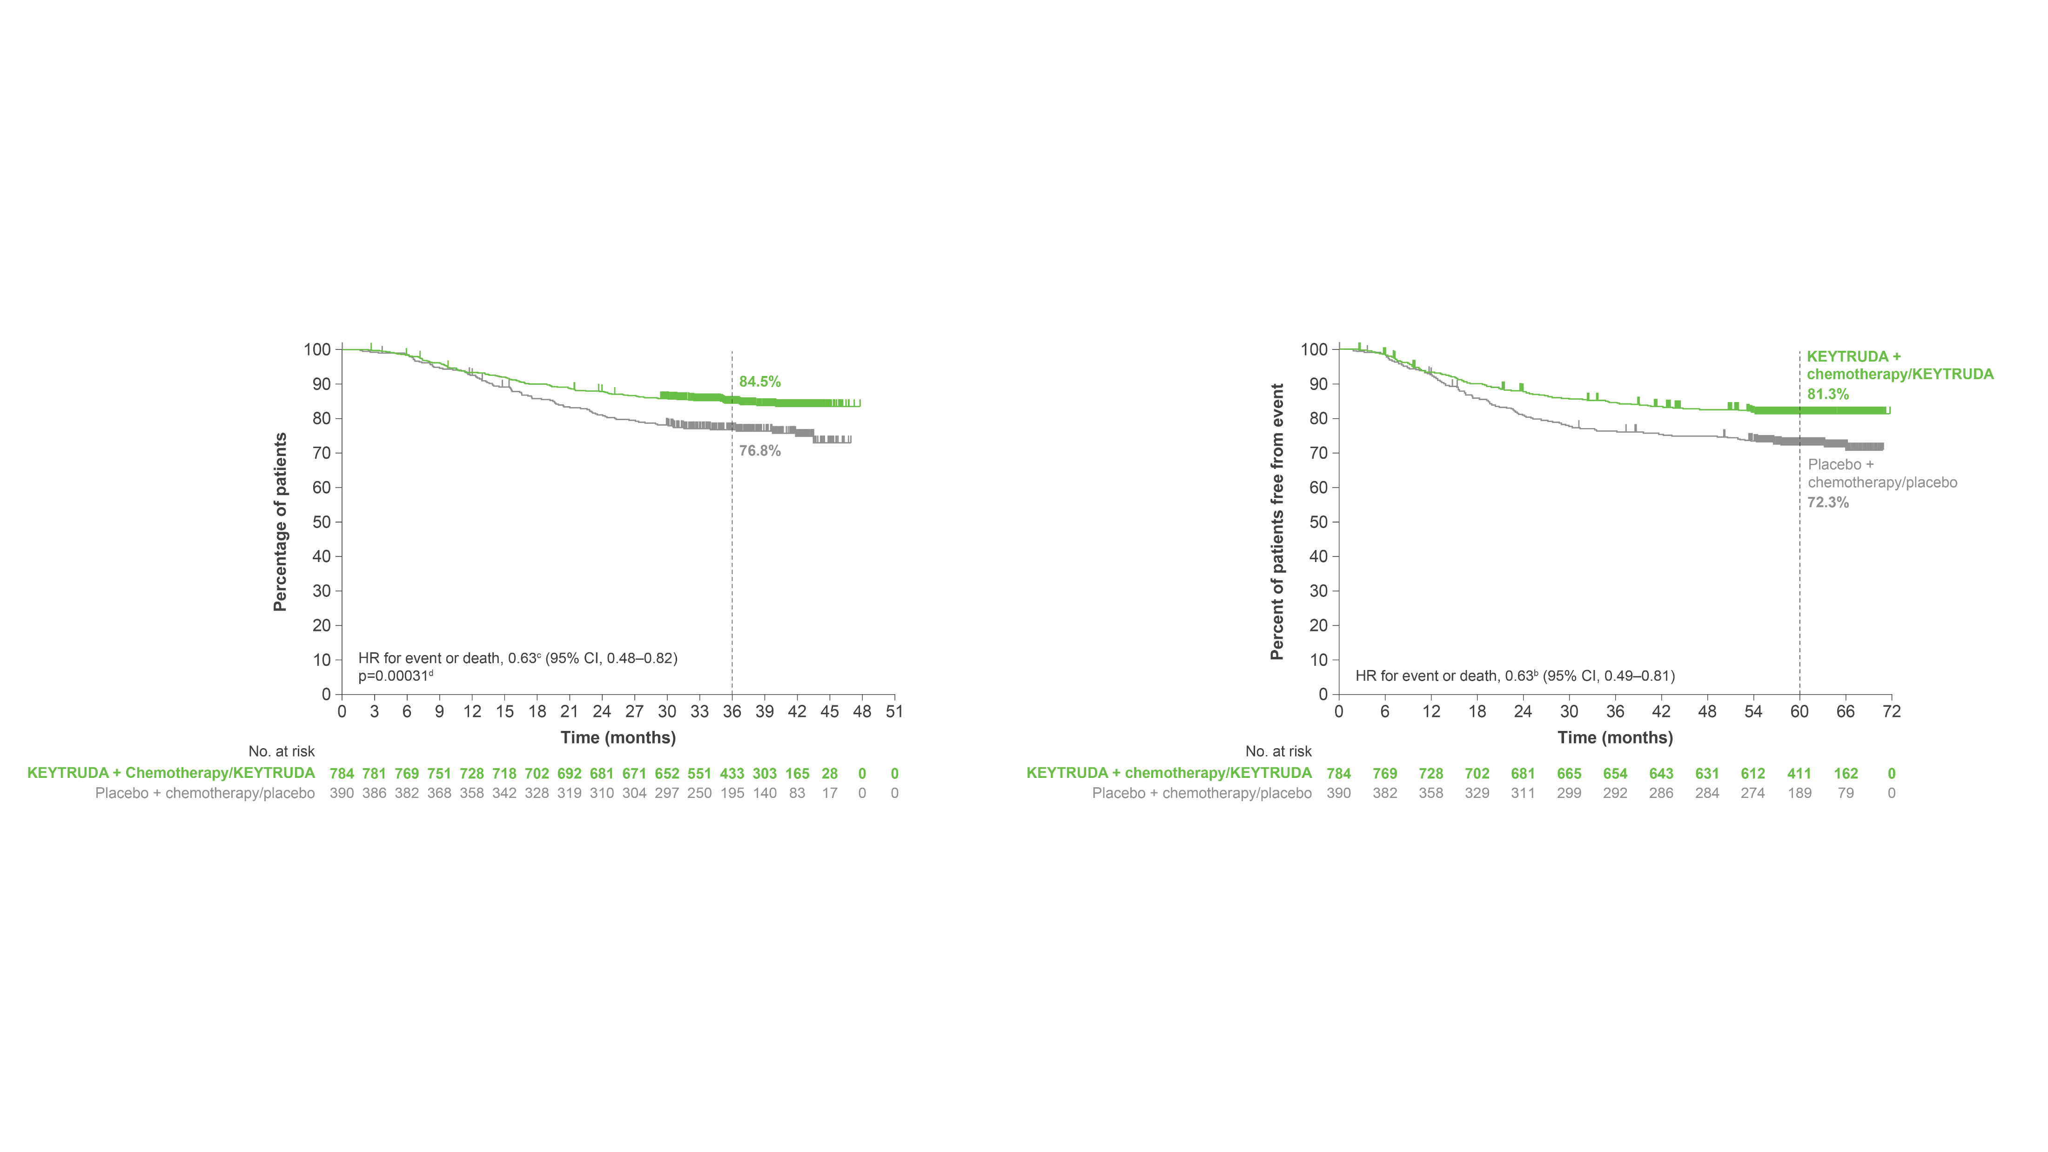
KEYNOTE-522: EFS in the ITT population at primary analysis
KEYTRUDA + chemotherapy in the neoadjuvant setting, followed by KEYTRUDA monotherapy as adjuvant treatment, resulted in a statistically significant improvement in EFS vs neoadjuvant placebo + chemotherapy followed by adjuvant placebo
The 36-month estimated EFS was:
  84.5% in the neoadjuvant KEYTRUDA + chemotherapy followed by adjuvant KEYTRUDA group (95% CI, 81.7–86.9)
  76.8% in the neoadjuvant placebo + chemotherapy followed by adjuvant placebo group (95% CI, 72.2–80.7)
Median EFS was not reached for either group
HR for event or death, 0.63 (95% CI, 0.48–0.82)
p<0.001
Median follow up: 39.1 months
Click here to view the forest plot for
EFS in key subgroups
Adapted from Schmid P et al. 2022.
Data cutoff: 23 March 2021.
Tick marks indicate data censored at the last time the patient was known to be alive and without an event (disease progression that precludes definitive surgery; local or distant recurrence or a second primary tumour; or death from any cause). The HR and CI were analysed with the use of a Cox regression model with treatment as a covariate stratified according to the randomisation stratification factors of nodal status (+ or −), tumour size (T1/T2 or T3/T4) and frequency of carboplatin administration (QW or Q3W).
CI, confidence interval; EFS, event-free survival; HR, hazard ratio; ITT, intention-to-treat; Q3W, every 3 weeks; QW, once a week.
Schmid P et al. N Engl J Med 2022;386:556–567.
UK Prescribing Information

Slide 17
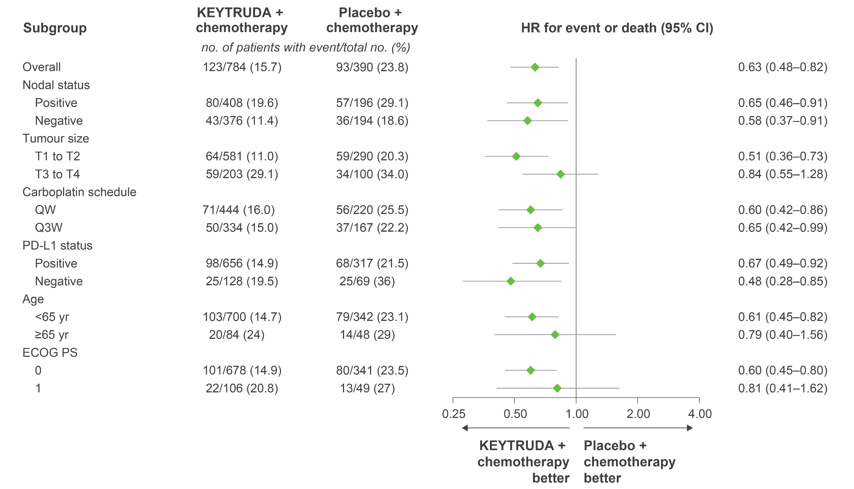
KEYNOTE-522: EFS in key subgroups at primary analysis
KEYNOTE-522 was not powered to detect differences in treatment effect between these subgroups. Results from exploratory analyses should be interpreted with caution due to modest patient numbers and potential imbalances in baseline characteristics
KEYTRUDA + chemotherapy better
Placebo + chemotherapy better
Adapted from Schmid P et al. 2022.
Data cutoff: 23 March 2021.
The HR and CI were analysed with the use of a Cox regression model, with treatment as a covariate and stratified according to the randomisation stratification factors of nodal status (+ or −),
tumour size (T1/T2 or T3/T4) and frequency of carboplatin administration (QW or Q3W).
CI, confidence interval; ECOG PS, Eastern Cooperative Oncology Group performance status; EFS, event-free survival; HR, hazard ratio; PD-L1, programmed death ligand-1; Q3W, every 3 weeks;
QW, once a week; yr, years.
Schmid P et al. N Engl J Med 2022;386:556–567 (plus supplementary appendix).
UK Prescribing Information

Slide 18
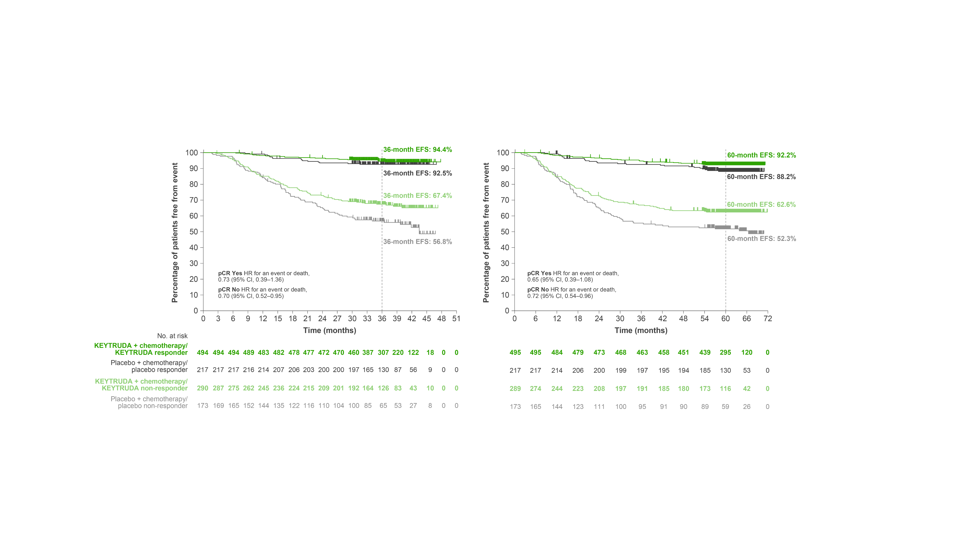
KEYNOTE-522: Exploratory analysis – EFS by pCR (ypT0/Tis ypN0) at
36 months
Adapted from Schmid P et al. Presented at ESMO 2023.
Data cut-off: 23 March 2021.
CI, confidence interval; EFS, event-free survival; HR, hazard ratio; pCR, pathologic complete response.
Schmid P et al. Presented at the European Society of Medical Oncology Congress 2023, 20–24 September, Madrid, Spain.
This was an exploratory analysis; significance was not tested and no statistical conclusions can be drawn
UK Prescribing Information

Slide 19
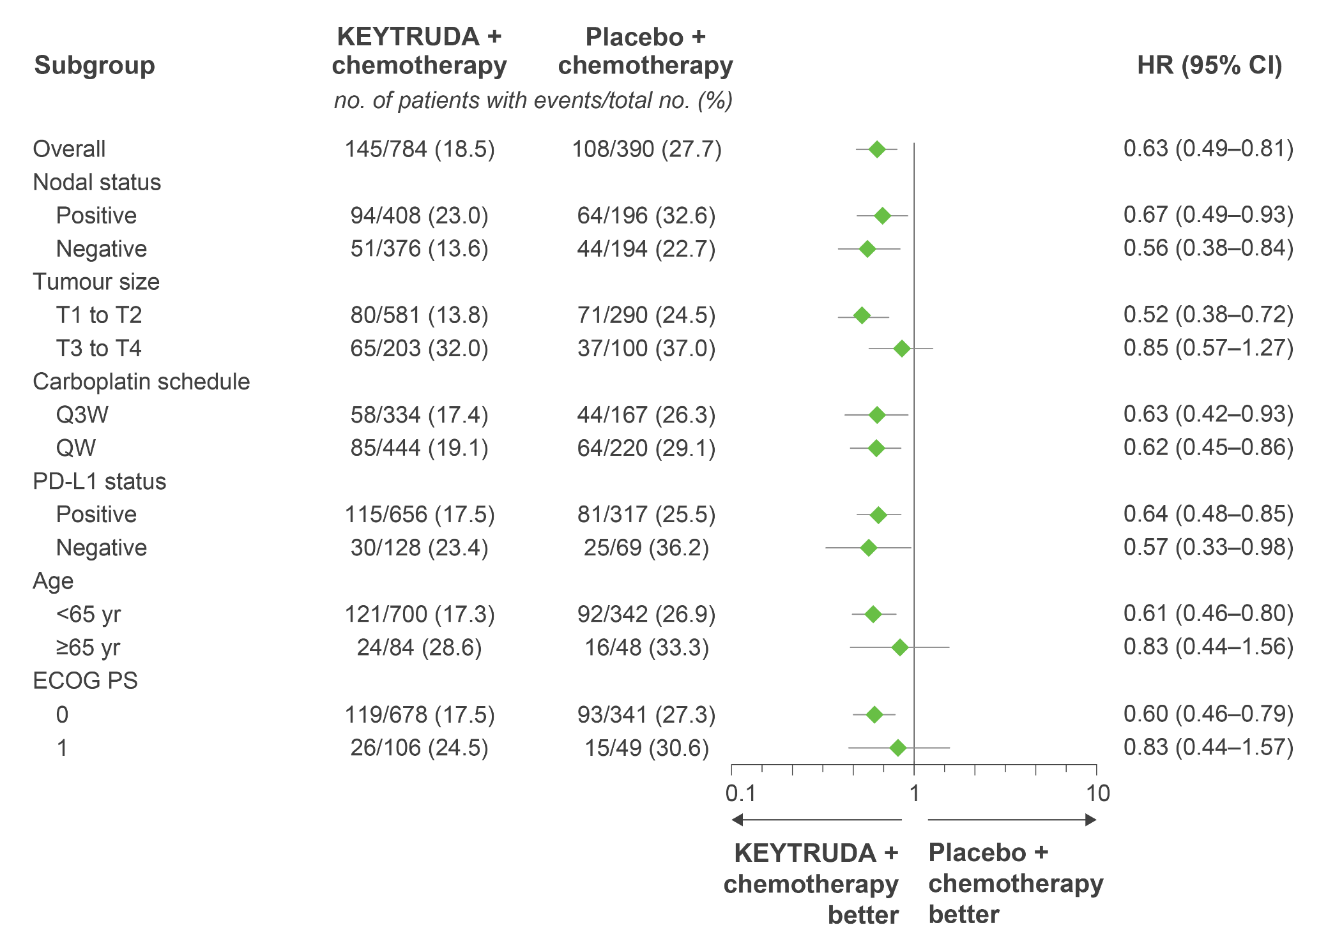
KEYNOTE-522: Exploratory analysis – EFS in key subgroups at
60 months
no. of patients with event/total no. (%)
KEYNOTE-522 was not powered to detect differences in treatment effect between these subgroups. Results from exploratory analyses should be interpreted with caution due to modest patient numbers and potential imbalances in baseline characteristics
Adapted from Schmid P et al. Presented at ESMO 2023.
Data cut-off: 23 March 2023.
For the overall population and PD-L1 subgroups, analyses were based on a Cox regression model with Efron’s method of tie handling, with treatment as a covariate and stratification by nodal status
(positive vs negative), tumour size (T1/T2 vs T3/T4) and frequency of carboplatin administration (QW vs Q3W); for other subgroups, analysis was based on an unstratified Cox model.
CI, confidence interval; ECOG PS, Eastern Cooperative Oncology Group performance status; EFS, event-free survival; HR, hazard ratio; pCR, pathologic complete response;
PD-L1, programmed death ligand-1; QW, every week; Q3W, every 3 weeks; yr, years.
Schmid P et al. Presented at the European Society of Medical Oncology (ESMO) Congress 2023, 20–24 September, Madrid, Spain.
UK Prescribing Information

Slide 20
KEYNOTE-522: Exploratory analysis – EFS by pCR (ypT0/Tis ypN0) at
60 months
Adapted from Schmid P et al. Presented at ESMO 2023.
Data cut-off: 23 March 2023.
CI, confidence interval; EFS, event-free survival; HR, hazard ratio; pCR, pathologic complete response.
Schmid P et al. Presented at the European Society of Medical Oncology Congress 2023, 20–24 September, Madrid, Spain.
This was an exploratory analysis; significance was not tested and no statistical conclusions can be drawn
UK Prescribing Information

Slide 21
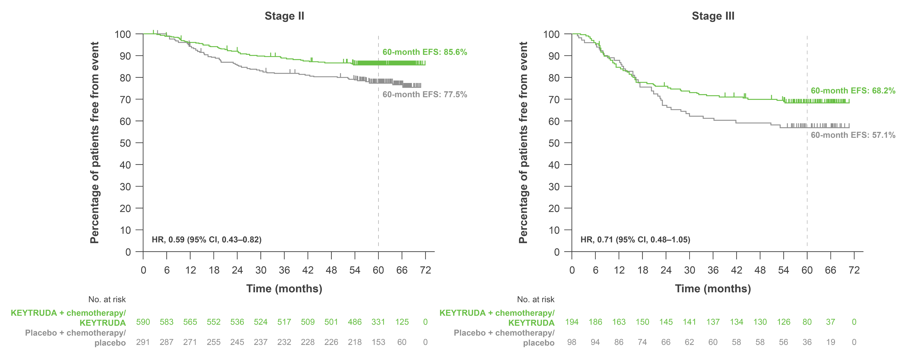
KEYNOTE-522: Exploratory analysis – EFS by disease stage at
60 months
Adapted from Schmid P et al. Presented at SABCS 2023.
Data cutoff: 23 March 2023.
CI, confidence interval; EFS, event-free survival; HR, hazard ratio.
Schmid P et al. Presented at the San Antonio Breast Cancer Symposium (SABCS) Congress 2023, 5–9 December, San Antonio, USA.
This was an exploratory analysis; significance was not tested and no statistical conclusions can be drawn
UK Prescribing Information

Slide 22
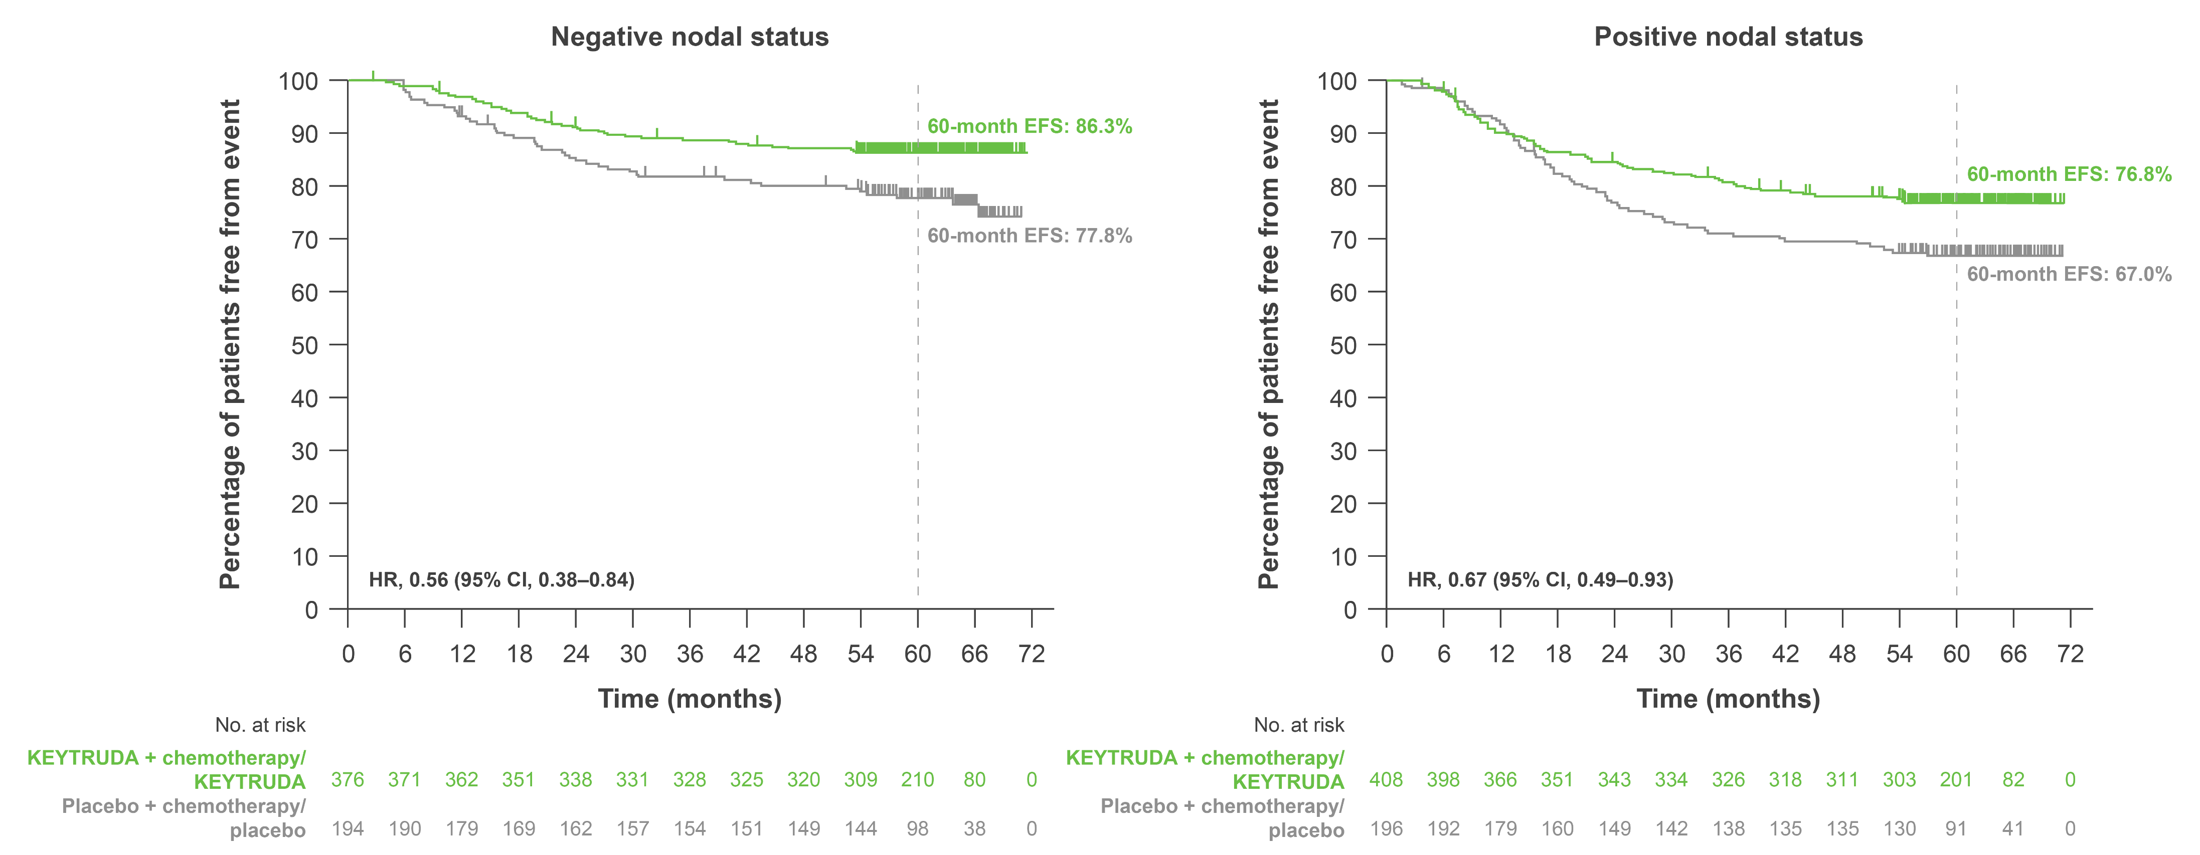
KEYNOTE-522: Exploratory analysis – EFS by nodal status at
60 months
Adapted from Schmid P et al. Presented at SABCS 2023.
Data cutoff: 23 March 2023.
CI, confidence interval; EFS, event-free survival; HR, hazard ratio.
Schmid P et al. Presented at the San Antonio Breast Cancer Symposium (SABCS) Congress 2023, 5–9 December, San Antonio, USA.
This was an exploratory analysis; significance was not tested and no statistical conclusions can be drawn
UK Prescribing Information

Slide 23
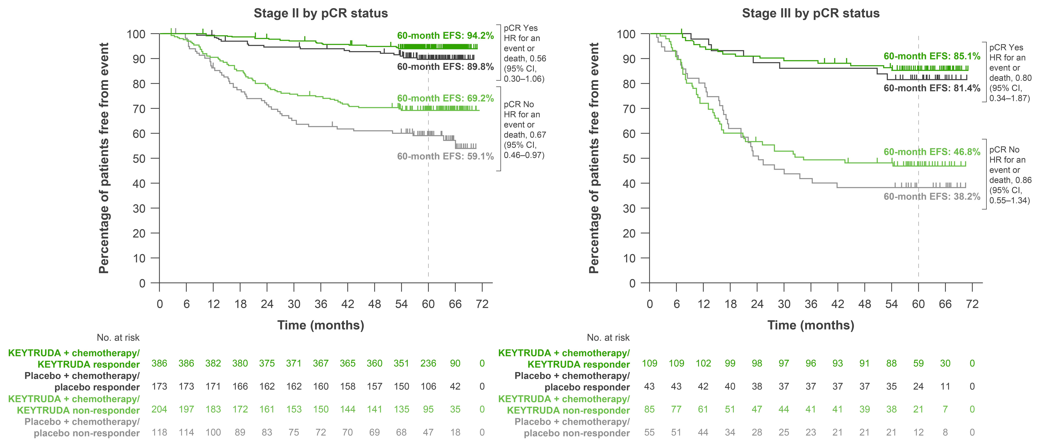
KEYNOTE-522: Exploratory analysis – EFS by disease stage in patients with and without pCR at 60 months
Adapted from Schmid P et al. Presented at SABCS 2023.
Data cutoff: 23 March 2023.
CI, confidence interval; EFS, event-free survival; HR, hazard ratio; pCR, pathologic complete response.
Schmid P et al. Presented at the San Antonio Breast Cancer Symposium (SABCS) Congress 2023, 5–9 December, San Antonio, USA.
This was an exploratory analysis; significance was not tested and no statistical conclusions can be drawn
UK Prescribing Information

Slide 24
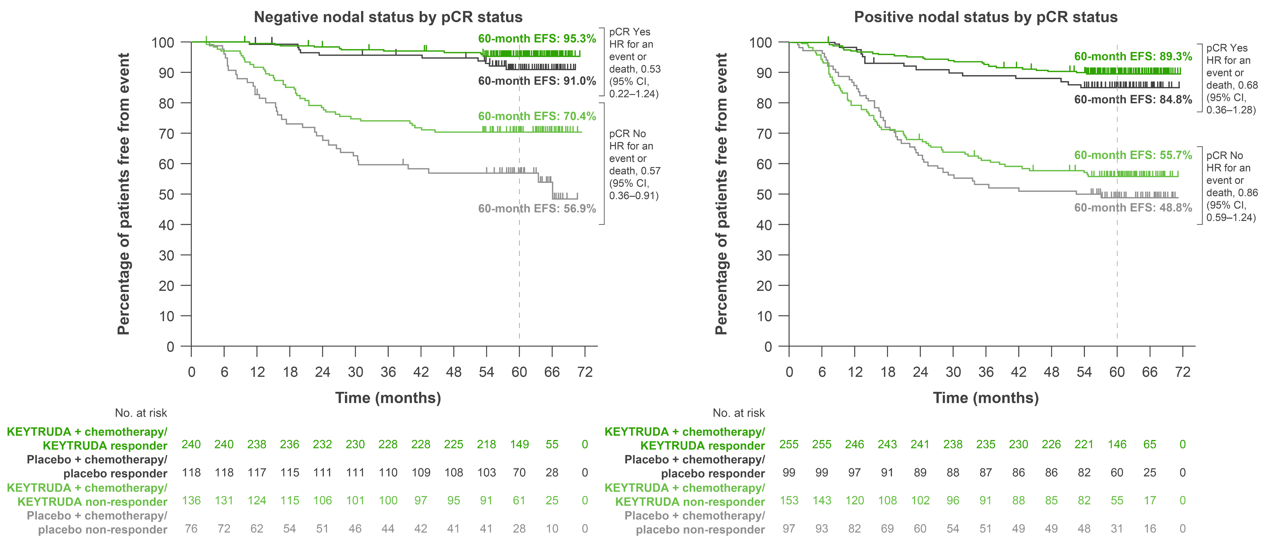
KEYNOTE-522: Exploratory analysis – EFS by nodal status in patients with and without pCR at 60 months
Adapted from Schmid P et al. Presented at SABCS 2023.
Data cutoff: 23 March 2023.
CI, confidence interval; EFS, event-free survival; HR, hazard ratio; pCR, pathologic complete response.
Schmid P et al. Presented at the San Antonio Breast Cancer Symposium (SABCS) Congress 2023, 5–9 December, San Antonio, USA.
This was an exploratory analysis; significance was not tested and no statistical conclusions can be drawn
UK Prescribing Information

Slide 25
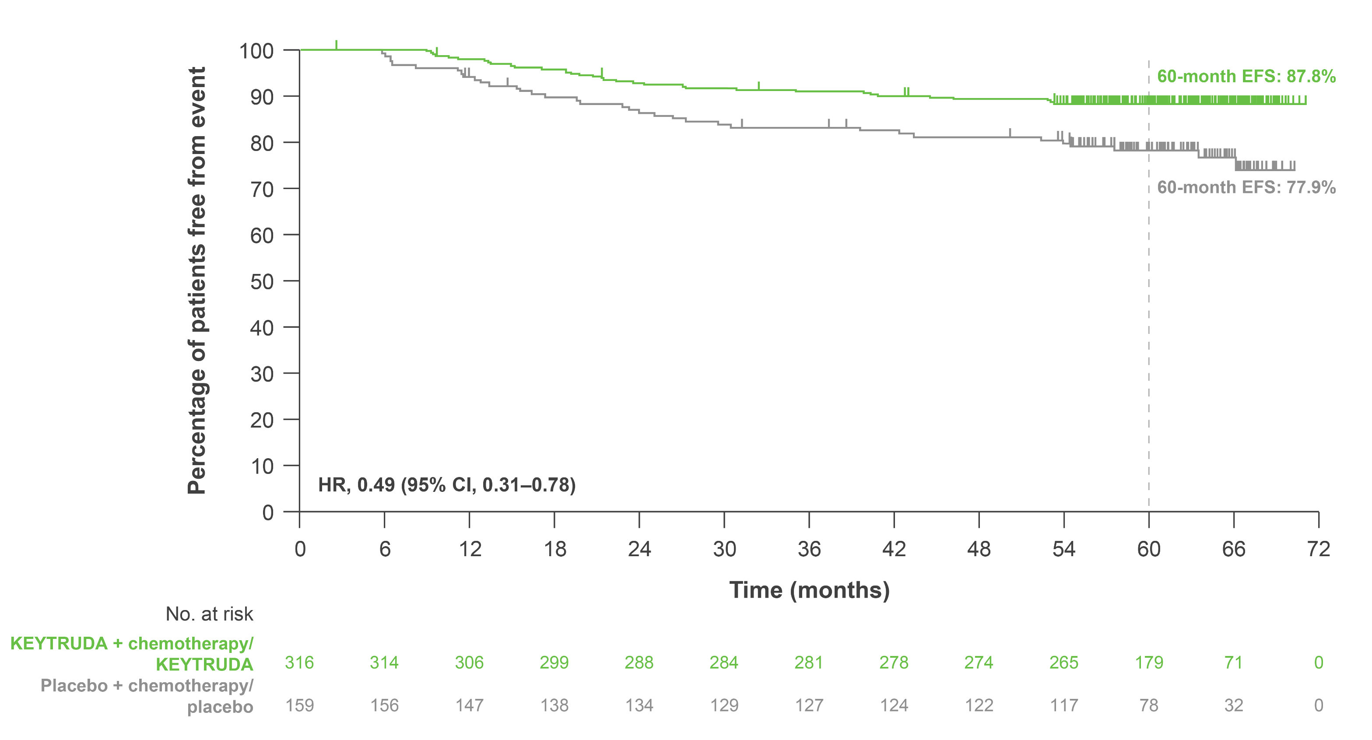
KEYNOTE-522: Exploratory analysis – EFS in patients with baseline T2N0 disease at 60 months
Adapted from Schmid P et al. Presented at SABCS 2023.
Data cutoff: 23 March 2023.
CI, confidence interval; EFS, event-free survival; HR, hazard ratio.
Schmid P et al. Presented at the San Antonio Breast Cancer Symposium (SABCS) Congress 2023, 5–9 December, San Antonio, USA.
This was an exploratory analysis; significance was not tested and no statistical conclusions can be drawn
UK Prescribing Information

Slide 26
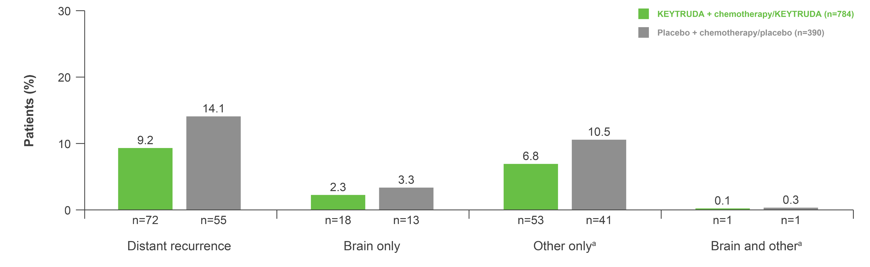
KEYNOTE-522: Exploratory analysis – Distant recurrence as first
EFS event at 60 months
Adapted from Schmid P et al. Presented at SABCS 2023.
This was an exploratory analysis; significance was not tested and no statistical conclusions can be drawn
Data cutoff: 23 March 2023.
ªOther refers to non-brain distant recurrence sites, which were classified per clinical identification.
EFS, event-free survival.
Schmid P et al. Presented at the San Antonio Breast Cancer Symposium (SABCS) Congress 2023, 5–9 December, San Antonio, USA.
UK Prescribing Information

Slide 27
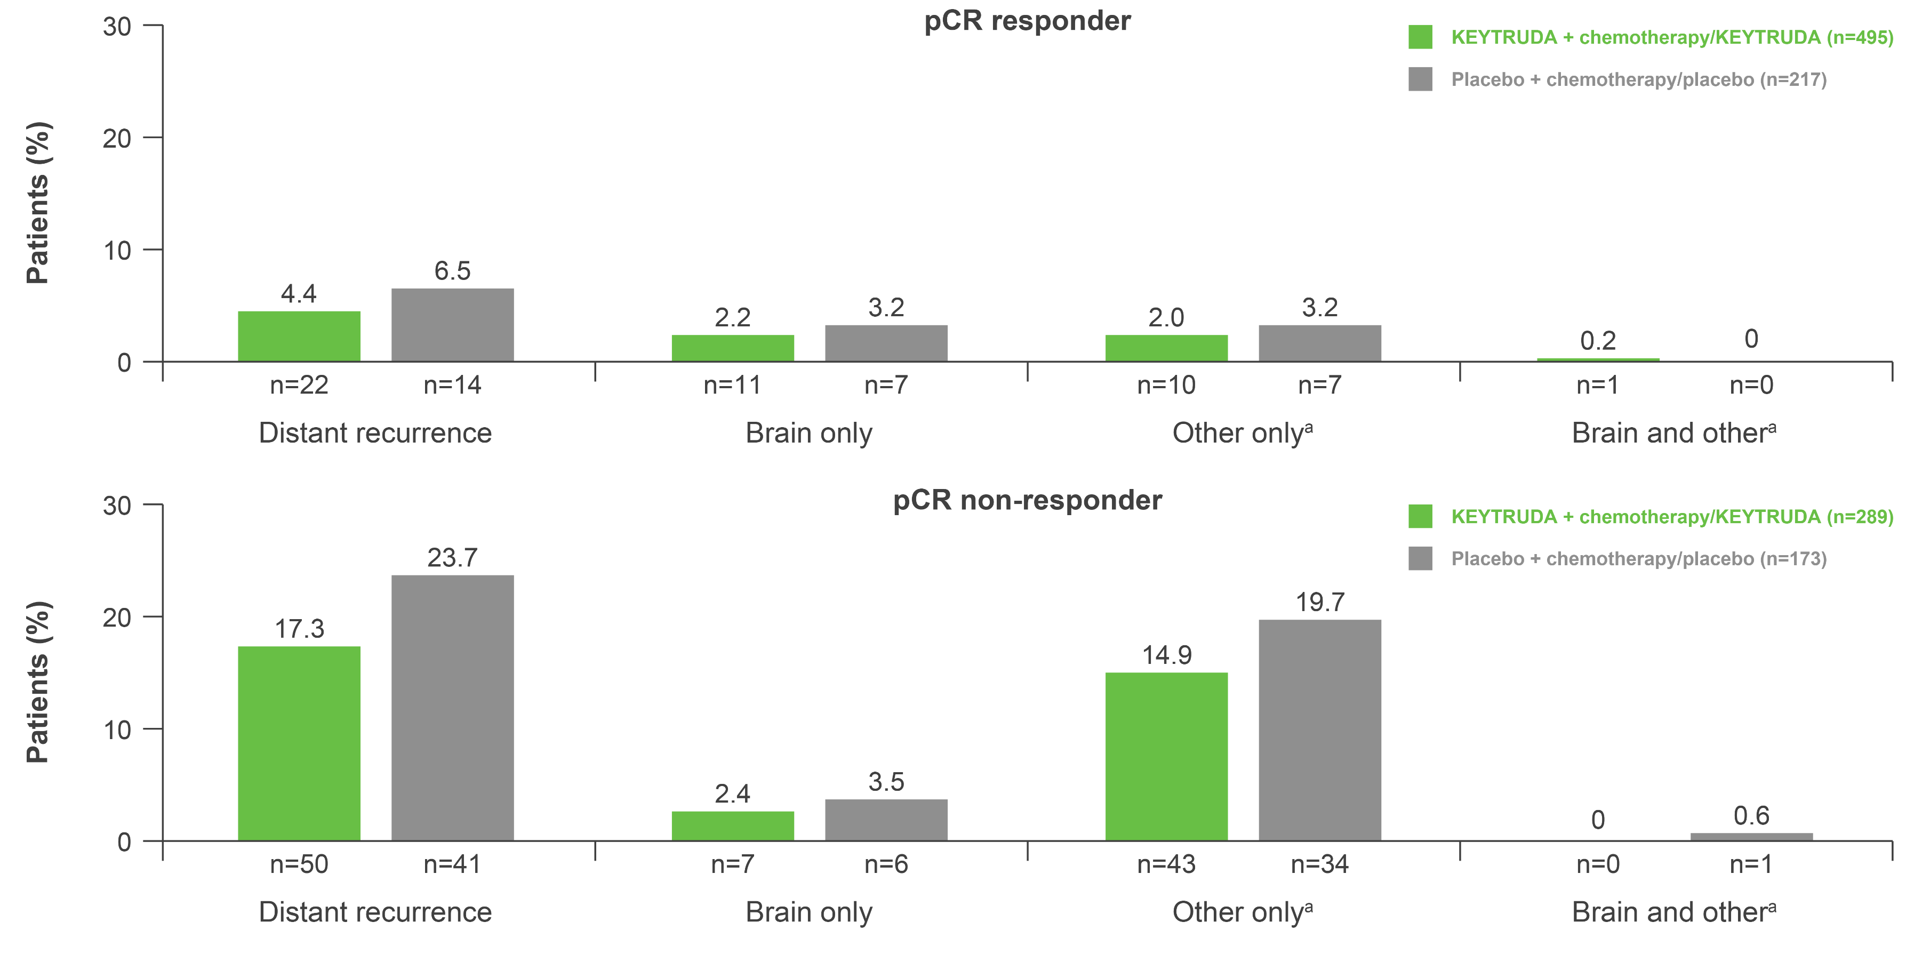
KEYNOTE-522: Exploratory analysis – Distant recurrence as first
EFS event by pCR (ypT0/Tis ypN0) at 60 months
Adapted from Schmid P et al.
Presented at SABCS 2023.
This was an exploratory analysis; significance was not tested and no statistical conclusions can be drawn
Data cutoff: 23 March 2023.
ªOther refers to non-brain distant recurrence sites, which were classified per clinical identification.
EFS, event-free survival; pCR, pathologic complete response.
Schmid P et al. Presented at the San Antonio Breast Cancer Symposium (SABCS) Congress 2023, 5–9 December, San Antonio, USA.
UK Prescribing Information

Slide 28
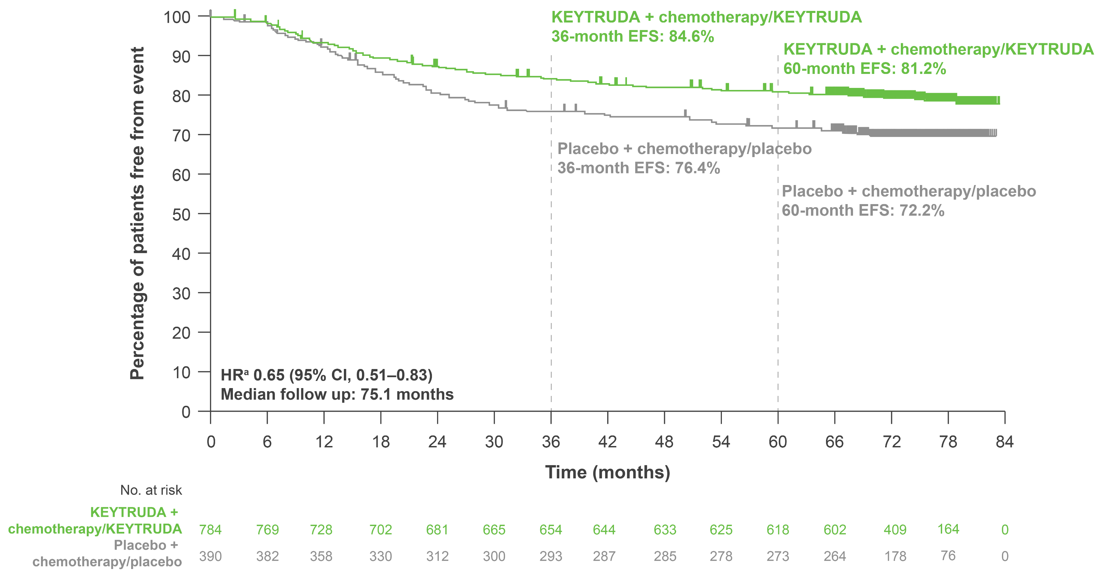
KEYNOTE-522: Exploratory analysis – EFS in the ITT population at 75-month follow-up
Descriptive EFS analysis only. Results provide an updated estimate of treatment effect following achievement of statistical significance at a prior prespecified analysis. No statistical conclusions can be drawn.
 | KEYTRUDA + chemotherapy/ KEYTRUDA (n=784) | Placebo + chemotherapy/ placebo (n=390)
Patients with event, % | 20.3 | 29.2
Adapted from Schmid P et al. Presented at ESMO 2024.
Data cut-off: 22 March 2024.
ªHR (CI) analysed based on a Cox regression model with treatment as a covariate stratified by the randomisation stratification factors.
CI, confidence interval; HR, hazard ratio; ITT, intention-to-treat.
Schmid P et al. Presented at the European Society of Medical Oncology (ESMO) Congress 2024, 13–17 September, Barcelona, Spain.
UK Prescribing Information

Slide 29
KEYNOTE-522: Exploratory analysis – EFS in the ITT population at final analysis¹
84-month final analysis^{a,1}
100
90
36-month EFS: 84.5%
60-month EFS:^{b,2} 81.2%
84-month EFS: 78.3%
80
Descriptive EFS analysis only. Results provide an updated estimate of treatment effect following achievement of statistical significance at a prior prespecified analysis. No statistical conclusions can be drawn.
70
36-month EFS: 76.8%
60-month EFS:^{b,2} 72.2%
84-month EFS: 69.8%
60
Percentage of patients free from event
50
40
 | KEYTRUDA + chemotherapy/ KEYTRUDA (n=784) | Placebo + chemotherapy/ placebo (n=390)
Patients with event, % | 21.9 | 30.3
30
20
10
HR,^{c} 0.68 (95% CI, 0.54–0.86)
Median follow up:^{d} 93.8 months
0
0
12
24
36
48
60
72
84
96
108
Time (months)
No. at risk
KEYTRUDA + chemotherapy/KEYTRUDA | 784 | 728 | 681 | 654 | 635 | 620 | 608 | 590 | 188 | 0
Placebo + chemotherapy/placebo | 390 | 358 | 312 | 293 | 286 | 274 | 264 | 259 | 85 | 0
ªData cutoff: 14 October 2025;^{1 b}Data cutoff: 22 March 2024.²
^{c}HR (CI) analysed based on a Cox regression model with treatment as a covariate stratified by the randomisation stratification factors;¹ ^{d}Defined as the time from randomisation to data cutoff.¹
CI, confidence interval; EFS, event-free survival; HR, hazard ratio; ITT, intention-to-treat.
1. Schmid P et al. Presented at the American Society of Clinical Oncology (ASCO) Annual Meeting 2026, 29 May–2 June, Chicago, USA;
2. Schmid P et al. Presented at the European Society of Medical Oncology (ESMO) Congress 2024, 13–17 September, Barcelona, Spain.
Adapted from Schmid P et al. Presented at ASCO 2026.¹
UK Prescribing Information

Slide 30
KEYNOTE-522: Exploratory analysis – EFS in key subgroups at
final analysis
Subgroup | KEYTRUDA + chemotherapy | Placebo + chemotherapy |  |  | HR (95% CI)
Overall | 172/784 (21.9) | 118/390 (30.3) |  |  | 0.68 (0.54–0.86)
Nodal status
Positive | 109/408 (26.7) | 67/196 (34.2) |  |  | 0.74 (0.55–1.00)
Negative | 63/376 (16.8) | 51/194 (26.3) |  |  | 0.59 (0.41–0.85)
Tumour size
T1/T2 | 102/580 (17.6) | 79/290 (27.2) |  |  | 0.59 (0.44–0.80)
T3/T4 | 70/204 (34.3) | 39/100 (39.0) |  |  | 0.86 (0.58–1.28)
Carboplatin schedule
Q3W | 75/334 (22.5) | 47/167 (28.1) |  |  | 0.75 (0.52–1.08)
QW | 95/444 (21.4) | 71/220 (32.3) |  |  | 0.62 (0.46–0.85)
PD-L1 status
CPS ≥1 | 138/656 (21.0) | 90/316 (28.5) |  |  | 0.70 (0.54–0.91)
CPS <1 | 34/128 (26.6) | 28/70 (40.0) |  |  | 0.56 (0.34–0.93)
Age category
<65 yrs | 139/700 (19.9) | 100/342 (29.2) |  |  | 0.64 (0.49–0.83)
≥65 yrs | 33/84 (39.3) | 18/48 (37.5) |  |  | 1.01 (0.57–1.79)
no. of patients with event/total no. (%)
KEYNOTE-522 was not powered to detect differences in treatment effect between these subgroups. Results from exploratory analyses should be interpreted with caution due to modest patient numbers and potential imbalances in baseline characteristics
0.1
1
10
KEYTRUDA + chemotherapy better
Placebo + chemotherapy better
Adapted from Schmid P et al. Presented at ASCO 2026.
Data cutoff: 14 October 2025.
For the overall population and PD-L1 subgroups, analyses were based on a Cox regression model with Efron’s method of tie handling, with treatment as a covariate and stratification by nodal status
(positive vs negative), tumour size (T1/T2 vs T3/T4) and frequency of carboplatin administration (QW vs Q3W); for other subgroups, analysis was based on an unstratified Cox model.
CI, confidence interval; CPS, combined positive score; EFS, event-free survival; HR, hazard ratio; PD-L1, programmed death ligand-1; Q3W, every 3 weeks; QW, once a week; yr, years.
Schmid P et al. Presented at the American Society of Clinical Oncology (ASCO) Annual Meeting 2026, 29 May–2 June, Chicago, USA.
UK Prescribing Information

Slide 31
KEYNOTE-522: Exploratory analysis – EFS by pCR (ypT0/Tis ypN0) at final analysis¹
84-month final analysisª
100
36-month EFS:^{b,2} 94.4%
60-month EFS:^{c,2} 92.2%
84-month EFS: 90.4%
90
36-month EFS:^{b,2} 92.5%
80
60-month EFS:^{c,2} 88.2%
84-month EFS: 85.9%
70
36-month EFS^{:b,2} 67.4%
60-month EFS:^{c,2} 62.6%
84-month EFS: 57.6%
60
Percentage of patients free from event
50
36-month EFS:^{b,2} 56.8%
60-month EFS:^{c,2} 52.3%
84-month EFS: 49.7%
40
pCR Yes HR for an event or death, 0.68 (95% CI, 0.44–1.07)
pCR No HR for an event or death,
0.78 (95% CI, 0.59–1.03)
Median follow-up: 93.8 months
30
20
10
0
0
12
24
36
48
60
72
84
96
108
No. at risk
Time (months)
KEYTRUDA + chemotherapy/ KEYTRUDA responder | 495 | 484 | 473 | 463 | 454 | 448 | 442 | 432 | 142 | 0
Placebo + chemotherapy/ placebo responder | 217 | 214 | 200 | 197 | 194 | 185 | 179 | 175 | 57 | 0
KEYTRUDA + chemotherapy/ KEYTRUDA non-responder | 289 | 244 | 208 | 191 | 181 | 172 | 166 | 158 | 46 | 0
Placebo + chemotherapy/ placebo non-responder | 173 | 144 | 112 | 96 | 92 | 89 | 85 | 84 | 28 | 0
Adapted from Schmid P et al.
Presented at ASCO 2026.¹
This was an exploratory analysis; significance was not tested and no statistical conclusions can be drawn
ªData cutoff: 14 October 2025. This is a non-randomised subgroup analysis based on the post-treatment outcomes of pCR; HRs should be interpreted with caution;¹ ^{b}Data cutoff: 23 March 2021;² ^{c}Data cutoff: 23 March 2023.²
CI, confidence interval; EFS, event-free survival; HR, hazard ratio; pCR, pathologic complete response.
1. Schmid P et al. Presented at the American Society of Clinical Oncology (ASCO) Annual Meeting 2026, 29 May–2 June, Chicago, USA;
2. Schmid P et al. Presented at the European Society of Medical Oncology Congress 2023, 20–24 September, Madrid, Spain.
UK Prescribing Information

Slide 32
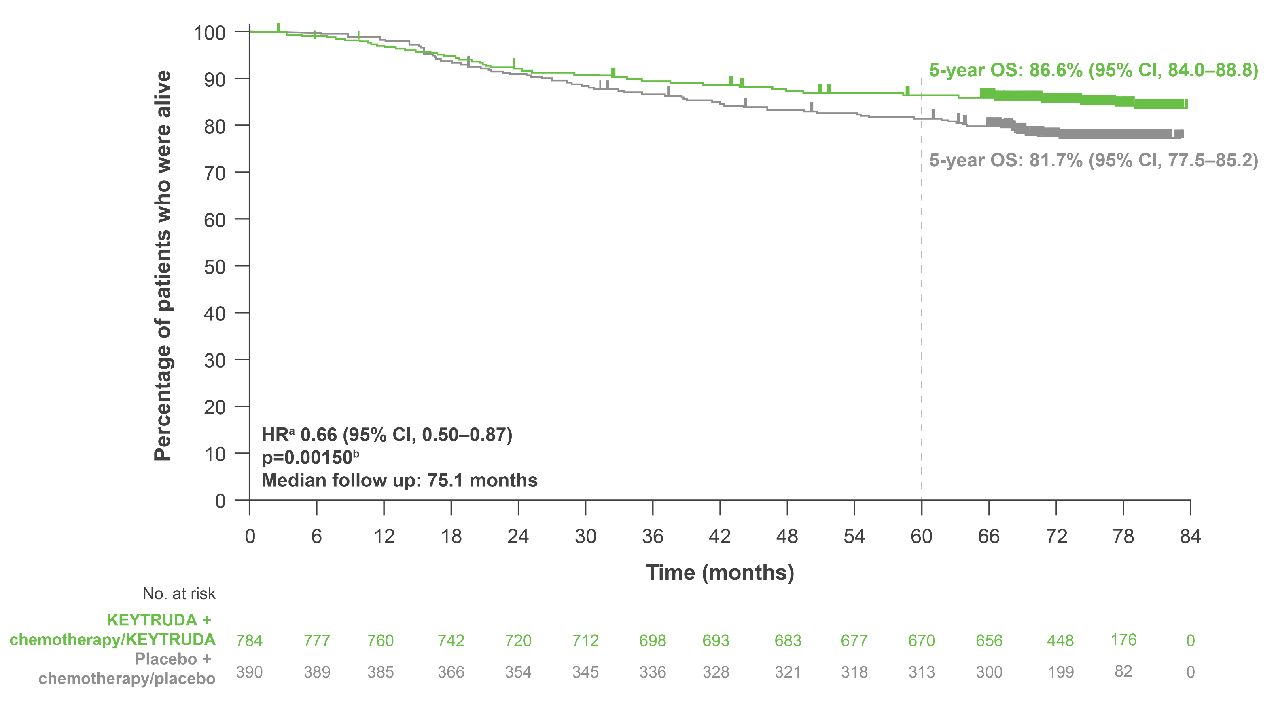
KEYNOTE-522: Key secondary endpoint – OS in the ITT population at 75-month follow-up
 | KEYTRUDA + chemotherapy/ KEYTRUDA (n=784) | Placebo + chemotherapy/ placebo (n=390)
Patients with event, % | 14.7 | 21.8
Adapted from Schmid P et al. Presented at ESMO 2024.
Data cutoff: 22 March 2024.
ªThe unstratified piecewise HR was 0.87 (95% CI, 0.57–1.32) before the 2-year follow up and 0.51 (95% CI, 0.35–0.75) afterwards. The weighted average HR with weights of number of events before and after
2-year follow up was 0.66; ^{b}With 200 events (67.3% information fraction), the observed p-value crossed the prespecified nominal boundary of 0.00503 (one-sided) at this interim analysis.
CI, confidence interval; HR, hazard ratio; ITT, intention-to-treat; OS, overall survival.
Schmid P et al. Presented at the European Society for Medical Oncology (ESMO) Congress 2024, 13–17 September, Barcelona, Spain.
UK Prescribing Information

Slide 33
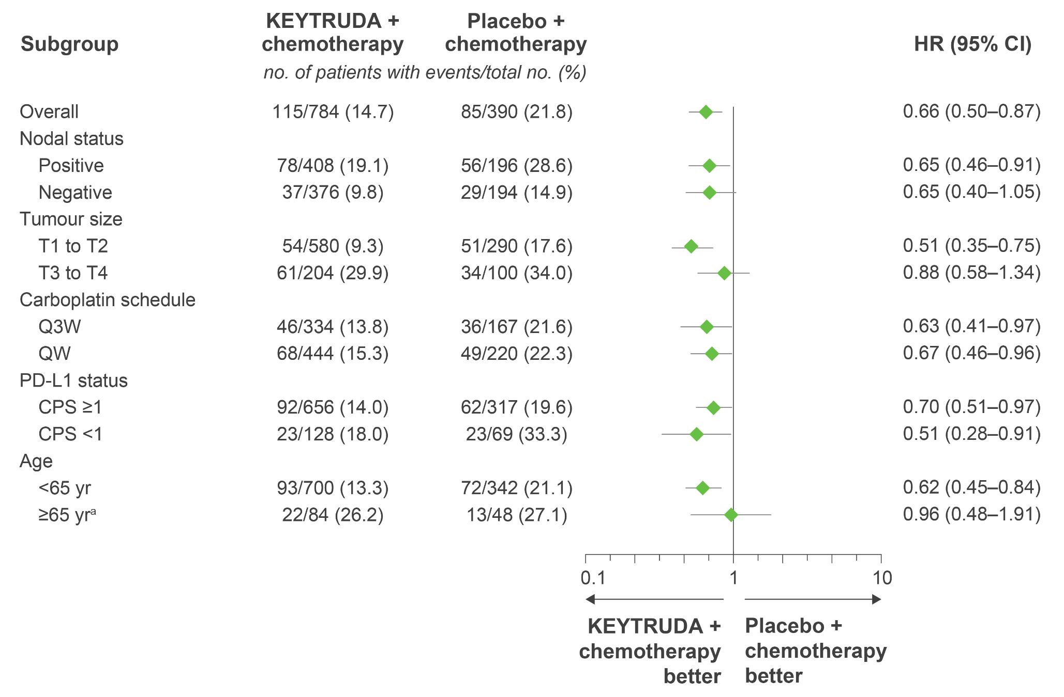
KEYNOTE-522: Exploratory analysis – OS in key patient subgroups at 75-month follow-up
no. of patients with event/total no. (%)
KEYTRUDA + chemotherapy better
Placebo + chemotherapy better
Adapted from Schmid P et al. Presented at ESMO 2024.
This was an exploratory analysis; significance was not tested and no statistical conclusions can be drawn
Data cutoff: 22 March 2024.
ªBased on the small sample size and few events, results should be interpreted with caution. For overall population and PD-L1 subgroups, analyses were based on Cox regression model with Efron's method of tie handling, with treatment as a covariate and stratified by nodal status (positive vs negative), tumour size (T1/T2 vs T3/T4), and frequency of carboplatin (Q3W vs QW); for other subgroups, analysis was based on an unstratified Cox model.
CI, confidence interval; CPS, combined positive score; HR, hazard ratio; OS, overall survival; PD-L1, programmed death ligand-1; Q3W, every 3 weeks; QW, once a week; yr, years.
Schmid P et al. Presented at the European Society for Medical Oncology (ESMO) Congress 2024, 13–17 September, Barcelona, Spain.
UK Prescribing Information

Slide 34
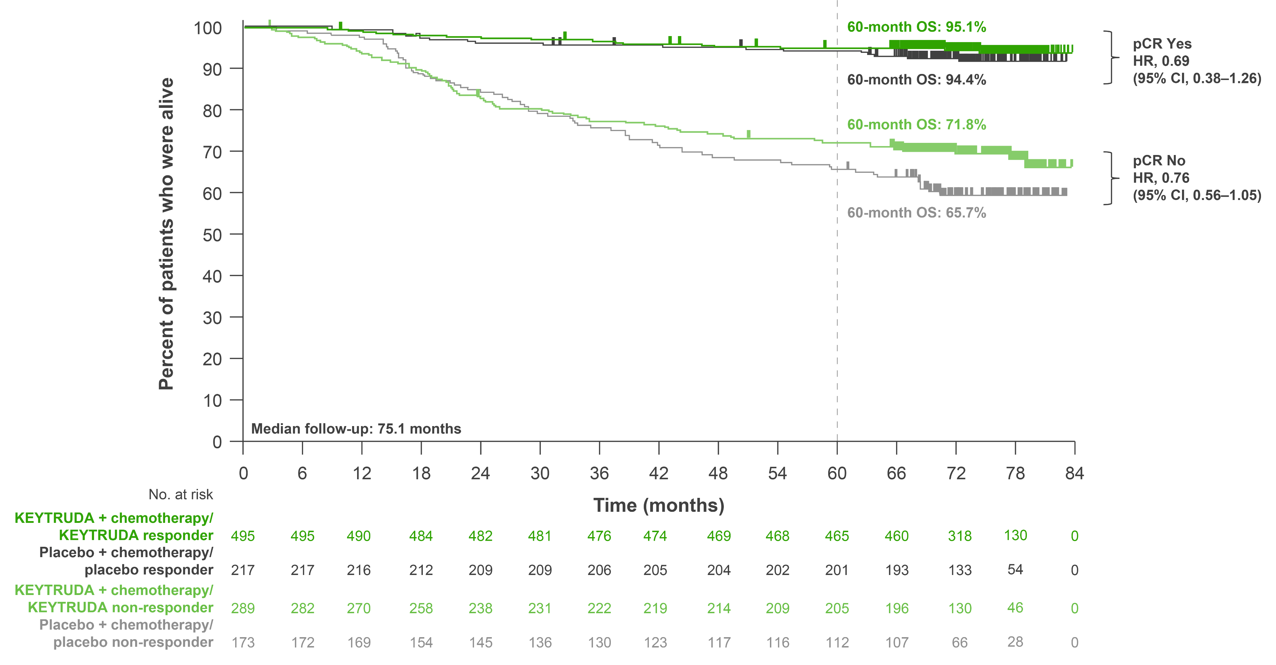
KEYNOTE-522: Exploratory analysis – OS by pCR
(pathological stage ypT0/Tis ypN0) at 75-month follow-up
Adapted from Schmid P et al. Presented at ESMO 2024.
This was an exploratory analysis; significance was not tested and no statistical conclusions can be drawn
Data cutoff: 22 March 2024.
This is a non-randomised subgroup analysis based on the post-treatment outcome of pCR. HRs should therefore be interpreted with caution.
CI, confidence interval; HR, hazard ratio; OS, overall survival; pCR, pathologic complete response.
Schmid P et al. Presented at the European Society for Medical Oncology (ESMO) Congress 2024, 13–17 September, Barcelona, Spain.
UK Prescribing Information

Slide 35
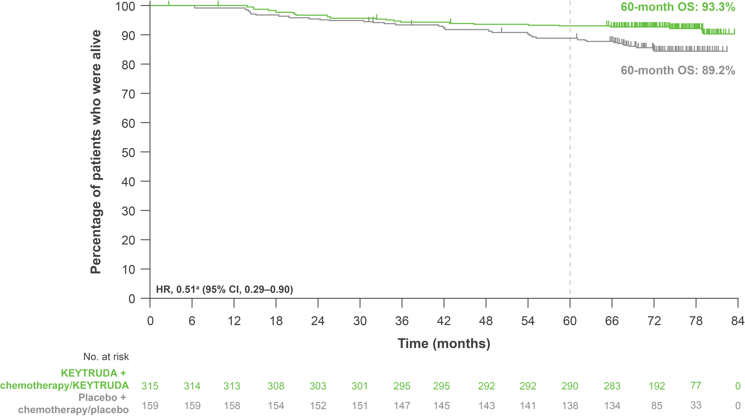
KEYNOTE-522: Exploratory analysis – OS in patients with baseline T2N0 disease at 75-month follow-up
 | KEYTRUDA + chemotherapy/ KEYTRUDA (n=315) | Placebo + chemotherapy/ placebo (n=159)
Patients with event, % | 7.6 | 14.5
Adapted from Dent R et al.
Presented at SABCS 2024.
Data cutoff: 22 March 2024.
ªHR (CI) analysed based on an unstratified Cox regression model with treatment as a covariate.
CI, confidence interval; HR, hazard ratio; OS, overall survival.
Dent R et al. Presented at the San Antonio Breast Cancer Symposium 2024, 10–13 December, San Antonio, USA.
This was an exploratory analysis; significance was not tested and no statistical conclusions can be drawn
UK Prescribing Information

Slide 36
KEYNOTE-522: Key secondary endpoint – OS in the ITT population at final analysis
100
60-month OS: 86.6%
84-month OS: 85.1%
Descriptive OS analysis only. Results provide an updated estimate of treatment effect following achievement of statistical significance at a prior prespecified analysis. No statistical conclusions can be drawn.
90
80
70
60-month OS: 81.7%
84-month OS: 77.2%
60
Percentage of patients who were alive
50
 | KEYTRUDA + chemotherapy/ KEYTRUDA (n=784) | Placebo + chemotherapy/ placebo (n=390)
Patients with event, % | 15.3 | 23.1
40
30
20
10
HR,ª 0.64 (95% CI, 0.49–0.85)
Median follow up:^{b} 93.8 months
0
0
12
24
36
48
60
72
84
96
108
Time (months)
No. at risk
KEYTRUDA + chemotherapy/KEYTRUDA | 784 | 760 | 720 | 699 | 685 | 673 | 666 | 658 | 202 | 0
Placebo + chemotherapy/placebo | 390 | 385 | 354 | 336 | 321 | 313 | 298 | 290 | 97 | 0
Adapted from Schmid P et al. Presented at ASCO 2026.
Data cutoff: 14 October 2025.
ªHR (CI) analysed based on a Cox regression model with treatment as a covariate stratified by the randomisation stratification factors; ^{b}Defined as the time from randomisation to data cutoff.
CI, confidence interval; HR, hazard ratio; ITT, intention-to-treat; OS, overall survival.
Schmid P et al. Presented at the American Society of Clinical Oncology (ASCO) Annual Meeting 2026, 29 May–2 June, Chicago, USA.
UK Prescribing Information

Slide 37
KEYNOTE-522: Exploratory analysis – OS in key patient subgroups at final analysis
Subgroup | KEYTRUDA + chemotherapy | Placebo + chemotherapy |  | HR (95% CI)
Overall | 120/784 (15.3) | 90/390 (23.1) |  | 0.64 (0.49–0.85)
Nodal status
Positive | 81/408 (19.9) | 58/196 (29.6) |  | 0.65 (0.46–0.91)
Negative | 39/376 (10.4) | 32/194 (16.5) |  | 0.61 (0.38–0.98)
Tumour size
T1/T2 | 57/580 (9.8) | 54/290 (18.6) |  | 0.51 (0.35–0.73)
T3/T4 | 63/204 (30.9) | 36/100 (36.0) |  | 0.86 (0.57–1.29)
Carboplatin schedule
Q3W | 48/334 (14.4) | 37/167 (22.2) |  | 0.64 (0.41–0.98)
QW | 71/444 (16.0) | 53/220 (24.1) |  | 0.64 (0.45–0.91)
PD-L1 status
CPS ≥1 | 96/656 (14.6) | 65/316 (20.6) |  | 0.69 (0.51–0.95)
CPS <1 | 24/128 (18.8) | 25/70 (35.7) |  | 0.48 (0.27–0.85)
Age category
<65 yrs | 98/700 (14.0) | 75/342 (21.9) |  | 0.62 (0.46–0.84)
≥65 yrs | 22/84 (26.2) | 15/48 (31.3) |  | 0.83 (0.43–1.59)
no. of patients with event/total no. (%)
This was an exploratory analysis; significance was not tested and no statistical conclusions can be drawn
0.1
1
10
KEYTRUDA + chemotherapy better
Placebo + chemotherapy better
Adapted from Schmid P et al. Presented at ASCO 2026.
Data cutoff: 14 October 2025.
For the overall population and PD-L1 subgroups, analyses were based on a Cox regression model with Efron’s method of tie handling, with treatment as a covariate and stratification by nodal status
(positive vs negative), tumour size (T1/T2 vs T3/T4) and frequency of carboplatin administration (QW vs Q3W); for other subgroups, analysis was based on an unstratified Cox model.
CI, confidence interval; CPS, combined positive score; HR, hazard ratio; OS, overall survival; PD-L1, programmed death ligand-1; Q3W, every 3 weeks; QW, once a week; yr, years.
Schmid P et al. Presented at the American Society of Clinical Oncology (ASCO) Annual Meeting 2026, 29 May–2 June, Chicago, USA.
UK Prescribing Information

Slide 38
KEYNOTE-522: Exploratory analysis – OS by pCR
(pathological stage ypT0/Tis ypN0) at final analysis^{a,1}
100
60-month OS:^{b,2} 95.1%
84-month OS: 94.5%
pCR Yes
HR, 0.64
(95% CI, 0.37–1.14)
90
60-month OS:^{b,2} 94.4%
84-month OS: 91.1%
80
60-month OS:^{b,2} 71.8%
84-month OS: 69.0%
70
pCR No
HR, 0.76
(95% CI, 0.55–1.03)
60
60-month OS:^{b,2} 65.7%
84-month OS: 59.8%
Percentage of patients who were alive
50
40
30
20
10
Median follow up: 93.8 months
0
0
12
24
36
48
60
72
84
96
108
No. at risk
Time (months)
KEYTRUDA + chemotherapy/ KEYTRUDA responder | 495 | 490 | 482 | 477 | 471 | 468 | 466 | 463 | 148 | 0
Placebo + chemotherapy/ placebo responder | 217 | 216 | 209 | 206 | 204 | 201 | 195 | 189 | 60 | 0
KEYTRUDA + chemotherapy/ KEYTRUDA non-responder | 289 | 270 | 238 | 222 | 214 | 205 | 200 | 195 | 54 | 0
Placebo + chemotherapy/ placebo non-responder | 173 | 169 | 145 | 130 | 117 | 112 | 103 | 101 | 37 | 0
Adapted from Schmid P et al. Presented at ASCO 2026.¹
This was an exploratory analysis; significance was not tested and no statistical conclusions can be drawn
ªData cutoff: 14 October 2025. This is a non-randomised subgroup analysis based on the post-treatment outcome of pCR. HRs should therefore be interpreted with caution;¹ ^{b}Data cutoff: 22 March 2024.².
CI, confidence interval; HR, hazard ratio; OS, overall survival; pCR, pathologic complete response.
1. Schmid P et al. Presented at the American Society of Clinical Oncology (ASCO) Annual Meeting 2026, 29 May–2 June, Chicago, USA
2. Schmid P et al. Presented at the European Society for Medical Oncology (ESMO) Congress 2024, 13–17 September, Barcelona, Spain.
UK Prescribing Information

Slide 39
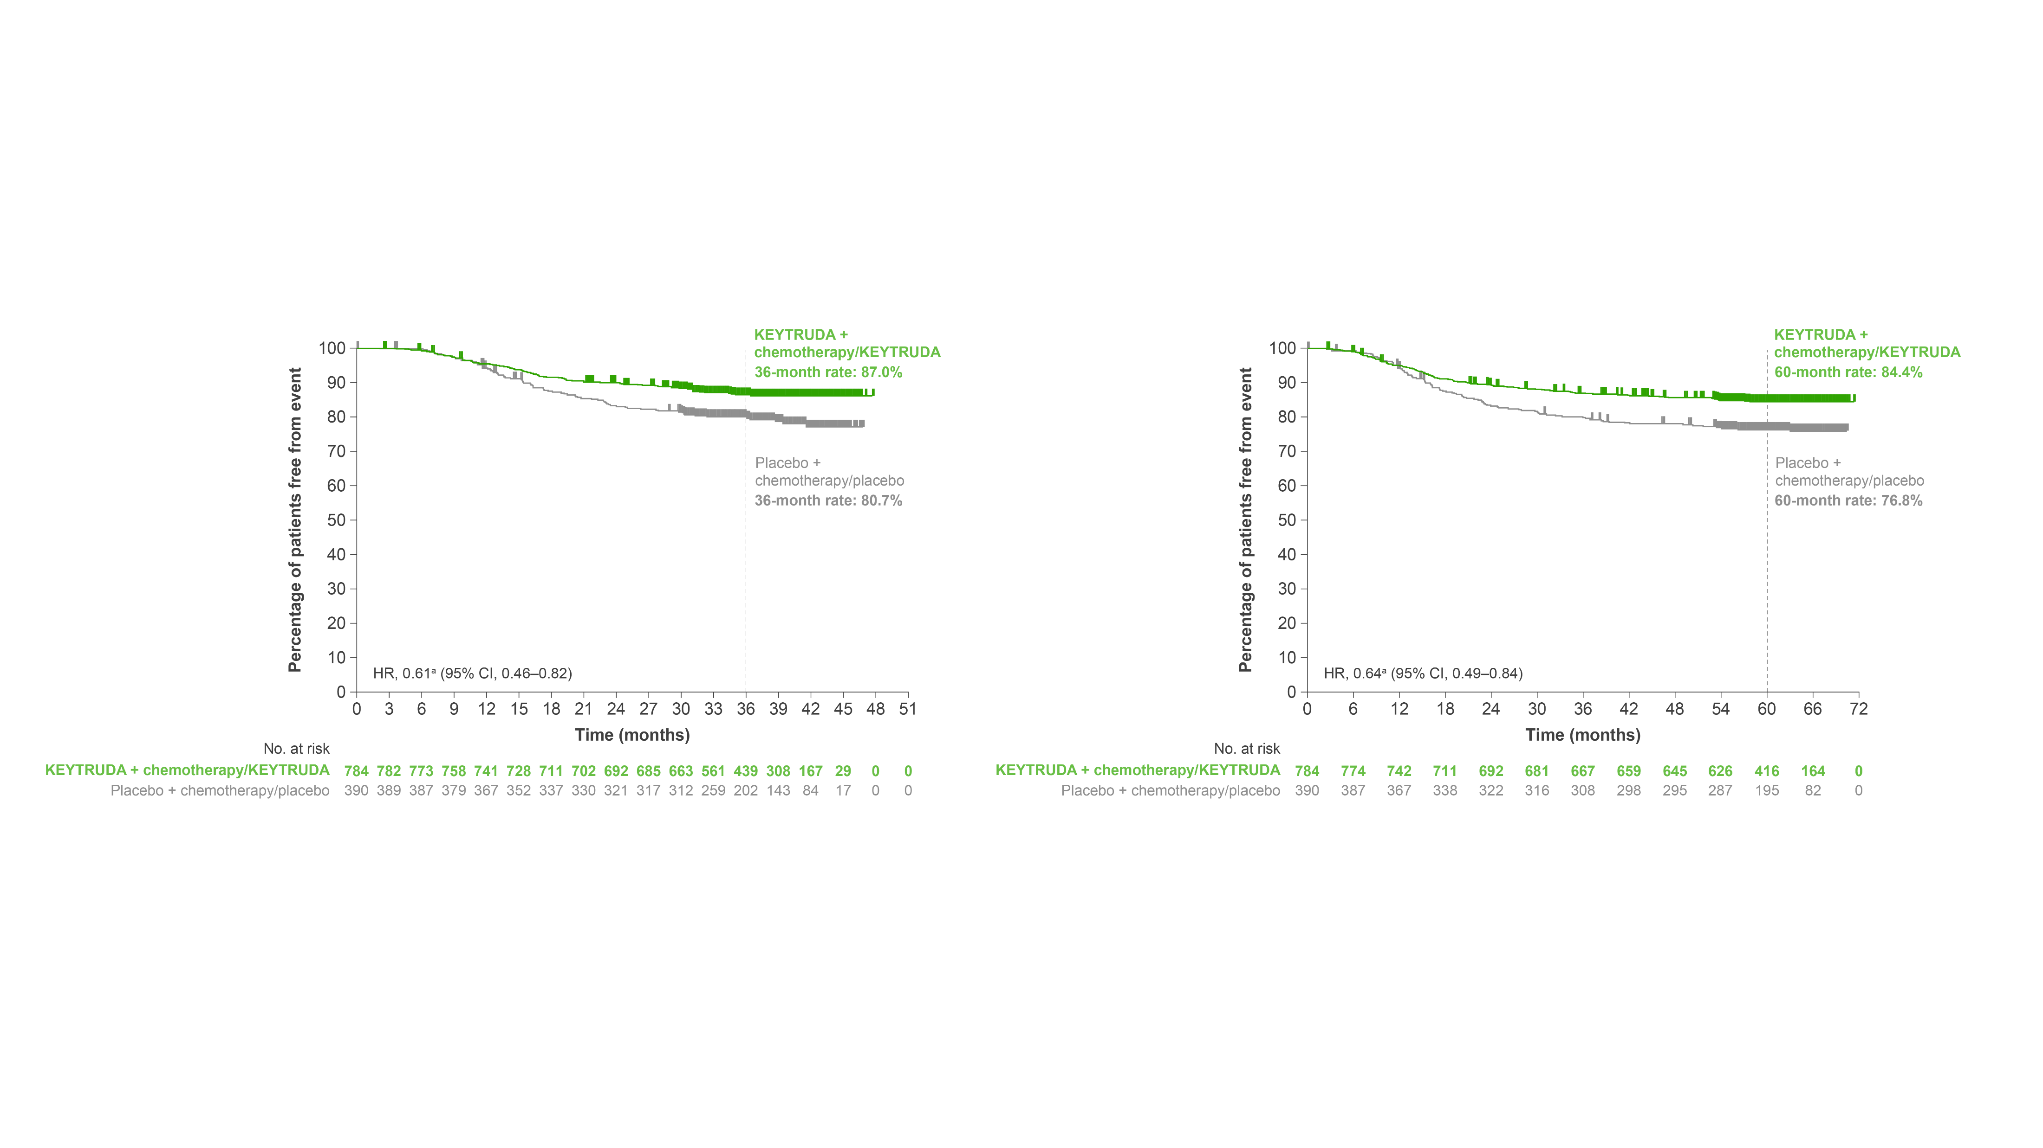
KEYNOTE-522: Exploratory analysis – DPFS or DRFS at 36 and
60 months
36 months
60 months
HRª 0.61 (95% CI, 0.46–0.82)
HRª 0.64 (95% CI, 0.49–0.84)
Adapted from Schmid P et al. Presented at ESMO 2023.
Data cut-off: 23 March 2021 and 23 March 2023.
ªHR (CI) analysed based on a Cox regression model with treatment as a covariate stratified by randomisation stratification factors.
CI, confidence interval; DPFS, distant progression-free survival; DRFS, distant recurrence-free survival; HR, hazard ratio.
Schmid P et al. Presented at the European Society of Medical Oncology Congress 2023, 20–24 September, Madrid, Spain.
This was an exploratory analysis; significance was not tested and no statistical conclusions can be drawn
UK Prescribing Information

Slide 40
KEYNOTE-522: Exploratory analysis – DPFS or DRFS at
final analysis¹
84-month final analysis^{a,1}
100
36-month rate:^{b,2}
87.0%
60-month rate:^{c,2}
84.4%
90
84-month rate: 82.9%
80
70
36-month rate:^{b,2}
80.7%
60-month rate:^{c,2}
76.8%
84-month rate: 74.2%
60
Percentage of patients free from event
50
40
30
20
10
HR^{d} 0.64 (95% CI, 0.49–0.83)
Median follow-up: 93.8 months
0
0
12
24
36
48
60
72
84
96
108
Time (months)
No. at risk
KEYTRUDA + chemotherapy/KEYTRUDA | 784 | 742 | 692 | 668 | 652 | 637 | 630 | 612 | 192 | 0
Placebo + chemotherapy/placebo | 390 | 367 | 323 | 309 | 299 | 291 | 279 | 272 | 88 | 0
Adapted from Schmid P et al. Presented at ASCO 2026.¹
ªData cutoff: 14 October 2025;¹ ^{b}Data cutoff: 23 March 2021;² ^{c}Data cutoff: 23 March 2023;² ^{d}HR (CI) analysed based on a Cox regression model with treatment as a covariate stratified by randomisation stratification factors.¹
CI, confidence interval; DPFS, distant progression-free survival; DRFS, distant recurrence-free survival; HR, hazard ratio.
1. Schmid P et al. Presented at the American Society of Clinical Oncology (ASCO) Annual Meeting 2026, 29 May–2 June, Chicago, USA;
2. Schmid P et al. Presented at the European Society of Medical Oncology Congress 2023, 20–24 September, Madrid, Spain.
This was an exploratory analysis; significance was not tested and no statistical conclusions can be drawn
UK Prescribing Information

Slide 41
KEYNOTE-522: Results – Safety
Click the links below to navigate to the section of interest
  Safety assessments
Neoadjuvant phase
Adjuvant phase
Combined phase
  Summary of
  any-grade AEs in the
  neoadjuvant phase
  (primary analysis)
  TRAEs in the adjuvant phase (36 months)
  Summary of safety results in the combined phase
  (36 months)
  Summary of any
  grade TRAEs in the combined phase
  (final analysis)
  AEs of interest in the neoadjuvant phase
  (primary analysis)
  Immune-mediated AEs and infusion reactions in the adjuvant phase
  (36 months)
  Summary of any grade
  TRAEs in the combined phase
  (75-month follow-up)
  Summary of
  immune-mediated AEs in the combined phase (final analysis)
  Summary of
  immune-mediated AEs in the combined phase (75-month follow-up)
AE, adverse event; TRAE, treatment-related adverse event.
UK Prescribing Information

Slide 42
KEYNOTE-522: Safety assessments^{1,2}
Combined phase
a
c
b
d
e
AEs were assessed during each phase of the study, as well as the study as a whole
a
c
b
d
e
Adapted from Schmid P et al. 2020 and Schmid P et al. 2022.
ªCarboplatin dose was AUC 5 Q3W or AUC 1.5 QW; ^{b}Paclitaxel dose was 80 mg/m² QW; ^{c}Doxorubicin dose was 60 mg/m² Q3W; ^{d}Epirubicin dose was 90 mg/m² Q3W; ^{e}Cyclophosphamide dose was 600 mg/m² Q3W.
AE, adverse event; AUC, area under the curve; ECOG PS, Eastern Cooperative Oncology Group performance status; EFS, event-free survival; pCR, pathologic complete response; PD-L1, programmed death ligand-1;
Q3W, every 3 weeks; QW, once a week; R, randomisation; TNBC, triple-negative breast cancer.
1. Schmid P et al. N Engl J Med 2020;382:810–821 (plus supplementary appendix); 2. Schmid P et al. N Engl J Med 2022;386:556–567 (plus supplementary appendix).
UK Prescribing Information

Slide 43
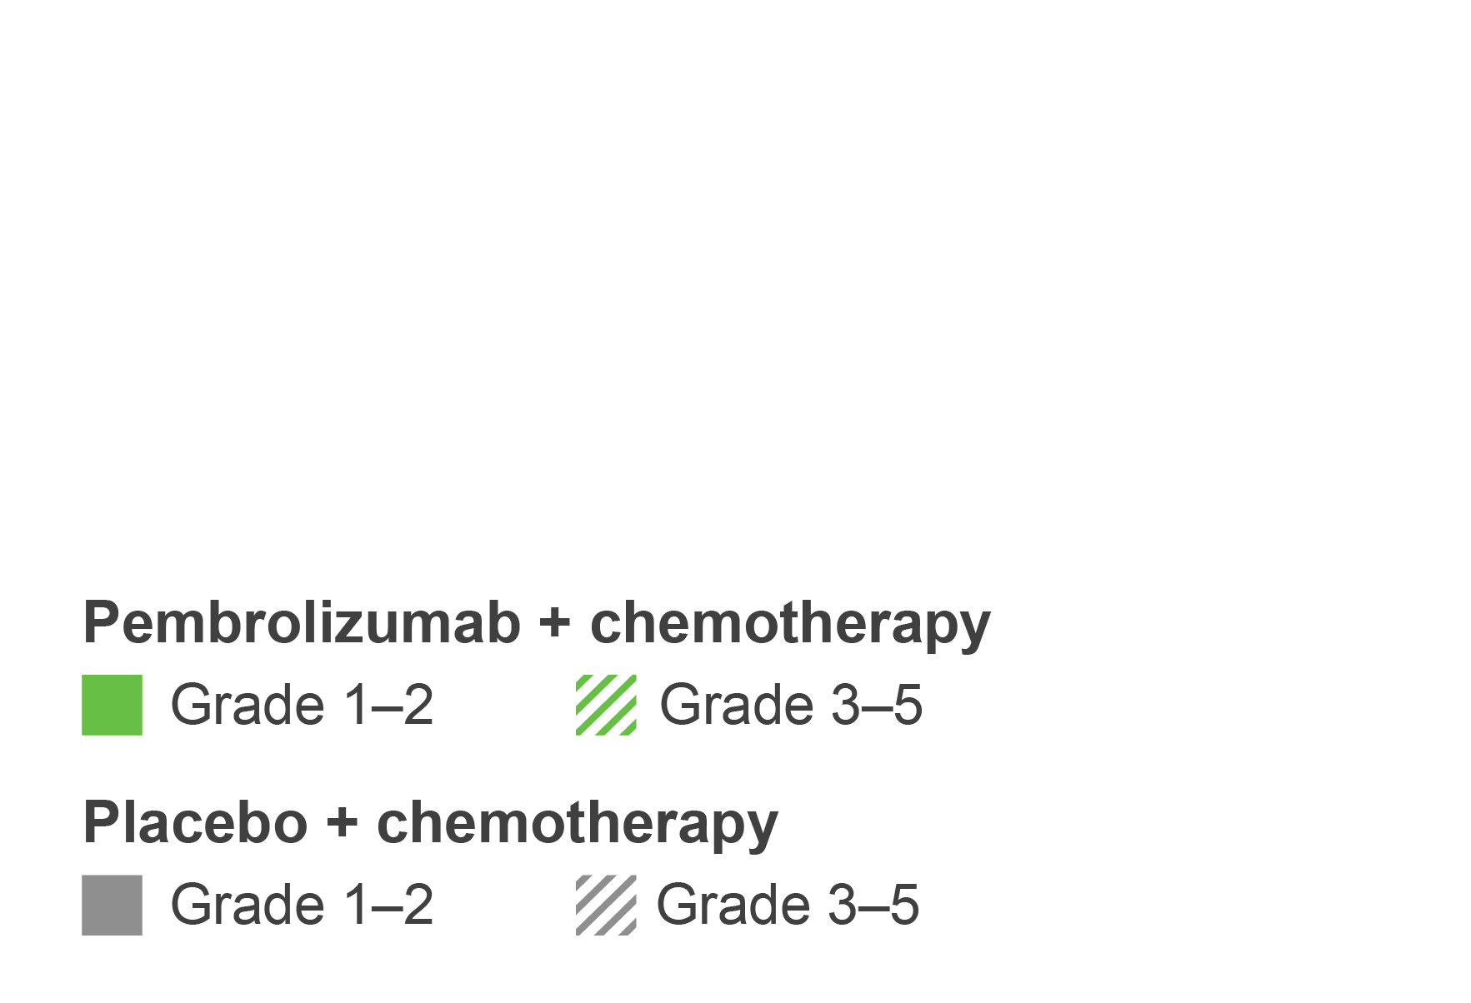
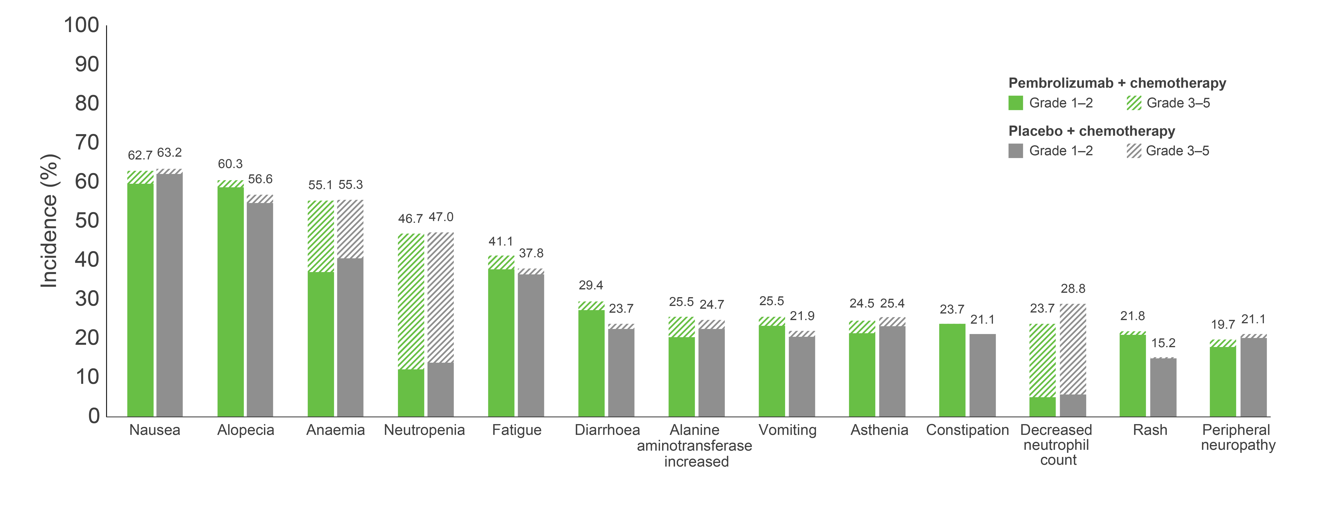
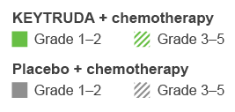
KEYNOTE-522: Summary of any-grade AEs occurring in ≥20% of patients in the neoadjuvant phase at primary analysis
The tabular data for this plot is shown in the appendix. Click here to view.
Adapted from Schmid P et al. 2020.
Listed are AEs that occurred during the treatment period or within 30 days after the treatment period (or, for serious AEs, within 90 days) in patients who were randomised and received at least one trial drug or surgery. The severity of the AEs was graded according to the Common Terminology Criteria for Adverse Events, v4.0, of the National Cancer Institute. Patients may have had more than one event.
AE, adverse event.
Schmid P et al. N Engl J Med 2020;382:810–821.
UK Prescribing Information

Slide 44
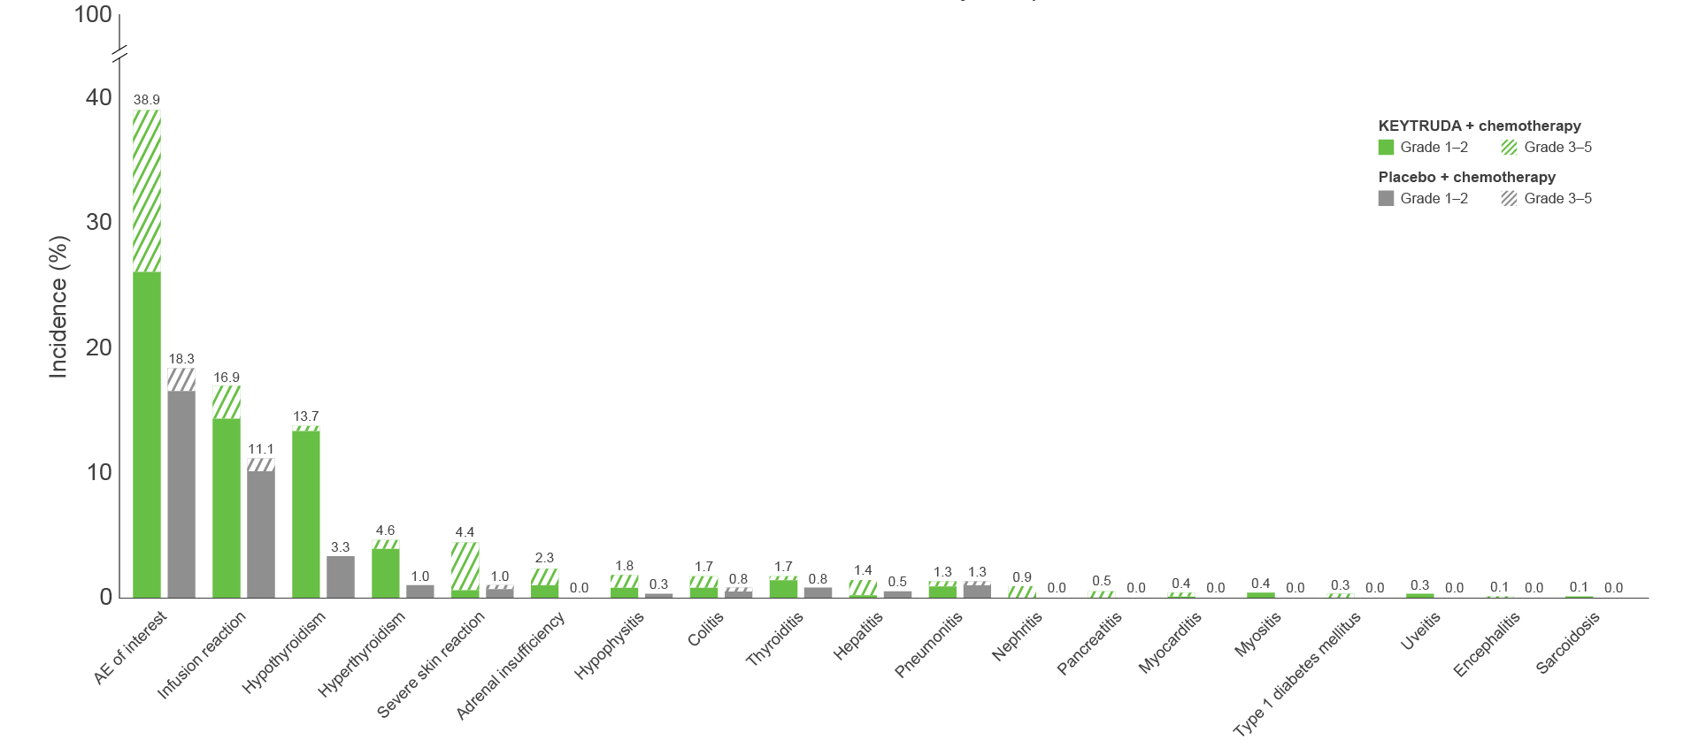
KEYNOTE-522: AEs of interest in the neoadjuvant phase at
primary analysisª
The tabular data for this plot is shown in the appendix. Click here to view.
Adapted from Schmid P et al. 2020.
Listed are AEs that occurred during the treatment period or within 30 days after the treatment period (or, for serious AEs, within 90 days) in patients who were randomised and received at least one trial drug or surgery. The severity of the AEs was graded according to the Common Terminology Criteria for Adverse Events, v4.0, of the National Cancer Institute. Patients may have had more than one event.
ªAEs of interest were determined according to a list of terms specified by the sponsor, regardless of attribution to any trial treatment by the investigators.
AE, adverse event.
Schmid P et al. N Engl J Med 2020;382:810–821 (plus supplementary appendix).
UK Prescribing Information

Slide 45
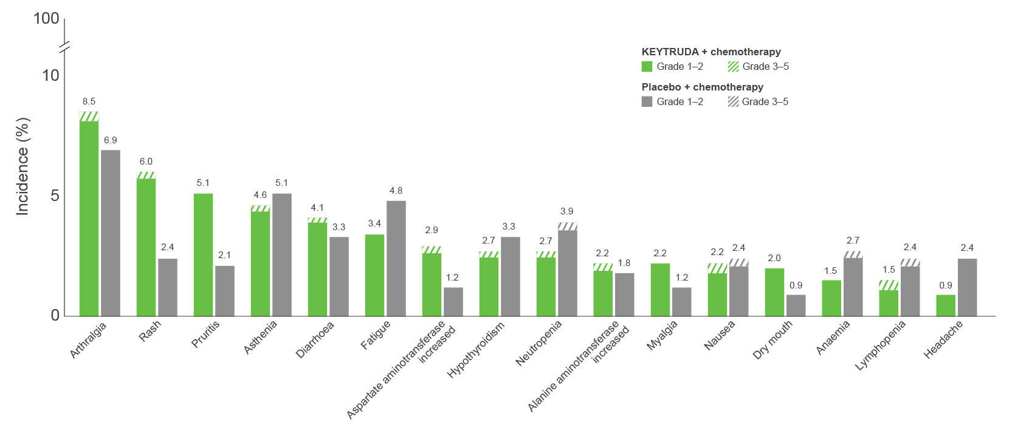
KEYNOTE-522: TRAEs occurring in ≥2% of patients in the
adjuvant phase at 36 months
Pruritus
The tabular data for this plot is shown in the appendix. Click here to view.
Adapted from Schmid P et al. Presented at ESMO 2021.
Listed are AEs that occurred during the treatment period or within 30 days after the treatment period (or, for serious AEs, within 90 days) in patients who were randomised and received at least one trial drug or surgery. The severity of the AEs was graded according to the Common Terminology Criteria for Adverse Events, v4.0, of the National Cancer Institute. Patients may have had more than one event.
AE, adverse event; TRAE, treatment-related adverse event.
Schmid P et al. Presented at the European Society for Medical Oncology (ESMO) Virtual Plenary 2021, 16–21 September.
UK Prescribing Information

Slide 46
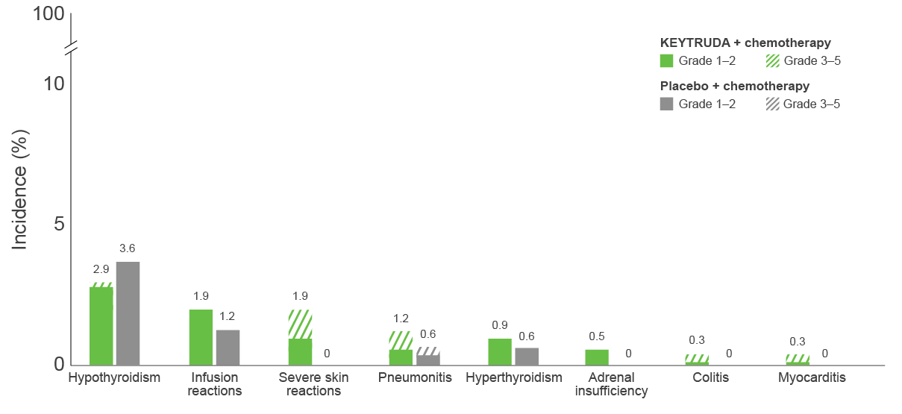
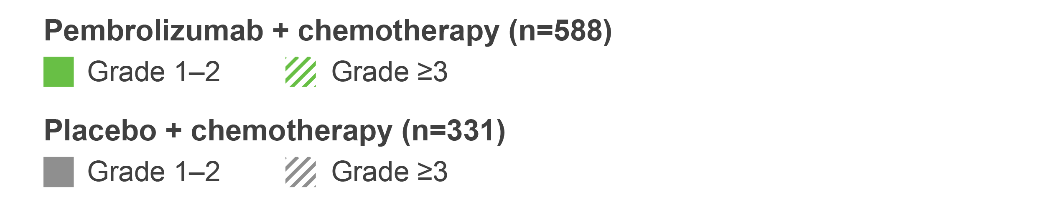
KEYNOTE-522: Immune-mediated AEs and infusion reactions in the adjuvant phase at 36 months¹
The tabular data for this plot is shown in the appendix. Click here to view.
Adapted from Schmid P et al. Presented at ESMO 2021.
Listed are AEs that occurred during the treatment period or within 30 days after the treatment period (or, for serious AEs, within 90 days) in patients who were randomised and received at least one trial drug or surgery.
The severity of the AEs was graded according to the Common Terminology Criteria for Adverse Events, v4.0, of the National Cancer Institute. Patients may have had more than one event. Immune-mediated AEs were determined according to the sponsor, regardless of attribution to any trial treatment.² Grade 5 immune-mediated AE was autoimmune encephalitis (n=1) in the KEYTRUDA + chemotherapy group.¹
AE, adverse event.
1. Schmid P et al. Presented at the European Society for Medical Oncology (ESMO) Virtual Plenary 2021, 16–21 September; 2. Schmid P et al. N Engl J Med 2020;382:810–821.
UK Prescribing Information

Slide 47
KEYNOTE-522: Summary of safety results in the combined (neoadjuvant and adjuvant) phase at 36 months
Immune-mediated AEs and infusion reactions
Time to onset and management of the most common (≥20 patients)
immune-mediated AEs and infusion reactions
 | KEYTRUDA + chemotherapy/ KEYTRUDA (n=783) | Placebo + chemotherapy/ placebo (n=389)
Any | 341 (43.6) | 85 (21.9)
Grade 1–2 | 224 (28.6) | 77 (19.8)
Grade 3–4 | 115 (14.7) | 8 (2.1)ª
Grade 5 | 2 (0.3)^{b} | 0
Led to dose reduction^{c}
Chemotherapy^{d} | 1 (0.1)^{e} | 0
Led to treatment interruption
KEYTRUDA/placebo | 43 (5.5) | 9 (2.3)
Chemotherapy^{d} | 88 (11.2) | 25 (6.4)
Led to discontinuation of any drug
KEYTRUDA/placebo | 61 (7.8) | 4 (1.0)
Chemotherapy^{d} | 45 (5.7) | 7 (1.8)
 | KEYTRUDA + chemotherapy/ KEYTRUDA (n=783) | Placebo + chemotherapy/ placebo (n=389)
Infusion reactions, n (%) | 141 (18.0) | 45 (11.6)
Median time to onset (range), days | 16 (1–458) | 22 (1–325)
Treated with corticosteroids, n | 85 | 28
Hypothyroidism, n (%) | 118 (15.1) | 22 (5.7)
Median time to onset (range), days | 105 (7–510) | 255 (7–527)
Treated with thyroid replacement, n | 106 | 13
Severe skin reactions, n (%) | 45 (5.7) | 4 (1.0)
Median time to onset (range), days | 64 (4–479) | 50.5 (32–186)
Treated with corticosteroids, n | 28 | 0
Hyperthyroidism, n (%) | 41 (5.2) | 7 (1.8)
Median time to onset (range), days | 107 (20–470) | 184 (1–284)
Adrenal insufficiency, n (%) | 20 (2.6) | 0
Median time to onset (range), days | 175.5 (100–383) | -
Treated with hormone replacement, n | 20 | -
Adapted from Cortés J et al. Presented at SABCS 2023.
ªThere were no Grade 4 immune-mediated AEs or infusion reactions; ^{b}n=1 with pneumonitis (neoadjuvant phase), n=1 with autoimmune encephalitis (adjuvant phase); ^{c}Dose reduction was not allowed for KEYTRUDA or placebo; ^{d}Chemotherapy was administered during the neoadjuvant phase only; ^{e}Due to a severe skin reaction.
AE, adverse event.
Cortés J et al. Presented at the San Antonio Breast Cancer Symposium (SABCS) Congress 2023, 5–9 December, San Antonio, USA.
UK Prescribing Information

Slide 48
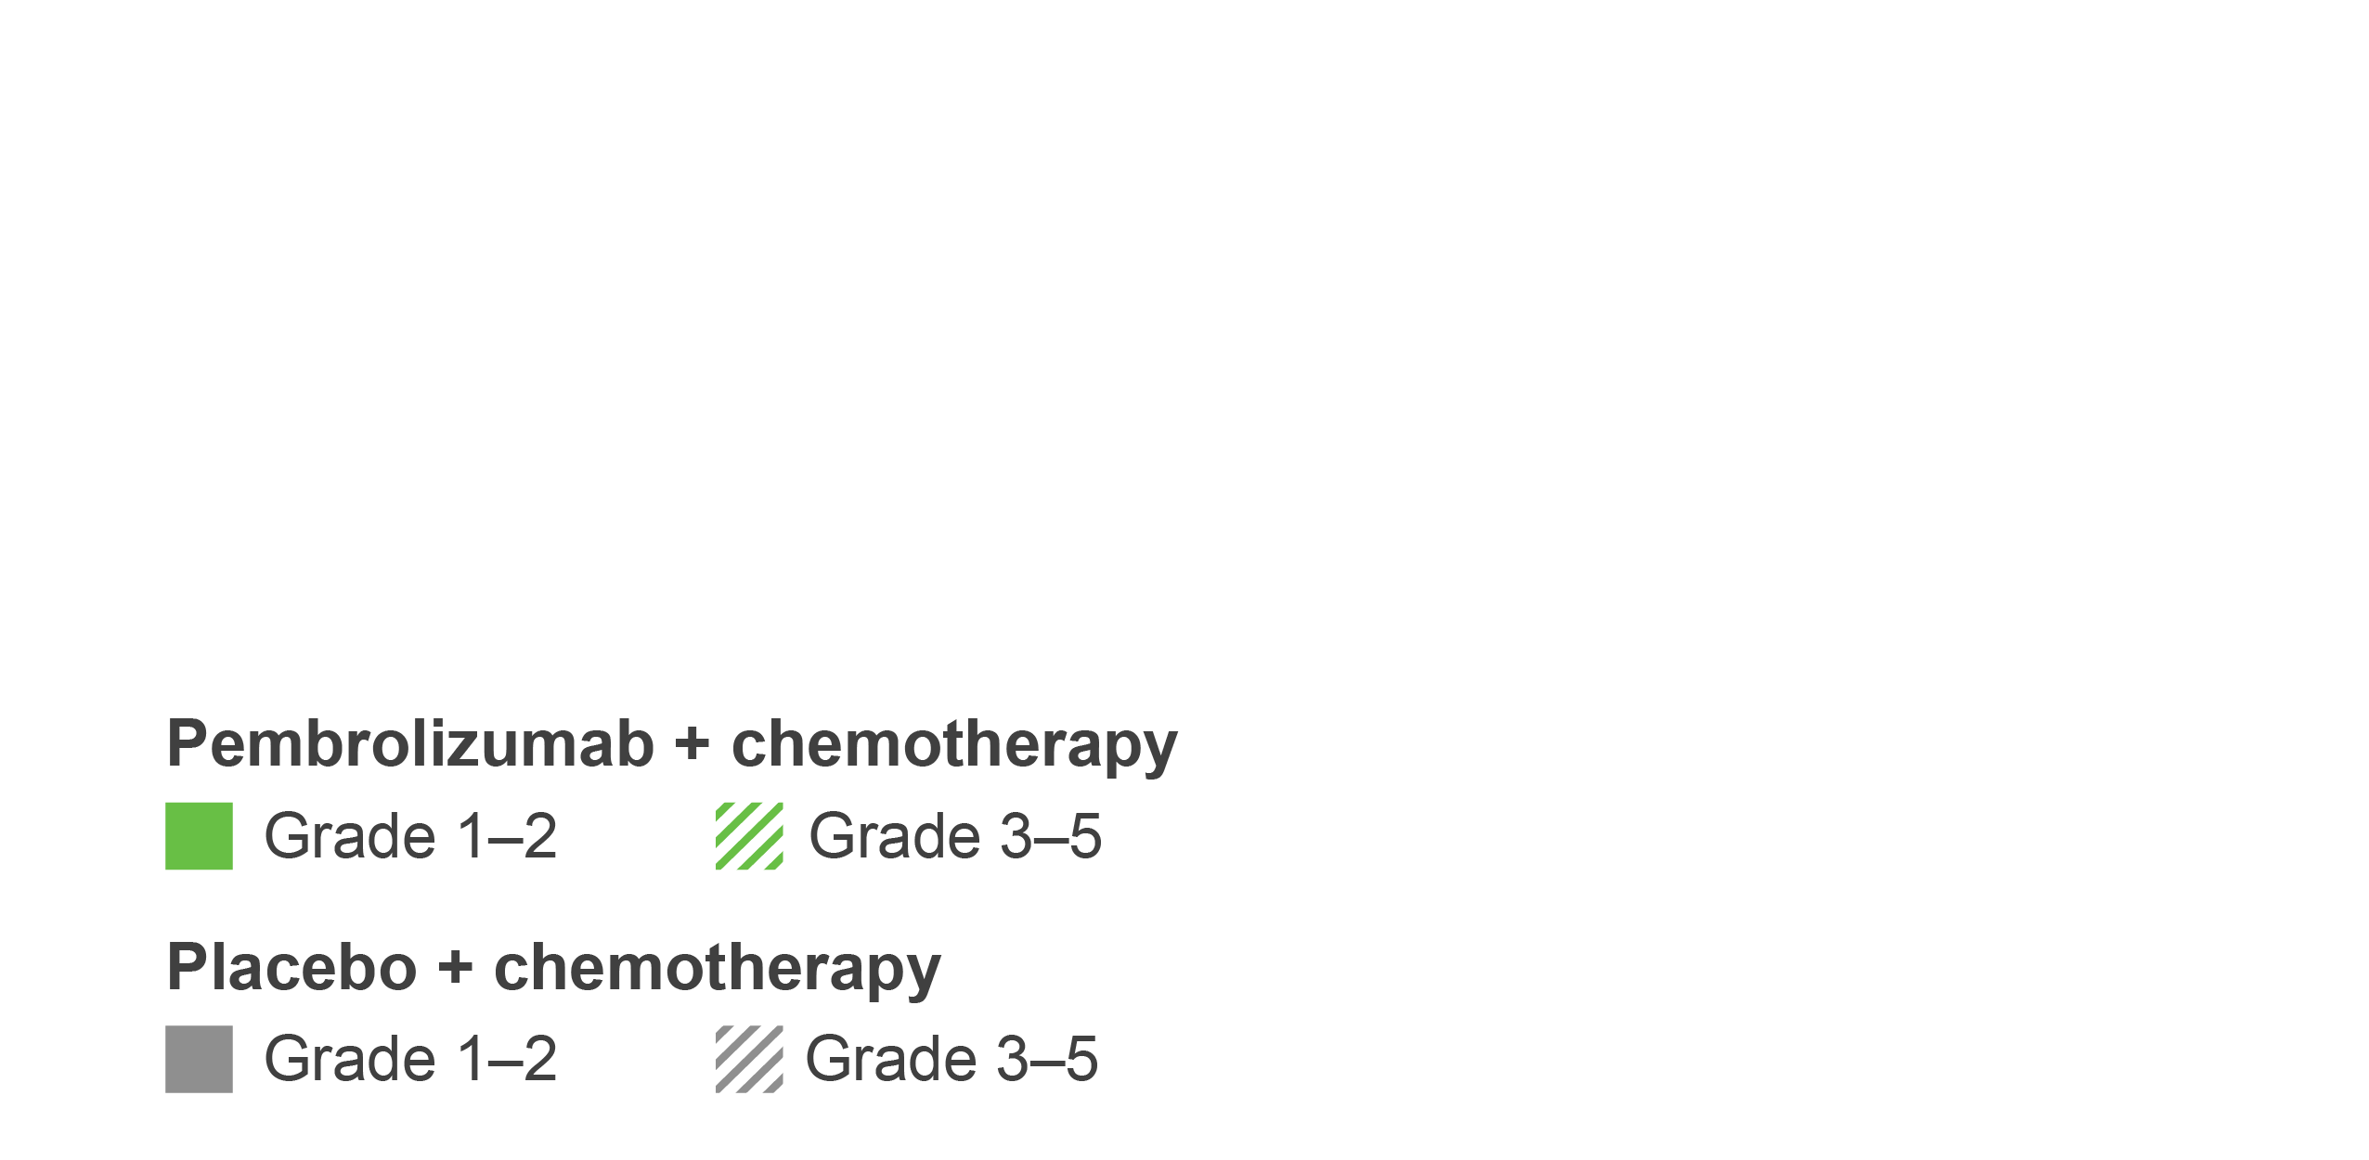
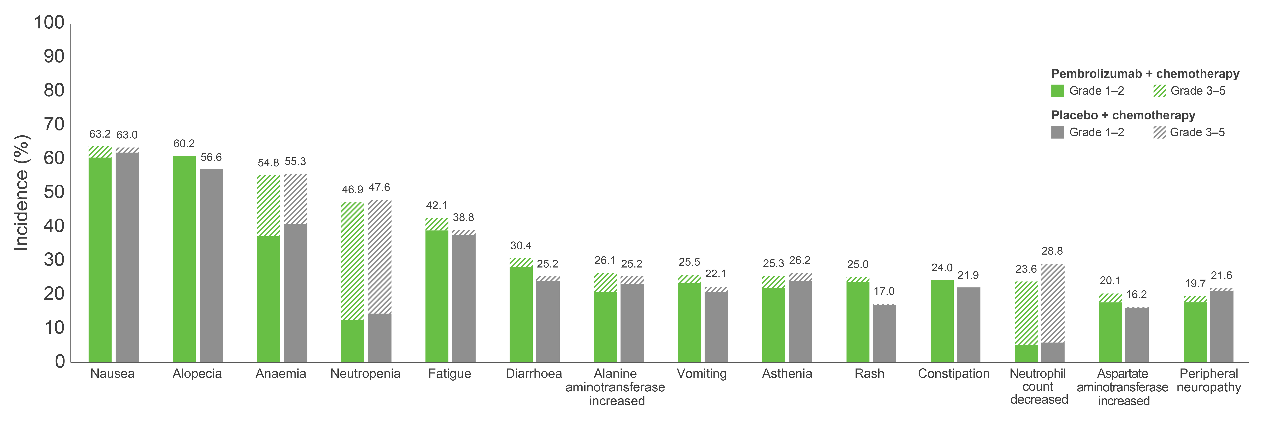
KEYNOTE-522: Summary of any-grade TRAEs occurring in ≥20%
of patients in the combined neoadjuvant and adjuvant phases at
75-month follow-up^{1,2}
All TRAEs | KEYTRUDA + chemotherapy/ KEYTRUDA (n=783) | Placebo + chemotherapy/ placebo (n=389)
Any grade, n (%) | 774 (98.9) | 388 (99.7)
Grade 3–5, n (%) | 604 (77.1) | 285 (73.3)
Death, n (%) | 4 (0.5)ª | 1 (0.3)^{b}
Serious TRAE, % | 34.1 | 20.1
Discontinuation of any drug, % | 27.6 | 14.1
The tabular data for this plot is shown in the appendix. Click here to view.
Adapted from Schmid P et al. Presented at ESMO 2024.¹
Data cut-off: 22 March 2024. AEs were assessed during each phase of the study, as well as the study as a whole. Listed are AEs that occurred during the treatment period or within 30 days after the treatment period (or, for serious AEs, within 90 days) in patients who were randomised and received at least one trial drug or surgery. The severity of the AEs was graded according to the Common Terminology Criteria for Adverse Events v4.0 of the National Cancer Institute. Patients may have had more than one event.
ªGrade 5 AEs in the KEYTRUDA + chemotherapy arm were sepsis and multiple organ dysfunction syndrome (n=1) and pneumonitis, pulmonary embolism and autoimmune encephalitis (n=1 in each group); ^{b}Grade 5 AEs in the placebo + chemotherapy arm were septic shock (n=1). AE, adverse event; TRAE, treatment-related adverse event.
1. Schmid P et al. Presented at the European Society of Medical Oncology Congress 2024, 13–17 September, Barcelona, Spain;
2. Schmid P et al. N Engl J Med 2024;391:1981–1991.
UK Prescribing Information

Slide 49
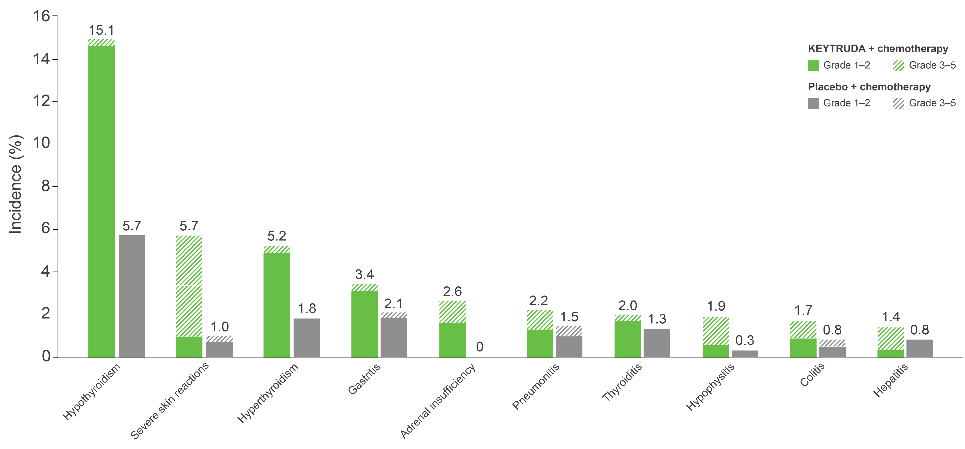
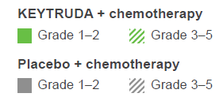
KEYNOTE-522: Summary of immune-mediated AEs occurring in
≥10 patients in the combined neoadjuvant and adjuvant phases at
75-month follow-up^{1,2}
All immune-mediated AEs | KEYTRUDA + chemotherapy/ KEYTRUDA (n=783) | Placebo + chemotherapy/ placebo (n=389)
Any grade, n (%) | 274 (35.0) | 51 (13.1)
Grade 3–5, n (%) | 102 (13.0) | 6 (1.5)
Death, n (%) | 2 (0.3)ª | 0 (0)
Discontinuation of any drug, % | 7.7 | 1.0
Adapted from Schmid P et al. Presented at ESMO 2024.¹
The tabular data for this plot is shown in the appendix. Click here to view.
Data cut-off: 22 March 2024. Data presented for AEs experienced by ≥10 patients.
ªOne patient from pneumonitis and one patient from autoimmune encephalitis. Considered regardless of attribution to treatment or immune-relatedness by the investigator. Related terms included in addition to preferred terms listed. AE, adverse event.
1. Schmid P et al. Presented at the European Society of Medical Oncology Congress 2024, 13–17 September, Barcelona, Spain;
2. Schmid P et al. N Engl J Med 2024;391:1981–1991.
UK Prescribing Information

Slide 50
KEYNOTE-522: Summary of any-grade TRAEs occurring in ≥20%
of patients in the combined neoadjuvant and adjuvant phases at
final analysis
All TRAEs | KEYTRUDA + chemotherapy/ KEYTRUDA (n=783) | Placebo + chemotherapy/ placebo (n=389)
Any grade, n (%) | 774 (98.9) | 388 (99.7)
Grade 3–5, n (%) | 604 (77.1) | 285 (73.3)
Death, n (%) | 4 (0.5)ª | 1 (0.3)^{b}
Discontinuation of any drug, % | 27.6 | 14.1
100
90
80
70
63.5
63.0
60
60.2
56.6
KEYTRUDA + chemotherapy/KEYTRUDA
Placebo + chemotherapy/placebo
54.8
55.3
Grade 1–2
Grade 3–5
Grade 1–2
Grade 3–5
Incidence (%)
47.6
50
46.9
42.3
38.8
40
30
30.4
26.1
26.2
28.8
25.2
25.2
25.5
22.1
25.3
25.0
24.0
21.9
23.5
21.6
20
17.0
20.1
19.5
16.2
10
0
Nausea
Alopecia
Anaemia
Neutropenia
Fatigue
Diarrhoea
ALT
increase
Vomiting
Asthenia
Rash
Constipation
Neutrophil
count decrease
AST increase
Peripheral neuropathy
Adapted from Schmid P et al. Presented at ASCO 2026.
Data cutoff: 14 October 2025. Listed are AEs attributed to trial treatment by investigators; patients may have had more than one event.
ªGrade 5 AEs in the KEYTRUDA + chemotherapy/KEYTRUDA arm were sepsis and multiple organ dysfunction syndrome (n=1), and pneumonitis, pulmonary embolism and autoimmune encephalitis (n=1 each); ^{b}Grade 5 AEs in the placebo + chemotherapy/placebo arm were septic shock (n=1).
AE, adverse event; ALT, alanine aminotransferase; AST, aspartate aminotransferase; TRAE, treatment-related adverse event.
Schmid P et al. Presented at the American Society of Clinical Oncology (ASCO) Annual Meeting 2026, 29 May–2 June, Chicago, USA.
UK Prescribing Information

Slide 51
KEYNOTE-522: Summary of immune-mediated AEs occurring in
≥10 patients in the combined neoadjuvant and adjuvant phases at
final analysis
16
15.1
All immune-mediated AEs | KEYTRUDA + chemotherapy/ KEYTRUDA (n=783) | Placebo + chemotherapy/ placebo (n=389)
Any grade, n (%) | 274 (35.0) | 51 (13.1)
Grade 3–5, n (%) | 102 (13.0) | 6 (1.5)
Death, n (%) | 2 (0.3)ª | 0 (0)
Discontinuation of any drug, % | 7.7 | 1.0
14
12
10
Incidence (%)
KEYTRUDA + chemotherapy/KEYTRUDA
Placebo + chemotherapy/placebo
8
Grade 1–2
Grade 3–5
Grade 1–2
Grade 3–5
6
5.7
5.7
5.2
4
3.4
2.1
2.6
2.2
2
1.8
1.5
2.0
1.9
1.7
1.4
1.0
1.3
0.8
0.8
0
0.3
0
Hypothyroidism
Severe skin reactions
Hyperthyroidism
Gastritis
Adrenal insufficiency
Pneumonitis
Thyroiditis
Hypophysitis
Colitis
Hepatitis
Adapted from Schmid P et al. Presented at ASCO 2026.
Data cutoff: 14 October 2025. AEs are considered regardless of attribution or immune relatedness by the investigator.
ªGrade 5 AEs in the KEYTRUDA + chemotherapy/KEYTRUDA arm were pneumonitis (n=1) and autoimmune encephalitis (n=1).
AE, adverse event.
Schmid P et al. Presented at the American Society of Clinical Oncology (ASCO) Annual Meeting 2026, 29 May–2 June, Chicago, USA.
UK Prescribing Information

Slide 52
Implementing KEYTRUDA + chemotherapy for early-stage TNBC
Click the links below to navigate to the section of interest
  KEYTRUDA dosing in
  KEYNOTE-522
  KEYTRUDA offers flexibility of dosing
TNBC, triple-negative breast cancer.
UK Prescribing Information

Slide 53

KEYTRUDA dosing in KEYNOTE-522
First neoadjuvant phase¹
Patients should be treated with KEYTRUDA until disease progression or unacceptable toxicity³
Atypical responses (i.e. an initial transient increase in tumour size or new small lesions within the first few months, followed by tumour shrinkage) have been observed³
It is recommended to continue treatment in clinically stable patients with initial evidence of disease progression until disease progression is confirmed³
No dose reductions of KEYTRUDA are recommended. KEYTRUDA should be withheld or discontinued to manage AEs as described within the SmPC³
When administering KEYTRUDA in combination with IV chemotherapy, KEYTRUDA should be administered first³
Consult the full KEYTRUDA SmPC for guidance on dosing
200 mg KEYTRUDA
+ paclitaxelª and carboplatin^{b}
Q3W
up to 12 weeks
Second neoadjuvant phase¹
200 mg KEYTRUDA + doxorubicin^{c} or epirubicin^{d} and cyclophosphamide^{e}
Q3W
up to 12 weeks
Adjuvant cycle²
200 mg KEYTRUDA monotherapy
(radiation therapy concurrently or
2 weeks prior to adjuvant KEYTRUDA)
Q3W
up to 27 weeks
ª80 mg/m² QW; ^{b}AUC of 5 mg/mm/min Q3W or 1.5 mg/mm/min QW; ^{c}60 mg/m² Q3W; ^{d}90 mg/m² Q3W; ^{e}600 mg/m² Q3W.
AE, adverse event; AUC, area under the curve; IV, intravenous; Q3W, every 3 weeks; QW, once a week; SmPC, Summary of Product Characteristics.
1. Schmid P et al. N Engl J Med 2020;382:810–821; 2. Schmid P et al. N Engl J Med 2022;386:556–567;
3. KEYTRUDA (pembrolizumab) Summary of Product Characteristics. Available at: https://www.medicines.org.uk/emc/product/2498/smpc. Accessed August 2025.
UK Prescribing Information

Slide 54
KEYTRUDA offers flexibility of dosing
Patients should be treated with KEYTRUDA until disease progression or unacceptable toxicity.
Atypical responses (i.e. an initial transient increase in tumour size or new small lesions within the first few months, followed by tumour shrinkage) have been observed.
It is recommended to continue treatment in clinically stable patients with suspected disease progression until disease progression is confirmed.
No dose reductions of KEYTRUDA are recommended. KEYTRUDA should be withheld or discontinued to manage AEs as described within the SmPC.
When administering KEYTRUDA in combination with IV chemotherapy, KEYTRUDA should be administered first.
Consult the full KEYTRUDA SmPC for guidance on dosing.
KEYTRUDA dosing:
Administered
as an IV infusion
Over 30 minutes
200 mg Q3W or 400 mg Q6W
The KEYTRUDA 200 mg Q3W regimen has been assessed in Phase 2 and Phase 3 registration studies across a multitude of indications.
An exposure–response evaluation (using modelling and simulation) led to the approval of the 400 mg Q6W dosing for monotherapy and combination therapy.
AE, adverse event; IV, intravenous; Q3W, every 3 weeks; Q6W, every 6 weeks; SmPC, Summary of Product Characteristics.
KEYTRUDA (pembrolizumab) Summary of Product Characteristics. Available at: https://www.medicines.org.uk/emc/product/2498/smpc. Accessed August 2025.
UK Prescribing Information

Slide 55
KEYNOTE-522: Summary
Click the links below to navigate to the section of interest
  Summary: Efficacy
  Summary: Safety
UK Prescribing Information

Slide 56
Summary: Efficacy (1)
KEYTRUDA, in combination with chemotherapy as neoadjuvant treatment, and then continued as
monotherapy as adjuvant treatment after surgery, is indicated in the treatment of adults with locally
advanced or early-stage TNBC at high risk of recurrence¹
There was a statistically significant improvement in pCR rates with KEYTRUDA + chemotherapy (neoadjuvant treatment) vs placebo + chemotherapy (neoadjuvant treatment) in the primary analysis (64.8% vs 51.2%, respectively; p<0.001) and in the prespecified final analysis of KEYNOTE-522 (64.0% vs 54.7%, respectively; p=0.00221)¹
KEYTRUDA + chemotherapy in the neoadjuvant setting, followed by KEYTRUDA monotherapy as adjuvant treatment, resulted in a statistically significant improvement in EFS compared with placebo + chemotherapy followed by placebo at the 36-month analysis (HR, 0.63; 95% CI, 0.48–0.82 [p<0.001])^{a,b,2} and numerically higher EFS at the 75-month (HR, 0.65; 95% CI: 0.51–0.83)^{a,3} and 84-month follow ups (HR, 0.68; 95% CI, 0.54–0.86)^{a,4}
  At 36-, 75- and 84-month follow ups, the percentages of patients who experienced an event were 15.7%, 20.3% and 21.9% in the KEYTRUDA + chemotherapy group, and 23.8%, 29.2% and 30.3% in the placebo + chemotherapy group, respectively^{2–4}
  An exploratory analysis of EFS in key subgroups, including disease stage, nodal status and T2N0 status, suggested a benefit for patients treated with KEYTRUDA + chemotherapy vs placebo + chemotherapy^{2,4,5}
ªHR (CI) analysed based on a Cox regression model with treatment as a covariate stratified by the randomisation stratification factors;^{2–4} ^{b}Prespecified p-value boundary of 0.00517 was crossed.
CI, confidence interval; EFS, event-free survival; HR, hazard ratio; pCR, pathologic complete response; TNBC, triple-negative breast cancer.
1. KEYTRUDA (pembrolizumab) Summary of Product Characteristics. Available at: https://www.medicines.org.uk/emc/product/2498/smpc. Accessed August 2025;
2. Schmid P et al. N Engl J Med 2022;386:556–567; 3. Schmid P et al. Presented at the European Society of Medical Oncology (ESMO) Congress 2024, 13–17 September, Barcelona, Spain;
4. Schmid P et al. Presented at the American Society of Clinical Oncology (ASCO) Annual Meeting 2026, 29 May–2 June, Chicago, USA;
5. Schmid P et al. Presented at the San Antonio Breast Cancer Symposium (SABCS) Congress 2023, 5–9 December, San Antonio, USA.
UK Prescribing Information

Slide 57
Summary: Efficacy (2)
KEYTRUDA, in combination with chemotherapy as neoadjuvant treatment, and then continued as
monotherapy as adjuvant treatment after surgery, is indicated in the treatment of adults with locally
advanced or early-stage TNBC at high risk of recurrence¹
An exploratory analysis of EFS by pCR (ypT0/Tis ypN0) suggested a benefit for KEYTRUDA + chemotherapy vs placebo + chemotherapy regardless of pCR outcome at 36 months of follow up, with the difference maintained at the 84-month
final analysis^{2,3}
KEYTRUDA + chemotherapy in the neoadjuvant setting, followed by KEYTRUDA monotherapy as adjuvant treatment, resulted in a statistically significant and clinically meaningful improvement in OS (key secondary endpoint) at 75-month follow up
(HR, 0.66; 95% CI, 0.50–0.87 [p=0.00150])ª compared with neoadjuvant placebo + chemotherapy followed by placebo in patients with previously untreated, high-risk, early-stage TNBC³
  This trend in OS improvement was maintained at the 84-month final analysis (HR, 0.64; 95% CI, 0.49–0.85)^{b,2}
  OS was numerically higher for patients treated with KEYTRUDA + chemotherapy vs placebo + chemotherapy in an exploratory analysis of key subgroups, including nodal status, tumour size T1/T2 vs T3/T4 and patients with baseline
  T2N0 disease^{2–4}
ªWith 200 events (67.3% information fraction), the observed p-value crossed the prespecified nominal boundary of 0.00503 (one-sided) at this interim analysis;
^{b}HR (CI) analysed based on a Cox regression model with treatment as a covariate stratified by the randomisation stratification factors.
CI, confidence interval; EFS, event-free survival; HR, hazard ratio; OS, overall survival; pCR, pathologic complete response; TNBC, triple-negative breast cancer.
1. KEYTRUDA (pembrolizumab) Summary of Product Characteristics. Available at: https://www.medicines.org.uk/emc/product/2498/smpc. Accessed August 2025;
2. Schmid P et al. Presented at the American Society of Clinical Oncology (ASCO) Annual Meeting 2026, 29 May–2 June, Chicago, IL; 3. Schmid P et al. Presented at the European Society for Medical Oncology (ESMO) Congress 2024, 13–17 September, Barcelona, Spain; 4. Dent R et al. Presented at the San Antonio Breast Cancer Symposium 2024, 10–13 December,
San Antonio, USA.
UK Prescribing Information

Slide 58
Summary: Safety
KEYTRUDA, in combination with chemotherapy as neoadjuvant treatment, and then continued as
monotherapy as adjuvant treatment after surgery, is indicated in the treatment of adults with locally
advanced or early-stage TNBC at high risk of recurrence¹
The safety data for KEYTRUDA + chemotherapy as neoadjuvant treatment, followed by KEYTRUDA monotherapy as adjuvant treatment, are consistent with the known AE profiles of each regimen, being generally manageable in both phases^{2–6}
No indication-specific immune-mediated AEs were identified at the 36-month analysis⁴
  At 36 months, most immune-mediated AEs and infusion reactions were Grade 1–2 in severity, manageable with corticosteroids, treatment interruption and/or hormone replacement, and did not result in treatment discontinuation⁴
At the 84-month final analysis, immune-mediated AEs of any grade were reported in 35.0% vs 13.1% of patients treated with KEYTRUDA + chemotherapy vs placebo + chemotherapy, respectively⁵
  Most immune-mediated AEs were Grade 1–2 in severity⁵
  Immune-mediated AEs resulted in discontinuation in 7.7% of patients treated with KEYTRUDA + chemotherapy
  compared with 1.0% of patients treated with placebo + chemotherapy⁵
The safety profile remained consistent with the previous analyses and the established safety profiles of KEYTRUDA + chemotherapy.⁵ No new safety concerns were identified at the 75-month follow up or at the 84-month final analysis^{5,6}
AE, adverse event; TNBC, triple-negative breast cancer.
1. KEYTRUDA (pembrolizumab) Summary of Product Characteristics. Available at: https://www.medicines.org.uk/emc/product/2498/smpc. Accessed August 2025; 2. Schmid P et al. N Engl J Med 2022;386:556–567; 3. Schmid P et al. N Engl J Med 2020;382:810–821; 4. Cortés J et al. Presented at the San Antonio Breast Cancer Symposium (SABCS) Congress 2023, 5–9 December, San Antonio, USA; 5. Schmid P et al. Presented at the American Society of Clinical Oncology (ASCO) Annual Meeting 2026, 29 May–2 June, Chicago, USA; 6. Schmid P et al. Presented at the European Society of Medical Oncology Congress 2024, 13–17 September, Barcelona, Spain.
UK Prescribing Information

Slide 59
Appendix
Click the links below to navigate to the section of interest
Efficacy
Safety
  EFS by RCB category
  Summary of
  any-grade AEs in the neoadjuvant phase (primary analysis)
  Immune-mediated AEs and infusion reactions in the adjuvant phase (36 months)
  First EFS events by RCB category
  AEs of interest in
  the neoadjuvant
  phase (1/2)
  (primary analysis)
  Any-grade AEs in the combined phase
  (75-month follow-up)
  pCR by PD-L1 expression level
  AEs of interest in
  the neoadjuvant
  phase (2/2)
  (primary analysis)
  Immune-mediated AEs in the combined phase (75-month follow-up)
  TRAEs in the
  adjuvant phase
  (36 months)
AE, adverse event; EFS, event-free survival; pCR, pathologic complete response; PD-L1, programmed death ligand-1; RCB, residual cancer burden; TRAE, treatment-related adverse event.
UK Prescribing Information

Slide 60
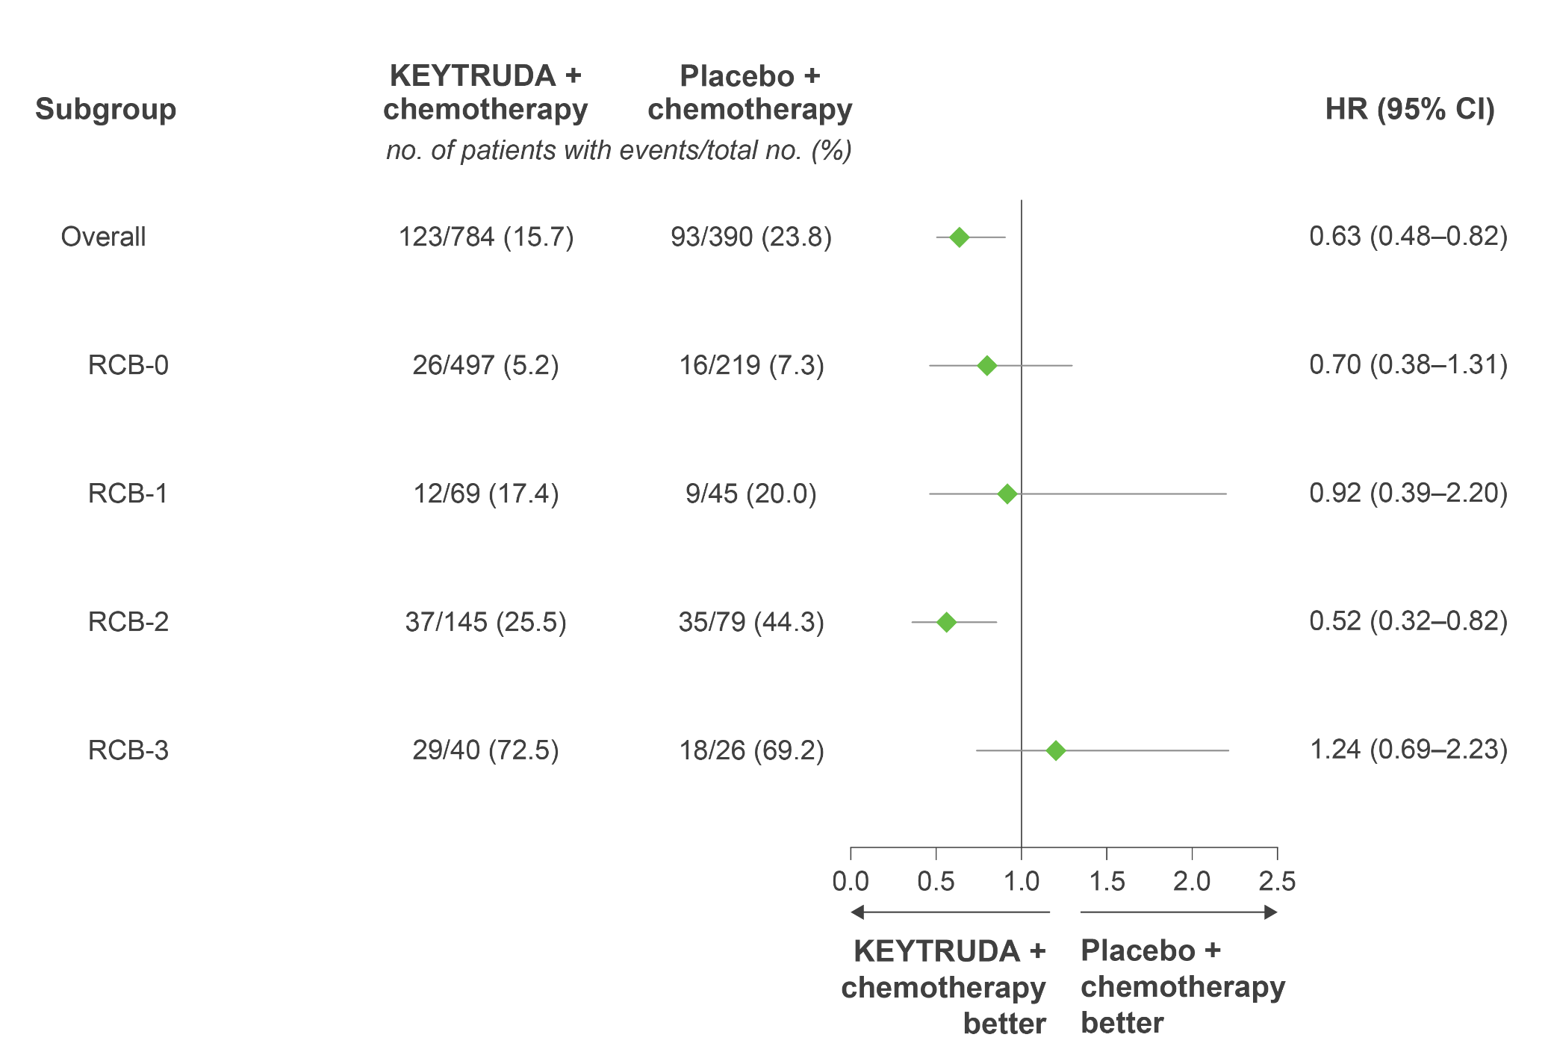
KEYNOTE-522: Exploratory analysis – EFS by RCB category
Adapted from Pusztai L et al. Presented at ASCO 2022.
This was an exploratory analysis; significance was not tested and no statistical conclusions can be drawn
Data cutoff: 23 March 2021.
EFS in the overall population is based on a stratified Cox model; EFS by RCB is based on an unstratified Cox model.
CI, confidence interval; EFS, event-free survival; HR, hazard ratio; RCB, residual cancer burden.
Pusztai L et al. Presented at the American Society of Clinical Oncology (ASCO) Annual Meeting 2022, 3–7 June, Chicago, USA.
UK Prescribing Information

Slide 61
KEYNOTE-522: Exploratory analysis – First EFS events by
RCB category
Event, % | RCB-0 |  | RCB-1 |  | RCB-2 |  | RCB-3
 | KEYTRUDA + chemo (n=497) | Placebo + chemo (n=219) | KEYTRUDA + chemo (n=69) | Placebo + chemo (n=45) | KEYTRUDA + chemo (n=145) | Placebo + chemo (n=79) | KEYTRUDA + chemo (n=40) | Placebo + chemo (n=26)
Any EFS event | 5.2 | 7.3 | 17.4 | 20.0 | 25.5 | 44.3 | 72.5 | 69.2
Secondary primary malignancy | 0.2 | 0 | 1.4 | 2.2 | 1.4 | 3.8 | 2.5 | 0
PD precluded definitive surgery | 0 | 0 | 1.4 | 2.2 | 1.4 | 5.1 | 10.0 | 7.7
Local recurrence | 0.6 | 1.4 | 4.3 | 6.7 | 6.9 | 8.9 | 25.0 | 7.7
Distant recurrence | 3.2 | 5.5 | 8.7 | 8.9 | 15.2 | 22.8 | 35.0 | 53.8
Death | 1.2 | 0.5 | 1.4 | 0 | 0.7 | 3.8 | 0 | 0
Adapted from Pusztai L et al. Presented at ASCO 2022.
Data cutoff: 23 March 2021.
The treatment regimen in each arm included chemotherapy. Among all patients (N=1174), 54 (4.6%) patients had missing RCB categorical data: 33 (4.2%) in the KEYTRUDA + chemotherapy group and
21 (5.4%) in the placebo + chemotherapy group.
EFS, event-free survival; PD, progressive disease; RCB, residual cancer burden.
Pusztai L et al. Presented at the American Society of Clinical Oncology (ASCO) Annual Meeting 2022, 3–7 June, Chicago, USA.
UK Prescribing Information

Slide 62
KEYNOTE-522: Exploratory analysis – pCR by PD-L1 expression level
Similar pCRª benefits were observed in PD-L1–positive and PD-L1–negative patients treated with KEYTRUDA + chemotherapy
Δ18.5%
(5.0–32.7)
Δ17.5%
(6.2–29.1)
Δ14.2%
(5.3–23.1)
Δ18.3%
(−3.3–36.8)
29/64
10/33
230/334
90/164
162/208
55/92
103/126
40/64
Adapted from Schmid P et al. Presented at SABCS 2019.
Data cutoff: 24 September 2018.
ªEstimated treatment difference based on Miettinen and Nurminen method stratified by nodal status (+ vs −), tumour size (T1/T2 vs T3/T4) and frequency of carboplatin administration (Q3W vs QW).
CI, confidence interval; CPS, combined positive score; pCR, pathologic complete response; PD-L1, programmed death ligand-1; Q3W, every 3 weeks; QW, once a week.
Schmid P et al. Presented at the San Antonio Breast Cancer Symposium 2019, 11–14 December, San Antonio, USA.
This was an exploratory analysis; significance was not tested and no statistical conclusions can be drawn
UK Prescribing Information

Slide 63
KEYNOTE-522: Summary of any-grade AEs occurring in ≥20% of patients in the neoadjuvant phase at primary analysis
AE, n (%) | KEYTRUDA + chemotherapy (n=781) |  | Placebo + chemotherapy (n=389)
 | Any grade | Grade ≥3 | Any grade | Grade ≥3
Any AE | 777 (99.2) | 633 (81.0) | 389 (100.0) | 295 (75.8)
Treatment-related AEª | 773 (99.0) | 600 (76.8) | 388 (99.7) | 281 (72.2)
Nausea | 490 (62.7) | 26 (3.3) | 246 (63.2) | 5 (1.3)
Alopecia | 471 (60.3) | 14 (1.8) | 220 (56.6) | 8 (2.1)
Anaemia | 430 (55.1) | 142 (18.2) | 215 (55.3) | 58 (14.9)
Neutropenia | 365 (46.7) | 270 (34.6) | 183 (47.0) | 129 (33.2)
Fatigue | 321 (41.1) | 27 (3.5) | 147 (37.8) | 6 (1.5)
Diarrhoea | 230 (29.4) | 17 (2.2) | 92 (23.7) | 5 (1.3)
Alanine aminotransferase increased | 199 (25.5) | 41 (5.2) | 96 (24.7) | 9 (2.3)
Vomiting | 199 (25.5) | 18 (2.3) | 85 (21.9) | 6 (1.5)
Asthenia | 191 (24.5) | 25 (3.2) | 99 (25.4) | 9 (2.3)
Constipation | 185 (23.7) | 0 | 82 (21.1) | 0
Decreased neutrophil count | 185 (23.7) | 146 (18.7) | 112 (28.8) | 90 (23.1)
Rash | 170 (21.8) | 7 (0.9) | 59 (15.2) | 1 (0.3)
Peripheral neuropathy | 154 (19.7) | 15 (1.9) | 82 (21.1) | 4 (1.0)
Adapted from Schmid P et al. 2020.
Listed are AEs that occurred during the treatment period or within 30 days after the treatment period (or, for serious AEs, within 90 days) in patients who were randomised and received at least one trial drug or surgery. The severity of the AEs was graded according to the Common Terminology Criteria for Adverse Events, v4.0, of the National Cancer Institute. Patients may have had more than one event.
AE, adverse event.
Schmid P et al. N Engl J Med 2020;382:810–821.
UK Prescribing Information

Slide 64
KEYNOTE-522: AEs of interest in the neoadjuvant phase at
primary analysis (1/2)
AE, n (%) | KEYTRUDA + chemotherapy (n=781) |  | Placebo + chemotherapy (n=389)
 | Any grade | Grade ≥3 | Any grade | Grade ≥3
Any AE | 777 (99.5) | 633 (81.0) | 389 (100.0) | 295 (75.8)
Treatment-related AEª | 773 (99.0) | 600 (76.8) | 388 (99.7) | 281 (72.2)
AE of interest^{b} | 304 (38.9) | 101 (12.9) | 71 (18.3) | 7 (1.8)
Infusion reaction | 132 (16.9) | 20 (2.6) | 43 (11.1) | 4 (1.0)
Hypothyroidism | 107 (13.7) | 3 (0.4) | 13 (3.3) | 0
Hyperthyroidism | 36 (4.6) | 2 (0.3) | 4 (1.0) | 0
Severe skin reaction | 34 (4.4) | 30 (3.8) | 4 (1.0) | 1 (0.3)
Adrenal insufficiency | 18 (2.3) | 10 (1.3) | 0 | 0
Hypophysitis | 14 (1.8) | 8 (1.0) | 1 (0.3) | 0
Colitis | 13 (1.7) | 7 (0.9) | 3 (0.8) | 1 (0.3)
Thyroiditis | 13 (1.7) | 2 (0.3) | 3 (0.8) | 0
Hepatitis | 11 (1.4) | 9 (1.2) | 2 (0.5) | 0
Adapted from Schmid P et al. 2020.
Listed are AEs that occurred during the treatment period or within 30 days after the treatment period (or, for serious AEs, within 90 days) in patients who underwent randomisation and received at least one trial drug or surgery. The severity of the AEs was graded according to the Common Terminology Criteria for Adverse Events, v4.0, of the National Cancer Institute. Patients may have had more than one event.
ªTreatment-related AEs were events occurring in ≥20% of patients or considered medically relevant by the investigator; ^{b}AEs of interest were determined according to a list of terms specified by the sponsor, regardless of attribution to any trial treatment by the investigators.
AE, adverse event.
Schmid P et al. N Engl J Med 2020;382:810–821.
UK Prescribing Information

Slide 65
KEYNOTE-522: AEs of interest in the neoadjuvant phase at
primary analysis (2/2)
AE, n (%) | KEYTRUDA + chemotherapy (n=781) |  | Placebo + chemotherapy (n=389)
 | Any grade | Grade ≥3 | Any grade | Grade ≥3
Any AE | 777 (99.5) | 633 (81.0) | 389 (100.0) | 295 (75.8)
Treatment-related AEª | 773 (99.0) | 600 (76.8) | 388 (99.7) | 281 (72.2)
AE of interest^{b} | 304 (38.9) | 101 (12.9) | 71 (18.3) | 7 (1.8)
Pneumonitis | 10 (1.3) | 3 (0.4) | 5 (1.3) | 1 (0.3)
Nephritis | 7 (0.9) | 7 (0.9) | 0 | 0
Pancreatitis | 4 (0.5) | 4 (0.5) | 0 | 0
Myocarditis | 3 (0.4) | 2 (0.3) | 0 | 0
Myositis | 3 (0.4) | 0 | 0 | 0
Type 1 diabetes mellitus | 2 (0.3) | 2 (0.3) | 0 | 0
Uveitis | 2 (0.3) | 0 | 0 | 0
Encephalitis | 1 (0.1) | 1 (0.1) | 0 | 0
Sarcoidosis | 1 (0.1) | 0 | 0 | 0
Adapted from Schmid P et al. 2020.
Listed are AEs that occurred during the treatment period or within 30 days after the treatment period (or, for serious AEs, within 90 days) in patients who were randomised and received at least one trial drug or surgery. The severity of the AEs was graded according to the Common Terminology Criteria for Adverse Events, v4.0, of the National Cancer Institute. Patients may have had more than one event.
ªTreatment-related AEs were events occurring in ≥20% of patients or considered medically relevant by the investigator; ^{b}AEs of interest were determined according to a list of terms specified by the sponsor, regardless of attribution to any trial treatment by the investigators.
AE, adverse event.
Schmid P et al. N Engl J Med 2020;382:810–821.
UK Prescribing Information

Slide 66
KEYNOTE-522: TRAEs occurring in ≥2% of patients in the
adjuvant phase at 36 months
AE, n (%)ª | KEYTRUDA + chemotherapy (n=588) | Placebo + chemotherapy (n=331)
Any grade | 316 | 286
Arthralgia | 50 (8.5) | 41 (6.9)
Rash | 35 (6.0) | 14 (2.4)
Pruritus | 30 (5.1) | 12 (2.1)
Asthenia | 27 (4.6) | 30 (5.1)
Diarrhoea | 24 (4.1) | 19 (3.3)
Fatigue | 20 (3.4) | 28 (4.8)
Aspartate aminotransferase increased | 17 (2.9) | 7 (1.2)
Hypothyroidism | 16 (2.7) | 19 (3.3)
Neutropenia | 16 (2.7) | 23 (3.9)
Alanine aminotransferase increased | 13 (2.2) | 11 (1.8)
Myalgia | 13 (2.2) | 7 (1.2)
Nausea | 13 (2.2) | 14 (2.4)
Dry mouth | 12 (2.0) | 5 (0.9)
Anaemia | 9 (1.5) | 16 (2.7)
Lymphopenia | 9 (1.5) | 14 (2.4)
Headache | 5 (0.9) | 14 (2.4)
Adapted from Schmid P et al. Presented at ESMO 2021.
Listed are AEs that occurred during the treatment period or within 30 days after the treatment period (or, for serious AEs, within 90 days) in patients who were randomised and received at least one trial drug or surgery. The severity of the AEs was graded according to the Common Terminology Criteria for Adverse Events, v4.0, of the National Cancer Institute. Patients may have had more than one event.
ªn numbers for each AE have been calculated from provided percentages.
AE, adverse event; TRAE, treatment-related adverse event.
Schmid P et al. Presented at the European Society for Medical Oncology (ESMO) Virtual Plenary 2021, 16–21 September.
UK Prescribing Information

Slide 67
KEYNOTE-522: Immune-mediated AEs and infusion reactions in the adjuvant phase at 36 monthsª
AE, n (%)^{b} | KEYTRUDA + chemotherapy (n=588) | Placebo + chemotherapy (n=331)
Any grade | 60 (10.2) | 35 (6.0)
Hypothyroidism | 17 (2.9) | 21 (3.6)
Infusion reactions | 11 (1.9) | 7 (1.2)
Severe skin reactions | 11 (1.9) | 0
Pneumonitis | 7 (1.2) | 4 (0.6)
Hyperthyroidism | 5 (0.9) | 4 (0.6)
Adrenal insufficiency | 3 (0.5) | 0
Colitis | 2 (0.3) | 0
Myocarditis | 2 (0.3) | 0
Adapted from Schmid P et al. Presented at ESMO 2021.
Listed are AEs that occurred during the treatment period or within 30 days after the treatment period (or, for serious AEs, within 90 days) in patients who were randomised and received at least one trial drug or surgery. The severity of the AEs was graded according to the Common Terminology Criteria for Adverse Events, v4.0, of the National Cancer Institute. Patients may have had more than one event.
ªImmune-mediated AEs were considered regardless of attribution to treatment or immune-relatedness by the investigator; ^{b}n numbers for each AE have been calculated from provided percentages.
AE, adverse event.
Schmid P et al. Presented at the European Society for Medical Oncology (ESMO) Virtual Plenary 2021, 16–21 September.
UK Prescribing Information

Slide 68
KEYNOTE-522: Any-grade AEs in the combined neoadjuvant and adjuvant phases occurring in ≥20% of patients at 75-month follow-up
AE, n (%) | KEYTRUDA + chemotherapy (n=783) |  | Placebo + chemotherapy (n=389)
 | Any grade | Grade ≥3 | Any grade | Grade ≥3
Any AE | 777 (99.2) | 645 (82.4) | 389 (100.0) | 306 (78.7)
TRAEª | 774 (98.9) | 604 (77.1) | 388 (99.7) | 285 (73.3)
Nausea | 495 (63.2) | 27 (3.4) | 245 (63.0) | 6 (1.5)
Alopecia | 471 (60.2) | 0 | 220 (56.6) | 0
Anaemia | 429 (54.8) | 141 (18.0) | 215 (55.3) | 58 (14.9)
Neutropenia | 367 (46.9) | 270 (34.5) | 185 (47.6) | 130 (33.4)
Fatigue | 330 (42.1) | 28 (3.6) | 151 (38.8) | 7 (1.8)
Diarrhoea | 238 (30.4) | 20 (2.6) | 98 (25.2) | 5 (1.3)
Alanine aminotransferase increased | 204 (26.1) | 43 (5.5) | 98 (25.2) | 9 (2.3)
Vomiting | 200 (25.5) | 19 (2.4) | 86 (22.1) | 6 (1.5)
Asthenia | 198 (25.3) | 28 (3.6) | 102 (26.2) | 9 (2.3)
Rash | 196 (25.0) | 12 (1.5) | 66 (17.0) | 1 (0.3)
Constipation | 188 (24.0) | 0 | 85 (21.9) | 0
Neutrophil count decreased | 185 (23.6) | 146 (18.6) | 112 (28.8) | 90 (23.1)
Aspartate aminotransferase increased | 157 (20.1) | 20 (2.6) | 63 (16.2) | 1 (0.3)
Peripheral neuropathy | 154 (19.7) | 15 (1.9) | 84 (21.6) | 4 (1.0)
Adapted from Schmid P et al. Presented at ESMO 2024.
Listed are AEs that occurred during the treatment period or within 30 days after the treatment period (or, for serious AEs, within 90 days) in patients who were randomised and
received at least one trial drug, underwent surgery, or both. The severity of the AEs was graded according to the Common Terminology Criteria for Adverse Events, v4.0, of the National Cancer Institute.
Patients may have had more than one event.
ªGrade 5 TRAEs were sepsis and multiple organ dysfunction syndrome (n=1) and pneumonitis, pulmonary embolism and autoimmune encephalitis (n=1 in each group) in the KEYTRUDA + chemotherapy arm and septic shock (n=1) in the placebo + chemotherapy arm.
AE, adverse event; TRAE, treatment-related adverse event.
Schmid P et al. N Engl J Med 2024;391:1981–1991.
UK Prescribing Information

Slide 69
KEYNOTE-522: Immune-mediated AEs occurring in patients in the combined neoadjuvant and adjuvant phases at 75-month follow-up
AE, n (%) | KEYTRUDA + chemotherapy (n=783) |  | Placebo + chemotherapy (n=389)
 | Any grade | Grade ≥3 | Any grade | Grade ≥3
Any AE | 777 (99.2) | 645 (82.4) | 389 (100.0) | 306 (78.7)
TRAEª | 774 (98.9) | 604 (77.1) | 388 (99.7) | 285 (73.3)
Immune-mediated AE^{b} | 274 (35.0) | 102 (13.0) | 51 (13.1) | 6 (1.5)
Hypothyroidism | 118 (15.1) | 4 (0.5) | 22 (5.7) | 0
Severe skin reaction | 45 (5.7) | 37 (4.7) | 4 (1.0) | 1 (0.3)
Hyperthyroidism | 41 (5.2) | 2 (0.3) | 7 (1.8) | 0
Gastritis | 27 (3.4) | 2 (0.3) | 8 (2.1) | 1 (0.3)
Adrenal insufficiency | 20 (2.6) | 8 (1.0) | 0 | 0
Pneumonitis | 17 (2.2) | 7 (0.9) | 6 (1.5) | 2 (0.5)
Thyroiditis | 16 (2.0) | 2 (0.3) | 5 (1.3) | 0
Hypophysitis | 15 (1.9) | 10 (1.3) | 1 (0.3) | 0
Adapted from Schmid P et al. 2024.
Listed are AEs that occurred during, or 30 days after the treatment period (or, for serious AEs, within 90 days) in patients who were randomised and received ≥1 trial drug, underwent surgery, or both.
The severity of the AEs was graded according to the Common Terminology Criteria for Adverse Events, v4.0, of the National Cancer Institute. Immune-mediated adverse events that occurred in ≥15
patients in either treatment group are reported. Patients may have had more than one event.
ªGrade 5 TRAEs were sepsis and multiple organ dysfunction syndrome (n=1) and pneumonitis, pulmonary embolism and autoimmune encephalitis (n=1 in each group) in the KEYTRUDA + chemotherapy arm and septic shock (n=1) in the placebo + chemotherapy arm; ^{b}Immune-mediated AEs were determined according to a list of terms determined by the sponsor, regardless of attribution to any trial treatment by the investigators. Grade 5 immune-mediated AEs were pulmonary embolism and autoimmune encephalitis (n=1 each) in the KEYTRUDA + chemotherapy group.
AE, adverse event.
Schmid P et al. N Engl J Med 2024;391:1981–1991.
UK Prescribing Information

